Slide 1
Gender equalıty and SustaInable Development
Aylın Talas & DENIZ OZDEMIR

Slide 2
oVERVIEW
Riddle: What’s up Doc?
Game Time
Basic concepts about gender
Game Time: Agree / Disagree
What is sustainable development (SD)?
Why do we need women for SD?

Slide 3
Rıddle
?
?
?
A father and son get in a car crash and are rushed to the hospital. The father dies. The boy is taken to the operating room and the surgeon says, “I can’t operate on this boy, because he’s my son.”.
Who is the surgeon ?
How is this possible ?

Slide 4
Answer
The doctor is the MOTHER of the boy.
She is a WOMAN.
What is the reason behind that you are confused or not able to reply it correctly?

Slide 5
Game tıme! Gırly or boyısh?
We will present you some words, and we ask you to decide that the word seems as a girly or boyish thing for you.

Slide 6
1. Dancing (To Dance)

Slide 7
2. Teaching (To Teach)

Slide 8
3. Cooking (To cook )

Slide 9
4. Repearing (To repair )

Slide 10
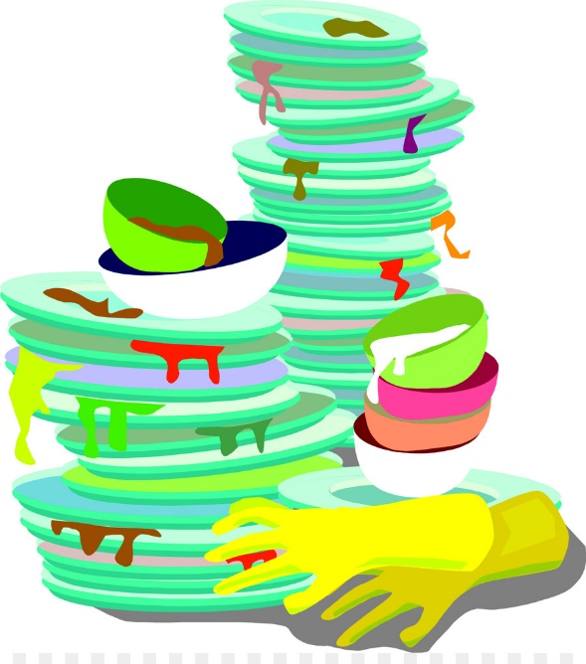
5. Washing (To wash)

Slide 11
6. Sports (Doing sports)

Slide 12
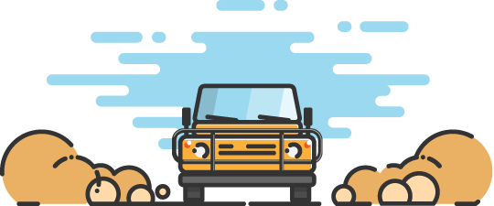
7. Driving

Slide 13
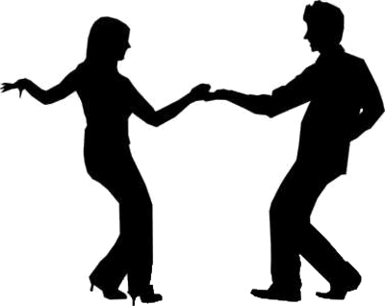
8. Dancer

Slide 14
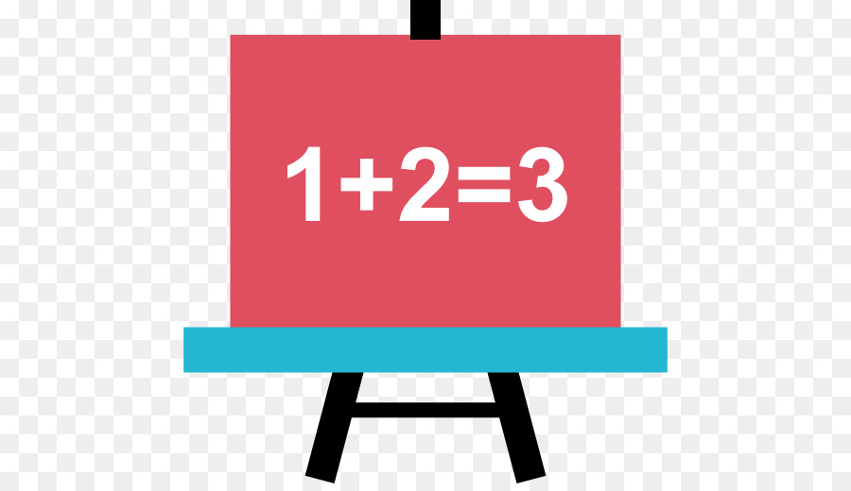
9. Primary School Teacher

Slide 15
10. Cook/Chef

Slide 16
11. Doctor

Slide 17
12. Nurse

Slide 18
13. University Professor

Slide 19
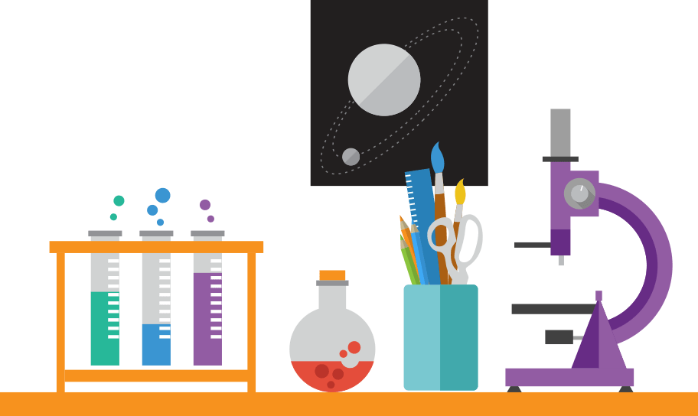
14. Scientist

Slide 20
15. Driver

Slide 21
Words
1) Dancing ( to dance) | 9) Primary School Teacher
2) Teaching ( to teach) | 10) Cook/Chef
3) Cooking ( to cook) | 11) Doctor
4) Repearing ( to repair) | 12) Nurse
5) Washing ( to wash ) | 13) University Proffesor
6) Sports ( doing sports) | 14) Scientist
7) Driving | 15) Driver
8) Dancer

Slide 22
Let’s count the answers on blackboard
Is there a difference between similar behavior and jobs?
If there is, how can we interpret that?

Slide 23
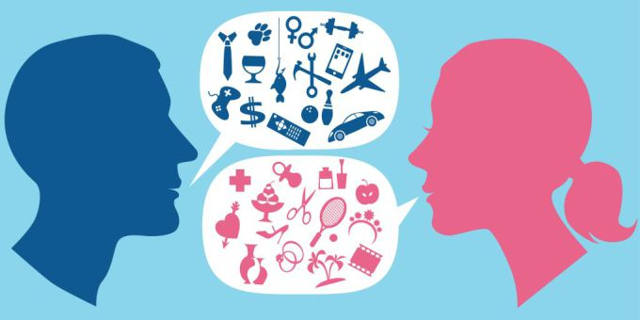
BASIC CONCEPTS: sex, gender, stereotype, prıvılege
Do you know…
Gender?
Sex?
Stereotype?
Privilege?

Slide 24
SEX
SEX TENDS TO RELATE TO BIOLOGICAL DIFFERENCES.

Slide 25
SEX
The concept of sex can be attributed to anatomical and physiological differences:
Hormones (testosterone, estrogen, and progesterone)
Chromosomes (XX, XY, X0, XXX, XXY…)
Genital organ differences

Slide 26
gender
World Health Organisation (WHO) defines the gender as:
"Gender refers to the socially constructed characteristics of women and men, such as norms, roles, and relationships of and between groups of women and men. It varies from society to society and can be changed."

Slide 27
Gender
Gender and sex are different concepts.
Gender is socially & culturally constructed behaviors or attitudes which are assigned to biological sex.
Gender concept is channeled via:
- Education
- Family Interactions
- Friends / Peers
- Traditional and Social Media

Slide 28
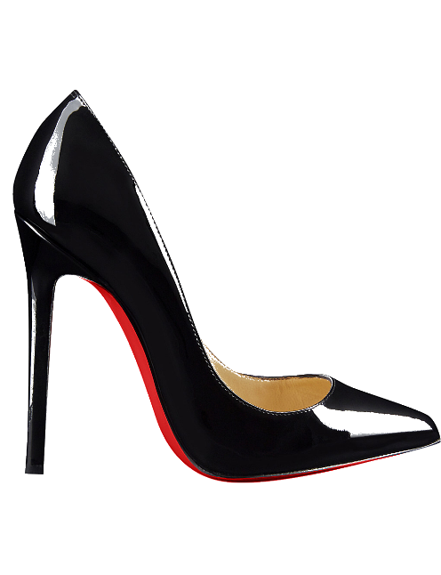
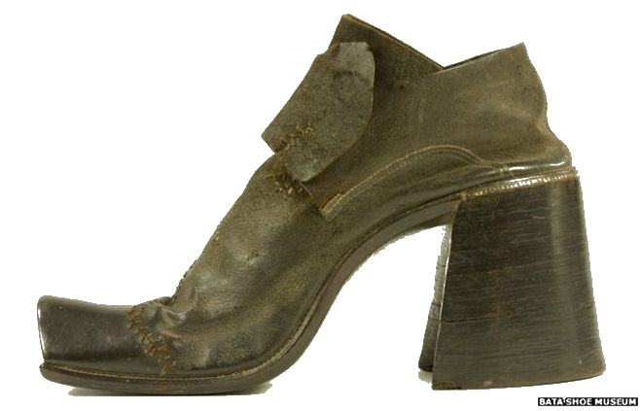
GENDER IS SOCIALLY AND CULTURALLY CONSTRUCTED? HOW?
High-heels were manifactured initially for:
Upper-class men to use when hunting on horse

Slide 29
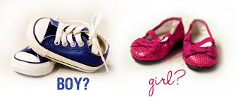
GENDER IS SOCIALLY AND CULTURALLY CONSTRUCTED? HOW?
Earnshaw's Infants' Department, published in 1918:
"The generally accepted rule is pink for the boys and blue for the girls. The reason is that pink, being a more decided and stronger color, is more suitable for the boy, while blue, which is more delicate and dainty, is prettier for the girl."
Video link: How do we change our behaviors according to gender perception?

Slide 30
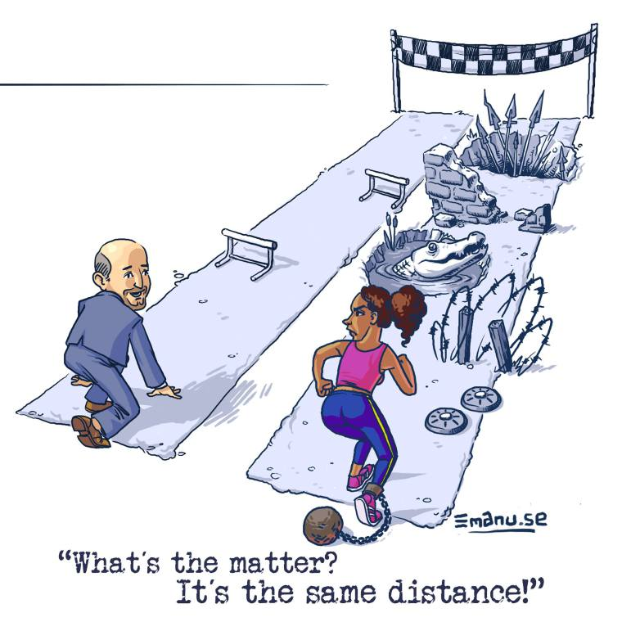
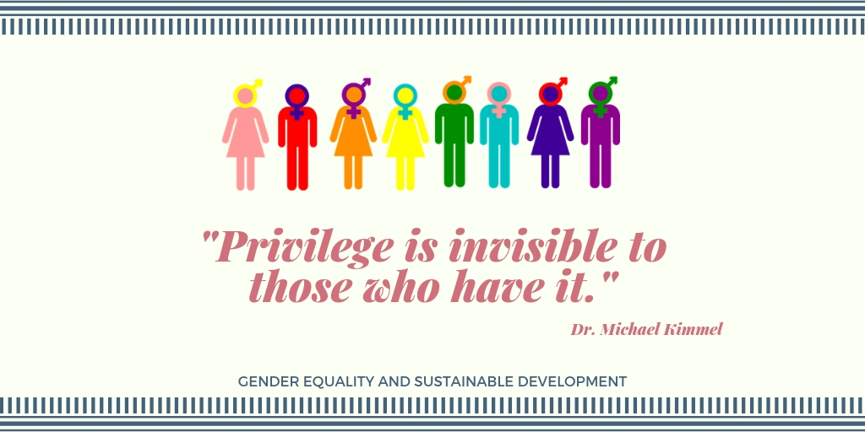
Prıvılege
A right or immunity granted as a peculiar benefit, advantage, or favor.
(From Merriam Webster Online Dictionary)

Slide 31
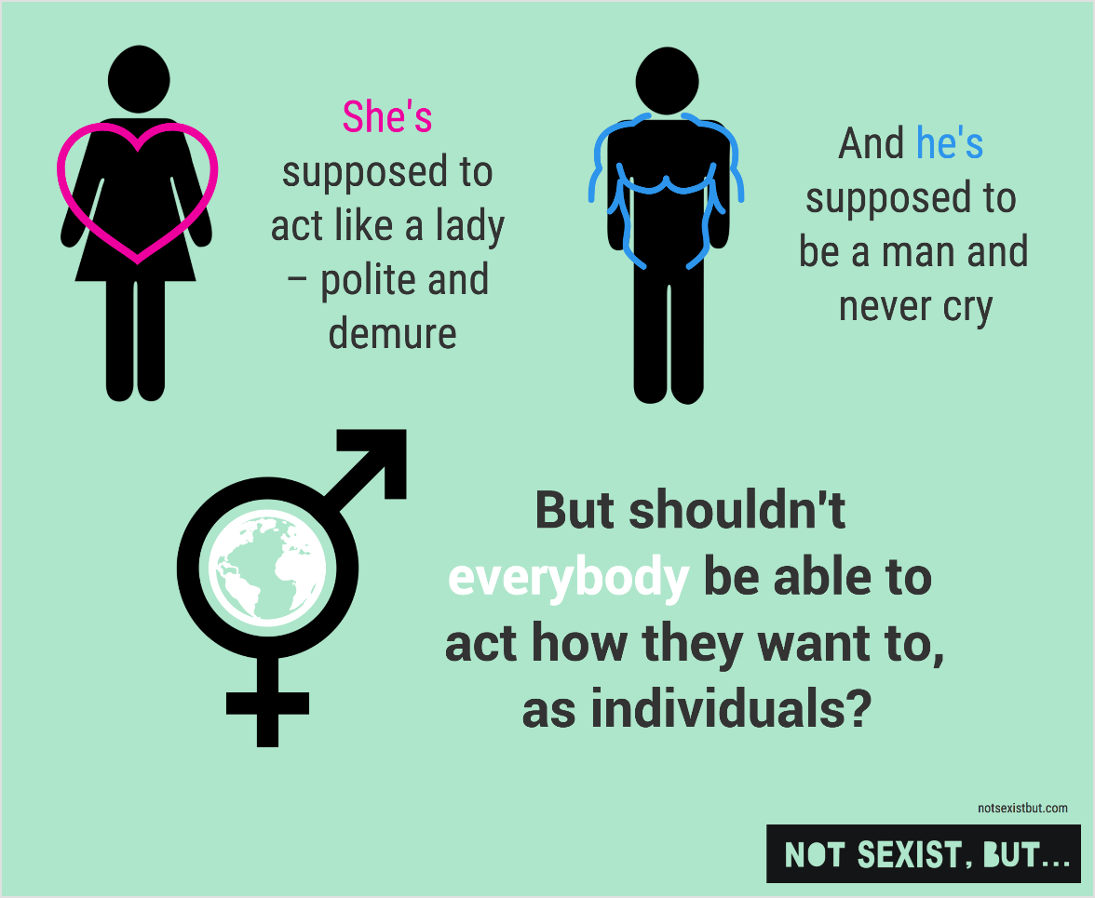
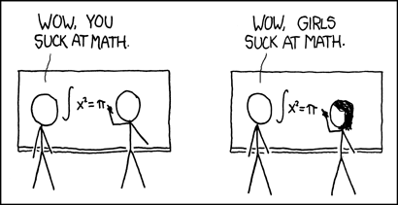
Stereotype: set of socıal assumptıons
Gender stereotype: Social assumptions about gender identities which are held by society in general.

Slide 33
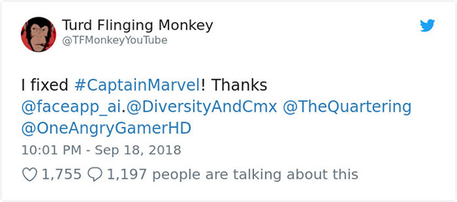
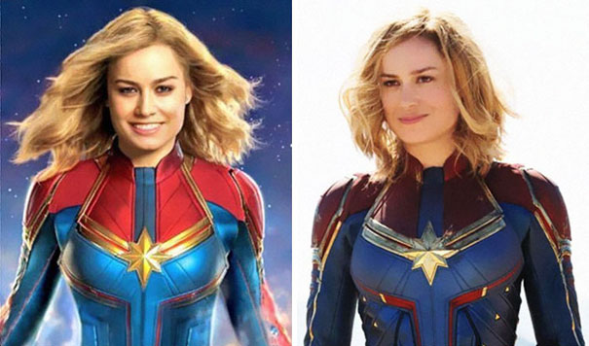
Women should smıle more, rıght?
Hollywood Actress Brie Larson is the first female hero of Marvel universe (as ‘Captain Marvel’) was told to smile more by Twitter users.

Slide 34
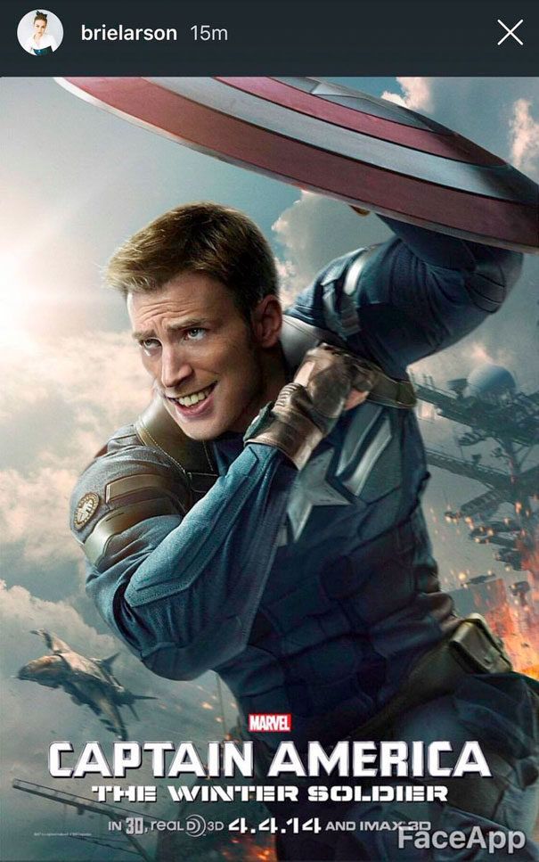
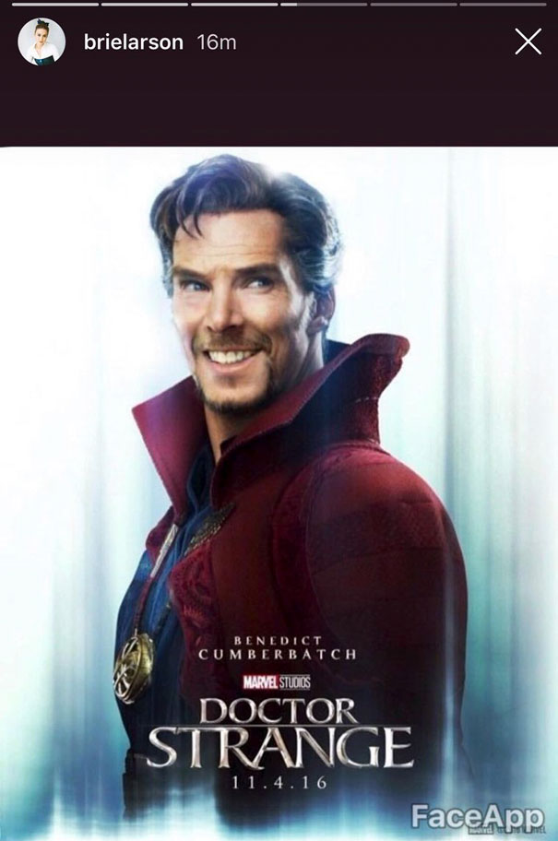
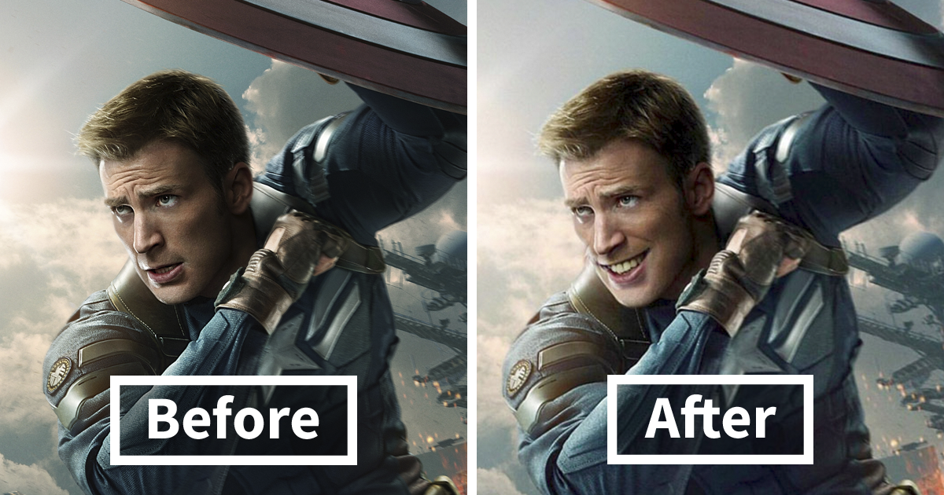
What ıf men smıle ın superhero posters?

Slide 35
Let’s dıscuss
What do you think?
Producers or audience do not even ask for male actors to smile. But why women?
Is it because of stereotypical image of womenhood?

Slide 36
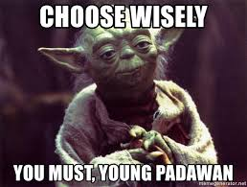
GAME TIME: AGREE/DISAGREE
We are going to present you some sentences.
You will choose your side according to whether you agree or disagree.
You will move to the agree or disagree divided zone.

Slide 37
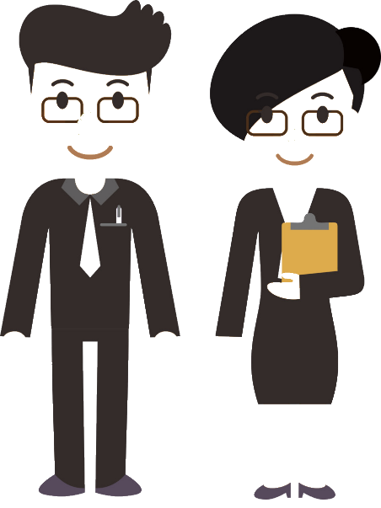
Sentence 1: Men work harder and longer hours than women.
AGREE
DISAGREE

Slide 38
Sentence 2: Boys are better than gırls at maths
AGREE
DISAGREE

Slide 39
Sentence 3: Gırls do better at school than boys.
AGREE
DISAGREE

Slide 40
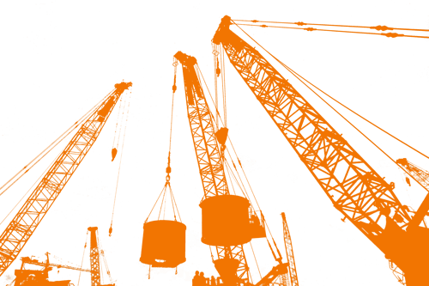
Sentence 4: There are some jobs that women are not able to do.
AGREE
DISAGREE

Slide 41
Sentence 5: We lıve ın the World whıch women and men are equal ın most of fıelds ( work, educatıon, housework)
AGREE
DISAGREE

Slide 42
Let’s dıscuss
Let’s look at the sentence you replied.
«Men work harder and longer than women.»
This graph shows the domestic work done by female and males.

Slide 43
Let’s dıscuss
Let’s look at the sentence you replied.
«Men work harder and longer than women.»
This graph shows the domestic + professional work done by female and males.

Slide 44
Can you guess the country?
World Economic Forum Global Gender Gap Index Top 5:
1)Iceland
2) Norway
3) Finland
4) Hint: This is not a European Country.
5) Sweden
Click: Online Access for GGGR of WEF (2017)

Slide 45
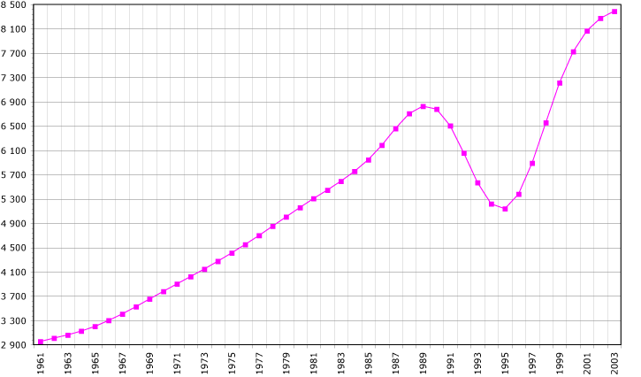
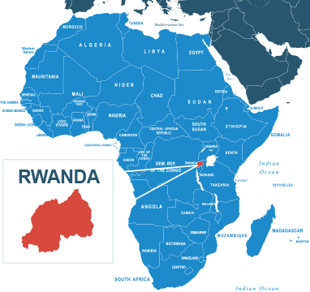
Is wage gap an ıssue of underdeveloped countrıes?
What is so special about Rwanda?
Women in ministerial jobs.
61% of the parliment is women!

Slide 46
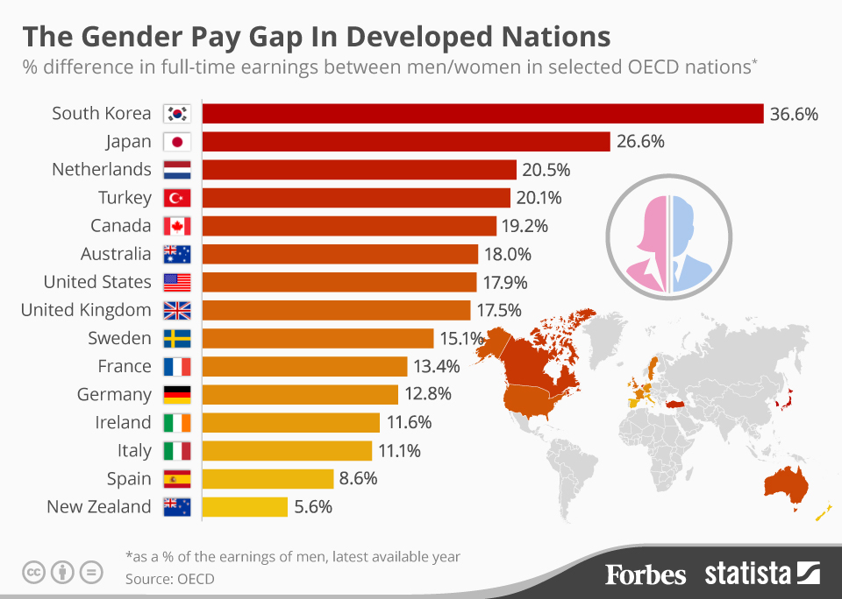
Let’s dıscuss
Surprise!
Video link: What do these kids understand that your boss doesn’t?

Slide 47
Let’s contınue wıth basıc concepts
Sustain: to maintain, continue, protect.
Sustainability: the quality of causing little or no damage to the environment and therefore able to continue for a long time. (Cambridge Advanced Learner's Dictionary & Thesaurus)
Development: The growth, or the act / process or result of an ongoing activity.

Slide 48
Sustaınable development
"Sustainable development is development that meets the needs of the present without compromising the ability of future generations to meet their own needs."

Slide 49
Sustaınable development
United Nations (UN) set the goals to be achieved for sustainable development until 2030.
One of the goals is achieving gender equality.

Slide 50
But why do we need to know all of these to learn about and achıeve sustaınable development?
Why do we need SD ?
To protect the world’s natural resources
To achieve social equality and solidarity
Sustainable development
Social equality and solidarity
Natural Resources

Slide 51
Gender equalıty as a Sustaınable development goal
Sustainable development
Social equality and solidarity
Natural Resources
Why should we promote gender equality for SD:
Equality between women and men - equal rights, opportunities and responsibilities – is a matter of human rights and social justice. Greater equality between women and men is also a precondition for (and effective indicator of) sustainable people-centred development. The perceptions, interests, needs and priorities of both women and men must be taken into consideration not only as a matter of social justice but because they are necessary to enrich development processes”

Slide 52
Gettıng a solutıon: EMPOWERING WOMEN
First, be informed about these topics, you already started to learn today ☺
Why do we need to empower women?
‘’Women have a vital role in environmental management and development. Their full participation is therefore essential to achieve sustainable development”
(Principle 20, Rio Declaration)
Video Link: Gender equality means empowering women and girls

Slide 53
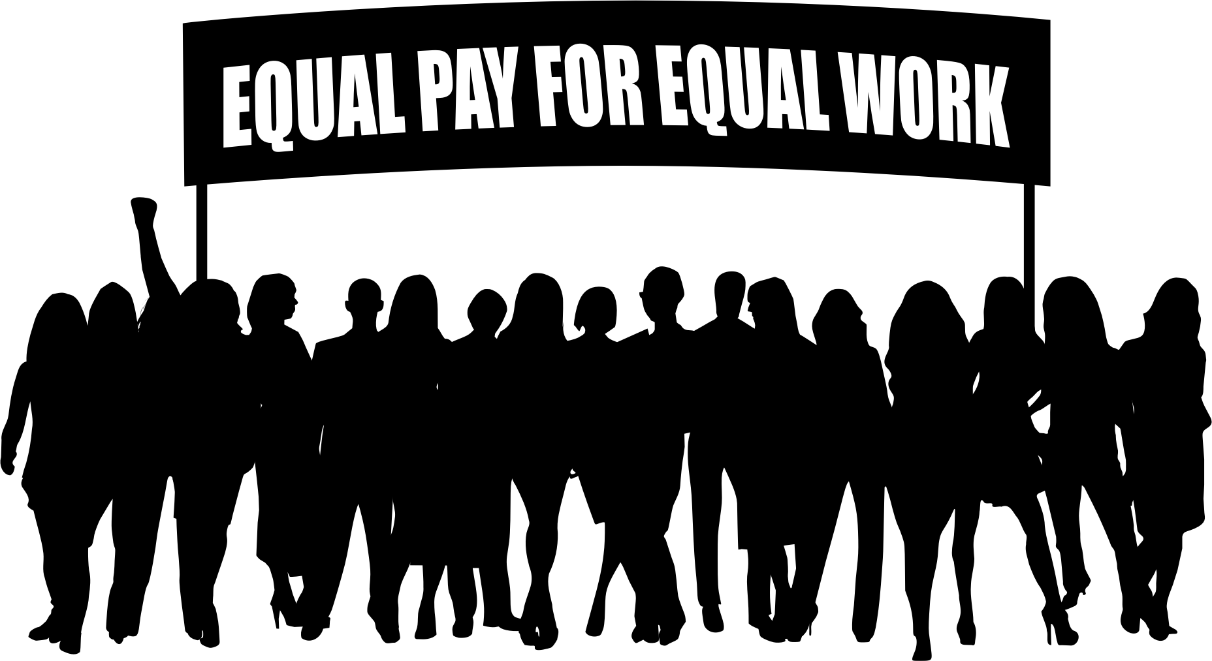
Questıons?
THANK YOU FOR LISTENING ☺

