Slide 1
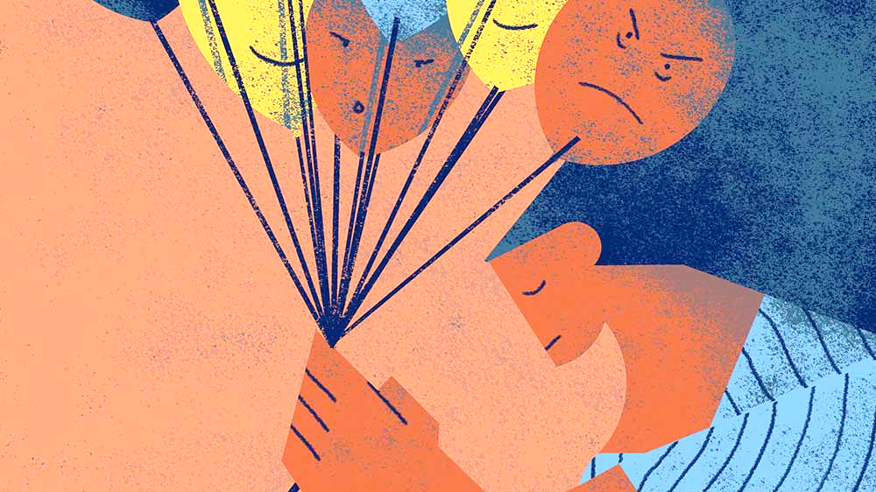
Mental Health Education
Destigmatizing and demystifying mental illness

Slide 2
What is stigma?
Stigma involves negative attitudes or discrimination against someone based on a distinguishing characteristic such as a mental illness, a health condition, or a disability. Social stigmas can also be related to other characteristics including gender, sexuality, race, religion, and culture.
Unfortunately, stigma surrounding mental health is still very common. Attitudes towards psychiatric illnesses tend to be more negative than attitudes toward physical conditions.

Slide 3
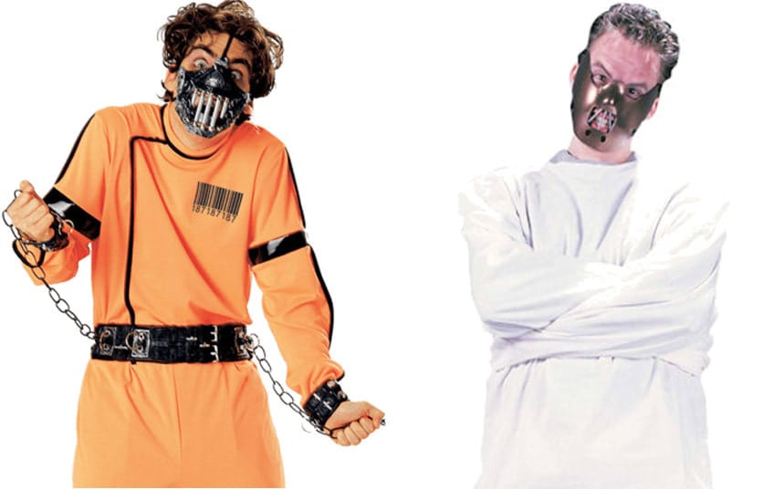
Examples of stigmatizing behaviors:
Movies where the villain is a character with a mental illness.
Halloween costumes that present people with mental illness as violent and dangerous.
Treating mental health issues like they are something people can overcome if they just "try harder" or "snap out of it“.
Using phrases like "she's crazy" or "he's nuts" to describe other people or their behavior.

Slide 4
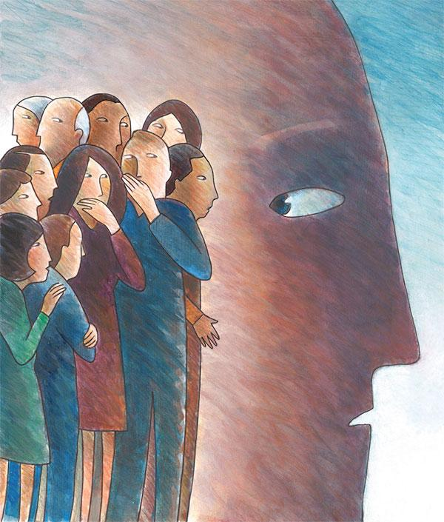
How does it affect people?
Research has shown that stigma is one of the leading risk factors contributing to poor mental health outcomes.
It leads to delays in treatment and reduces the chances that a person with mental illness will receive appropriate and adequate care.
It can cause people to doubt themselves and their abilities to achieve their goals in life.
It can also lead to feelings of shame and isolation.
It may make it harder for people to find jobs and adequate housing.

Slide 6
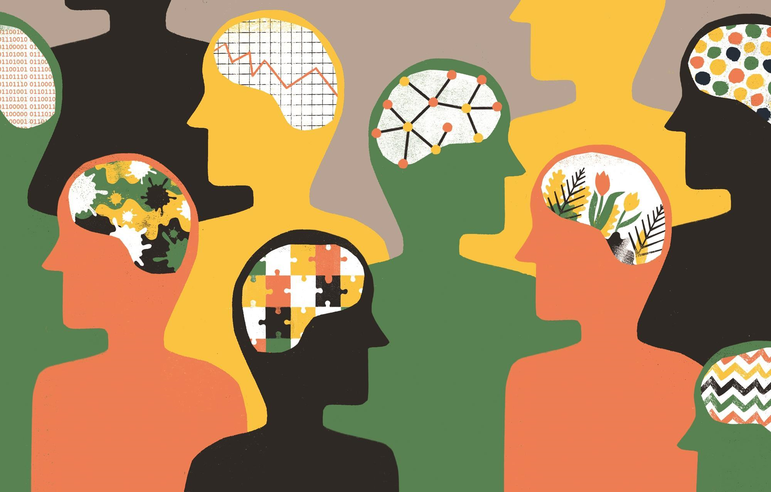
What is mental illness?
Mental illnesses are health conditions which involve changes in emotion, thinking or behavior (or a combination of these). Mental illnesses are associated with distress and/or problems in social, work or family activities.
Mental illness is nothing to be ashamed of. It is a medical problem, just like heart disease or diabetes.

Slide 7
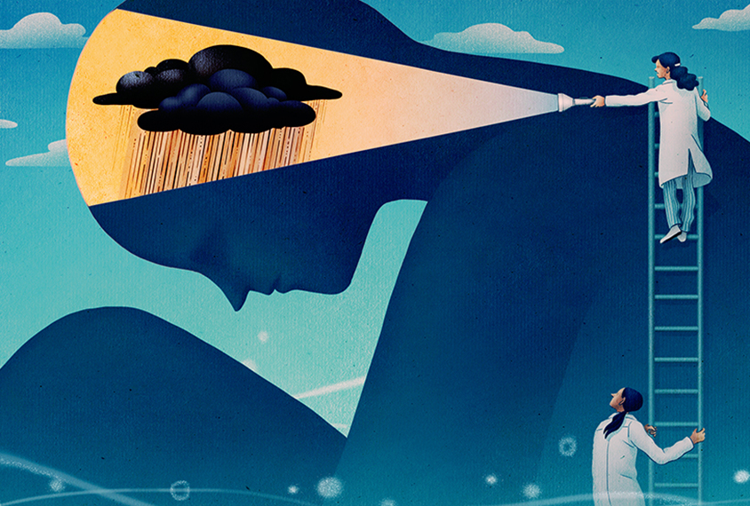
How does mental illness occur?
The exact cause of mental illness is rarely known, but research shows that many of these conditions are caused by a combination of biological, psychological and environmental factors.
Biology
Abnormal functioning of nerve cell circuits in the brain
Genetics
Infections
Brain defects or injury
Prenatal damage
Substance abuse
Poor nutrition
Exposure to toxins
Psychology
Severe psychological trauma suffered as a child, such as emotional, physical, or sexual abuse
An important early loss, such as the loss of a parent
Neglect
Poor ability to relate to others
Feelings of inadequacy, low self-esteem, anxiety, anger, or loneliness
Environment
Certain stressors can trigger an illness in a person who is highly susceptible. These stressors include:
Death or divorce
A dysfunctional family life
Changing jobs or schools
Social or cultural expectations
Substance abuse by someone close to the person

Slide 8
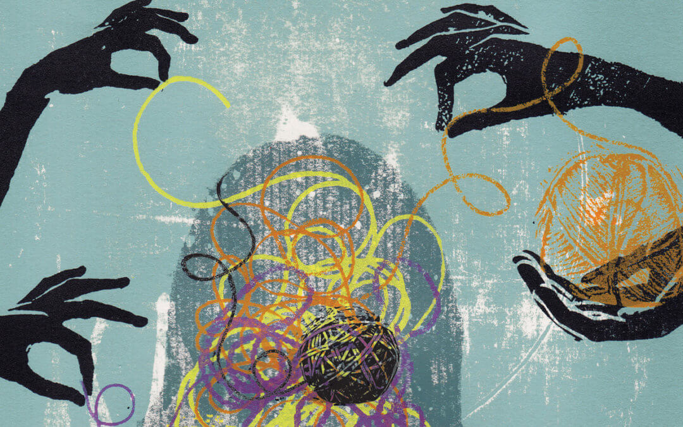
In the next slides, we will talk about only a few mental disorders, which are the most often discussed, but not everyone knows the accurate information about them.
But you should keep in mind that there are many other types and forms of mental disorders.
If you want to see what else exists, you can find the classification on this website.
http://teenmentalhealth.org/learn/mental-disorders/

Slide 9
Depression

Slide 10
Living with depression

Slide 11
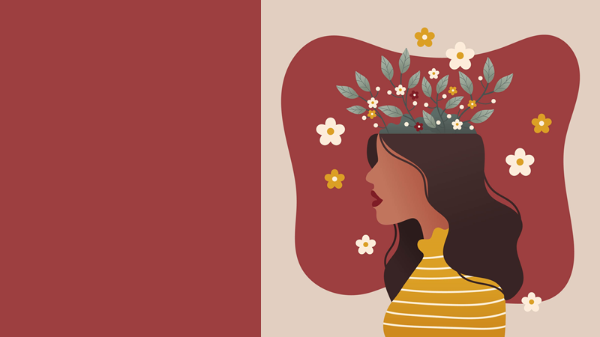
Busting the most common myths and misconceptions:
DEPRESSION

Slide 12
REALITY:
MYTH:
Depression is a psychological, social, and biological disorder that causes physical issues as well. It’s chronic and takes treatment to manage. Someone who is depressed can’t just shut it off. Depression is a real disease that takes time and treatment to manage.
Depression is all in your head.
A life event, like the loss of a loved one, triggers feelings of sadness, loneliness and emptiness in everyone. However, those who deal with depression are more likely to experience those feelings for long periods of time and more frequently. A traumatic event does not cause depression; it only heightens an already existing issue in someone who deals with depression.
REALITY:
MYTH:
Depression is only brought on by a traumatic event.

Slide 13
Medication is only one type of depression treatment. Therapy is another option, and research shows that cognitive behavioral therapy (CBT) is especially effective in helping people with depression. Generally, the combination of antidepressant medication and CBT are most effective in treating depression. Many people have to try different combinations of treatment before they find one that works.
REALITY:
MYTH:
Medication is the only way to manage depression.
Those who deal with depression don’t have to fight it alone. You can get help, and we encourage it. It’s possible to manage your depression. Depression is also not a normal part of getting older. Even though your life goes through many changes, being depressed is not something with which you have to live.
REALITY:
MYTH:
Depression is something that you have to deal with by yourself.

Slide 14
REALITY:
While there is a genetic component in depression, research shows it’s small. Of people who have a relative who deals with depression, only 10 to 15 % will also develop depression.
If you have a family member with depression, you will have it, too.
MYTH:
People who experience depression may have physical differences in their brains than the average person. These differences don’t always act the same way in everyone’s brain. The changes in the brain, plus hormone changes, can influence the severity of moods, thoughts, and physical issues.
REALITY:
MYTH:
Everyone experiences depression in the same way.

Slide 15
REALITY:
MYTH:
It’s not that there isn’t any depression in men, it’s just that men don’t talk about it as often as women. Some signs of depression in men are different than in women. More often men will feel anger, and women guilt.
Only women get depressed.
REALITY:
Depression can be brought on by feelings of sadness, but feeling down doesn’t last as long as an episode of depression. Depression can last from a few weeks to an entire year. People with depression have many other emotions other than feeling sad. They can feel anxious, tense, empty and experience other negative emotions. Depression also does not go away with time or encouragement from friends and loved ones like sadness does.
MYTH:
Depression is the same as being sad.

Slide 16
Clinical depression is a serious condition that causes those who suffer from it to withdraw from loved ones, take dangerous risks or even start conflicts with others. It requires treatment to manage and overcome. The fact that depression can lead directly to thoughts or actions of a suicidal nature make depression a very big deal.
REALITY:
MYTH:
Depression isn’t a big deal.
Depression does not discriminate. You do not decide to become depressed. The only reason depression is viewed as a weakness is that society has stigmatized the condition. Depression is a biological and psychological condition that has nothing to do with how strong you are.
REALITY:
Depression is a weakness.
MYTH:

Slide 17
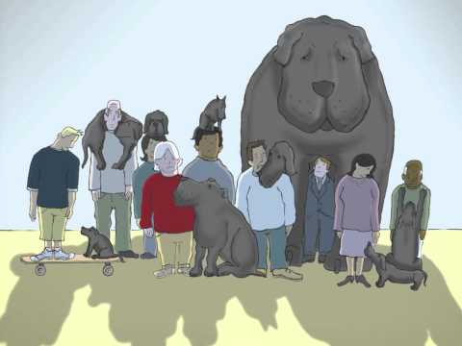

Slide 18
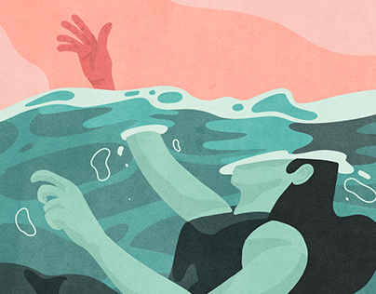
What signs to look out for:
Loss of interest in activities that used to bring joy and pleasure
Overall sadness
Feeling fatigued
Not being able to remember details
Overeating or not wanting to eat at all
Sleeping too much or not being able to sleep
Thoughts of suicide or suicide attempts
Aches, pains, headaches, cramps
Inability to meet daily responsibilities

Slide 19
Anxiety Disorders (Generalized Anxiety Disorder and Panic Disorder)

Slide 20
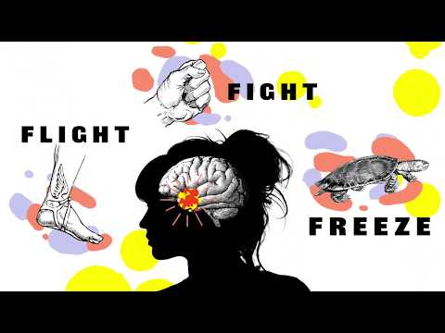

Slide 21
Busting the most common myths and misconceptions:
ANXIETY

Slide 22
REALITY:
For someone experiencing this condition, the worry is difficult or impossible to control. While you may feel worried about an upcoming test, someone with generalized anxiety disorder may fixate on the worst-case scenario and it will cause them significant distress and even physical symptoms.
MYTH:
People with Generalized Anxiety Disorder (GAD) are just drama queens.
REALITY:
MYTH:
Generalized Anxiety Disorder has no physical symptoms.
Even though GAD is a mental health condition, it can cause very real symptoms in the body such as sweating, shaking, difficulty swallowing, headaches, stomach aches or unexplained pains.

Slide 23
Everybody’s journey to recovery from anxiety is different, but most experts agree that counseling is an effective option whether or not the person uses medication. Therapy for generalized anxiety disorder is effective, it allows someone to challenge their fears and insecurities in order to overcome them.
REALITY:
MYTH:
Medication is the only way to manage generalized anxiety.
Empathy is the first step to help someone with GAD. It might seem difficult to know how to help, but trying your best to understand and listen to what they’re going through is a great first step. It is also good to watch out for signs that someone might be using substances such as alcohol or drugs to help manage their anxiety on their own.
REALITY:
MYTH:
There’s nothing you can do to help someone with GAD.

Slide 24
REALITY:
While panic disorder and generalized anxiety disorder are different conditions, they are not mutually exclusive, and people with panic disorder are not faking these attacks for attention. In fact, 28.3% of people will have a panic attack throughout their lifetime, and many of these people won’t be diagnosed with panic disorder. Although people have associated generalized anxiety disorder with panic attacks, each of these conditions can exist without the other.
MYTH:
People with anxiety fake panic attacks to get attention.
Fainting during panic attacks is pretty rare. More often, fainting can be attributed to another health condition.
Panic attacks cause fainting.
REALITY:
MYTH:

Slide 25
REALITY:
Panic attacks can feel terrible, but are not life-threatening. Panic attacks are often described as one of the most frightening experiences a person can have. The symptoms can become so severe that a person mistakenly thinks they are having a heart attack, dying or “losing their mind”. In spite of the severity of such symptoms, most panic attacks can last anywhere from 15 seconds to 30 minutes or longer.
MYTH:
Panic attacks cause extreme harm
People having a panic attack lose all control
People having a panic attack may feel out of control but that is not the same as actually losing control.
REALITY:
MYTH:

Slide 26
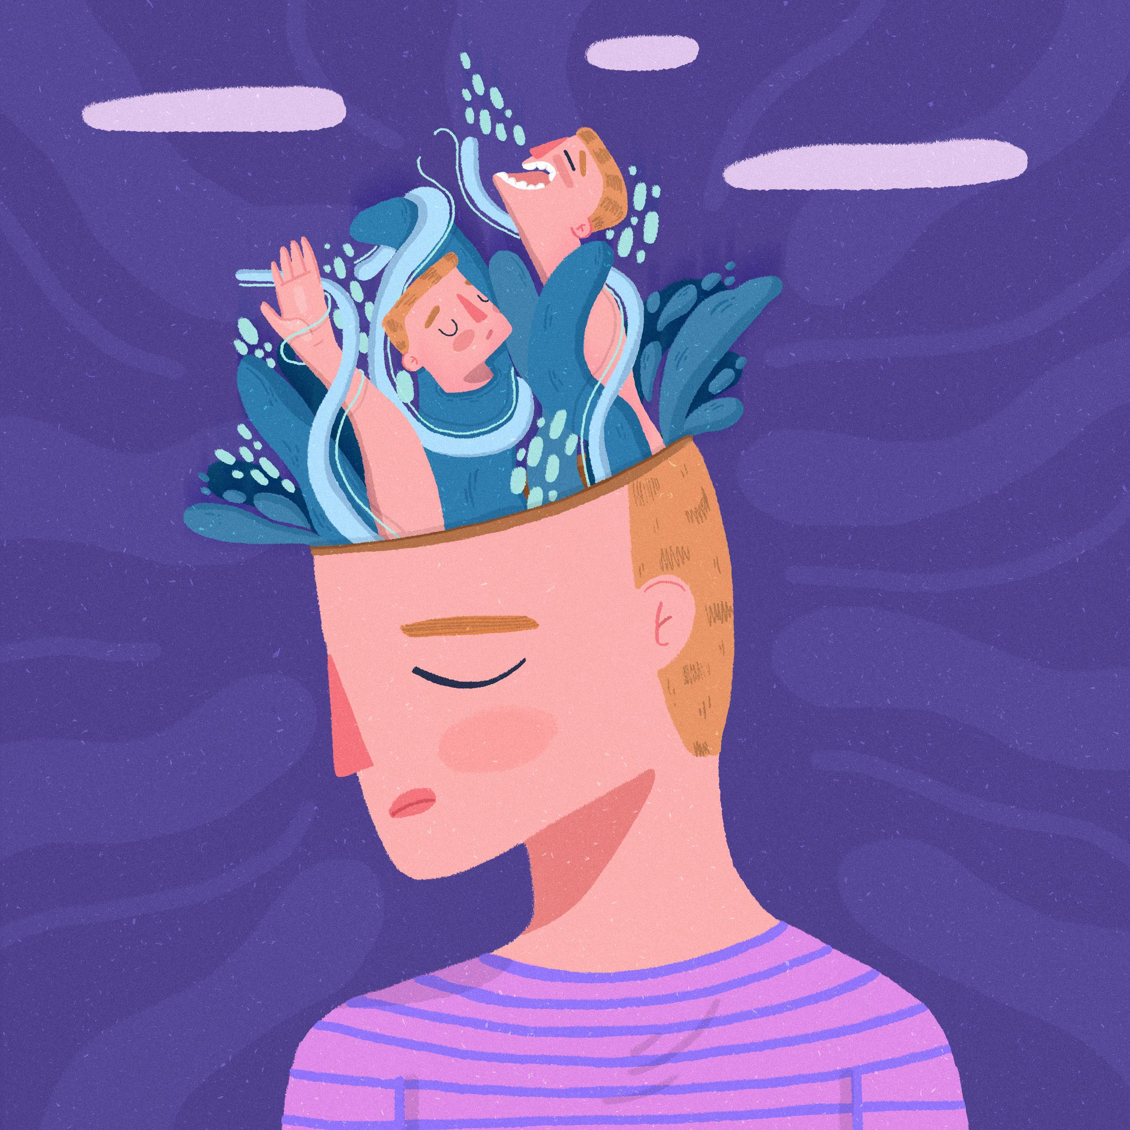
What signs to look out for:
Worrying more than usual about everyday issues
Trouble controlling thoughts
Nervousness
Fatigue
Difficulty concentrating
Muscle tension
Sleep issues
Just because someone isn’t exhibiting obvious symptoms doesn’t mean they are not affected by anxiety.
The anxiety has to be severe enough to prevent someone from functioning optimally in different areas of life. If the person cannot control the worry and it causes him or her significant distress, telling them to calm down will not be helpful.

Slide 27
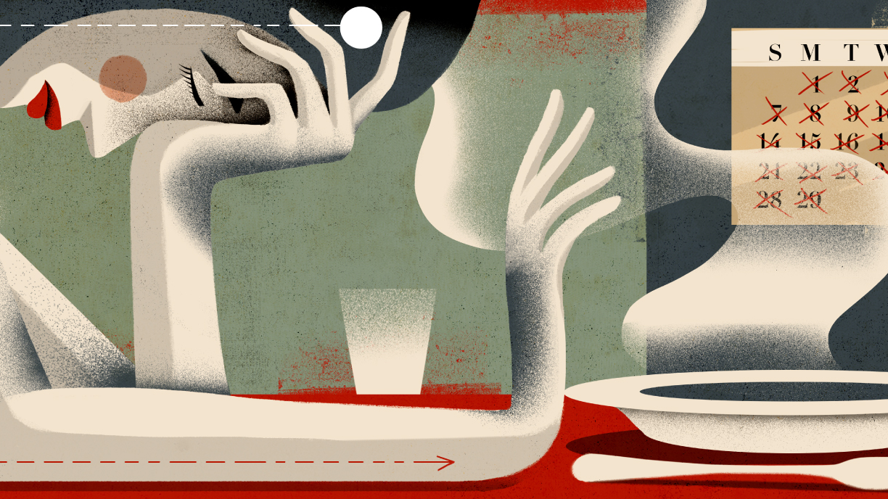
Eating disorders: Anorexia nervosa

Slide 28
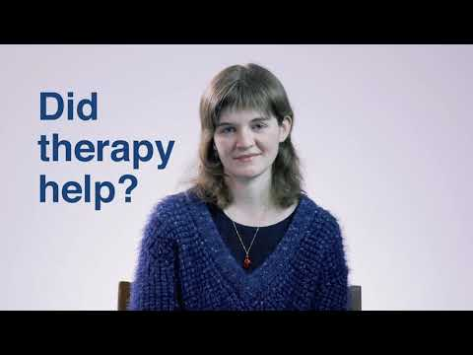

Slide 29
Busting the most common myths and misconceptions:
ANOREXIA NERVOSA

Slide 30
REALITY:
A diagnosis of anorexia is linked with a range of problematic behaviors surrounding weight, including restricted eating, reluctance to gain weight, and relating self-worth to appearance and body shape. These behaviors do not always result in extreme or visibly low body weight. In fact, some people with severe anorexia may appear to have a normal body weight; this does not mean that their illness is not serious or does not require treatment.
MYTH:
Someone needs to be dangerously thin to have anorexia.
REALITY:
People with anorexia do eat, but they follow strict rules, practice extreme calorie restriction and avoid certain foods. They may also keep a rigid food log and track every calorie they consume. These behaviors are maladaptive and can lead to a lack of energy and nutrients to properly fuel the body and can have extreme health consequences.
MYTH:
People with anorexia do not eat.

Slide 31
Although anorexia is more common in women, it can most certainly be diagnosed in men. Anorexia in men may have a slightly different symptom presentation in a way that men aspire to be lean and muscular, rather than extremely thin. Men are not immune to the pressures of social expectations, and can also experience feelings of anxiety and dissatisfaction related to their body shape. The stigma associated with male anorexia may lead to delays in men seeking and receiving treatment, which can impact their long-term health.
REALITY:
MYTH:
Men don’t suffer from anorexia.
REALITY:
For those who have not experienced an eating disorder, extreme restriction of food may appear to be a matter of choice. However, behaviors related to anorexia are often linked to much deeper thoughts and beliefs. Anorexia is an eating disorder based in low self-worth, self-doubt and extreme fear of weight gain.
MYTH:
Anorexia is a choice.

Slide 32
REALITY:
Anorexia is a severe and debilitating psychiatric condition that is to be taken seriously. The negative outcomes of anorexia can include loss of bone density, heart complications, organ failure, or in severe cases, death. These outcomes are not to be taken lightly and are far more serious than attention-seeking behavior. By reducing anorexia to an attention-seeking disorder, people suffering from the disorder may feel ashamed or embarrassed, which can worsen their condition and prevent them from seeking help.
MYTH:
Anorexia is just a cry for attention.
REALITY:
In general, exercise is a great strategy for developing a strong heart and cardiovascular system. However, this is not true for people with anorexia, and exercise may be a high-risk behavior for people with this eating disorder.
MYTH:
You cannot die from anorexia if you exercise to keep your heart strong.

Slide 33
REALITY:
Anorexia tends to begin for the first time during adolescence, which is believed to be related to some of the changes associated with puberty and growing societal pressure surrounding weight and body shape. It is linked to harmful ways of thinking and problematic coping strategies. These thoughts and behaviors are often so deep that it can take a considerable amount of time and effort to unlearn them. Because of this, it is rare that anorexia will stop without treatment, or with age. Thankfully, there are various treatment options available, such as family-based therapy, cognitive behavioral therapy and nutrition counseling. These treatments can be life-saving for a person suffering from an eating disorder.
MYTH:
Anorexia is a phase that can be outgrown.

Slide 34
What signs to look out for:
Fear of gaining weight
Dieting and exercising relentlessly, sometimes to the point of starvation
Fatigue, dizziness, mood swings
Counting calories obsessively and keeping food logs
Distorted body image, thinking they are overweight when in fact they are underweight
When confronted, someone with anorexia will often deny that there’s a problem

Slide 35
Schizophrenia

Slide 36
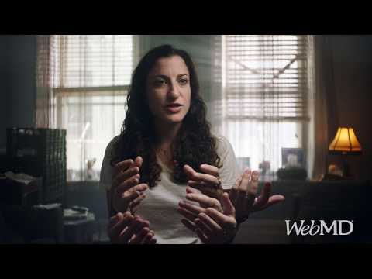

Slide 37
Busting the most common myths and misconceptions:
SCHIZOPHRENIA

Slide 38
MYTH:
REALITY:
A person with schizophrenia doesn't have two different personalities. Instead, they have false ideas or have lost touch with reality. Dissociative identity disorder is unrelated.
It means you have multiple personalities.
REALITY:
In movies and TV shows, who is the crazed killer? Often it's the character with this condition. That's not the case in real life. Even though people with schizophrenia can act unpredictably at times, most aren't violent, especially if they're getting treated. When people with this disorder do commit violent acts, they usually also have another condition, like childhood conduct problems or substance abuse.
MYTH:
Most people with schizophrenia are violent or dangerous.

Slide 39
REALITY:
Genes do play a role. But just because one of your parents has this mental illness doesn't mean you're destined to get it. If one parent has schizophrenia, your risk of getting the condition is about 10%. Having more than one family member with it raises your risk.
MYTH:
If your parent has schizophrenia, you'll get it too.
There was a time when people with mental illnesses were sent to asylums or even prisons. But now that experts know more about this disease, fewer people need to be placed in long-term mental health facilities. Most people with schizophrenia live with family or in supportive housing in the community.
REALITY:
MYTH:
If you have schizophrenia, you belong in a mental hospital.

Slide 40
REALITY:
MYTH:
Schizophrenia can make it harder for you to get a job and go to work every day. But with the right treatment, many people can find a position that fits their skills and abilities.
You can't hold a job if you have it.
REALITY:
MYTH:
The illness can make it harder for someone to take care of their daily needs, such as dressing and bathing. This doesn’t mean they're "lazy“. They just need some help with their daily routine.
Schizophrenia makes people lazy.

Slide 41
REALITY:
Schizophrenia can be hard to treat, but it's not impossible. With the right medicine and therapy, about 25% of people with this disease will recover completely. Another 50% will see some improvement in their symptoms. Many people with the condition can live full, productive lives.
MYTH:
You can never recover from it.

Slide 42
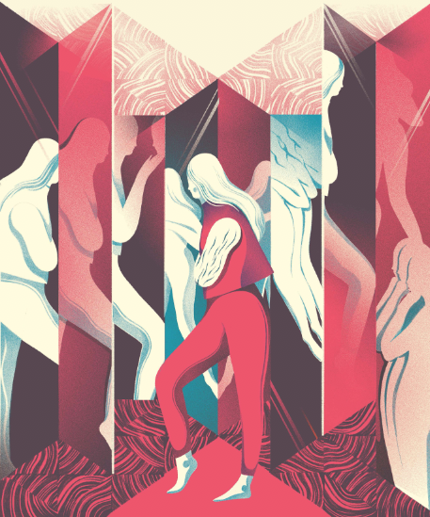
What signs to look out for:
Every case of schizophrenia can be different, but some most common symptoms are:
Hallucinations - people with schizophrenia might hear, see, smell, or feel things no one else does
Delusions - these are beliefs that seem strange to most people and are easy to prove wrong
Confused thoughts and disorganized speech
Lack of pleasure and withdrawal from society

Slide 43
Dementia

Slide 44
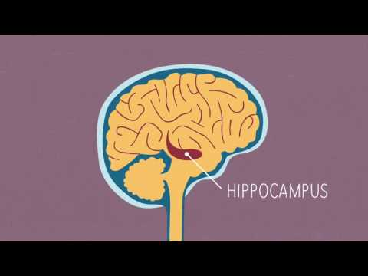

Slide 45
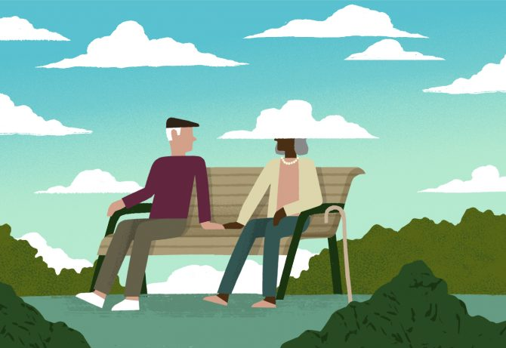
Busting the most common myths and misconceptions:
DEMENTIA

Slide 46
REALITY:
MYTH:
Memory loss is not the only symptom of dementia, and occasional forgetfulness is not the same as dementia.
Memory loss always equals dementia.
REALITY:
Only seniors develop dementia.
Most people with dementia are seniors, but some people develop dementia as early as their 30s.
MYTH:
REALITY:
MYTH:
Dementia is a normal part of the aging process.
Most people do not develop dementia.

Slide 47
REALITY:
A person with dementia’s perception and understanding of their surroundings vary at different times. It may be difficult for loved ones who are communicating with dementia patients, as it can sometimes seem that the person with dementia does not understand what is happening. However, people with dementia are not always clueless and confused about surroundings and events taking place. Dementia tends to be progressive, so a lack of understanding is more likely in later stages. In early stages, a person may even be aware of their diminishing memory capacity. Even during the later stages of dementia, some moments of clarity are possible. For those who ask themselves, “What does it feel like to have dementia?” the answer can be complex because not everyone experiences it the same way.
MYTH:
People with dementia don’t understand what’s going on around them.

Slide 48
REALITY:
MYTH:
Alzheimer’s is a form of dementia, but dementia has other forms as well.
Dementia and Alzheimer’s are the same thing.
REALITY:
Dementia affects each person differently and certainly not all become aggressive. Loss of memory and an increasing inability to understand what is happening around them can cause people with dementia to express their frustration through their behavior. Taking steps to make the environment as comfortable and calming as possible can avoid many upsetting situations for both the person with dementia and people nearby.
MYTH:
All people who have dementia become violent and aggressive.

Slide 49
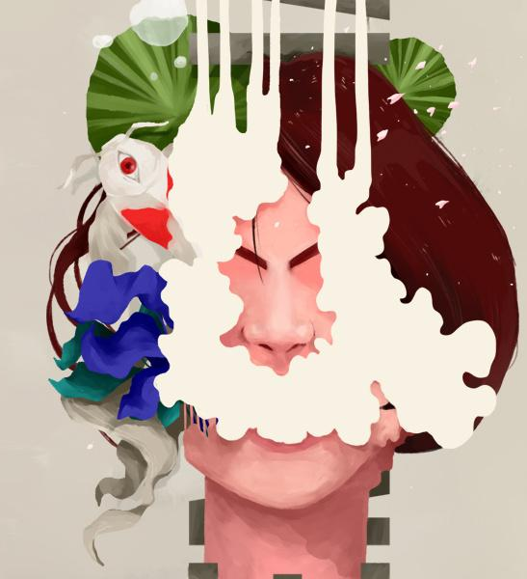
What signs to look out for:
Memory loss that affects day-to-day functioning
Difficulty performing familiar tasks
Confusion about time and place
Problems with language
Poor or decreased judgment
Problems misplacing things
Changes in personality or behavior
A loss of initiative

Slide 50
What can you do?
Remember that many people experience mental illness. If you have a mental illness, know that you are not alone. 1 in 5 people experience some kind of mental illness in their life.
Find support. Whatever you do, stay connected to others and get support. Get treatment so that you can experience reduced symptoms and a better quality of life.
Speak out. If you do not have a mental illness, educate people around you about the reality that mental illness is more common than people realize and speak out against stigma. Bust the myths and misconceptions that a lot of people believe in!

Slide 51
Don’t be afraid to talk about it!

Slide 52
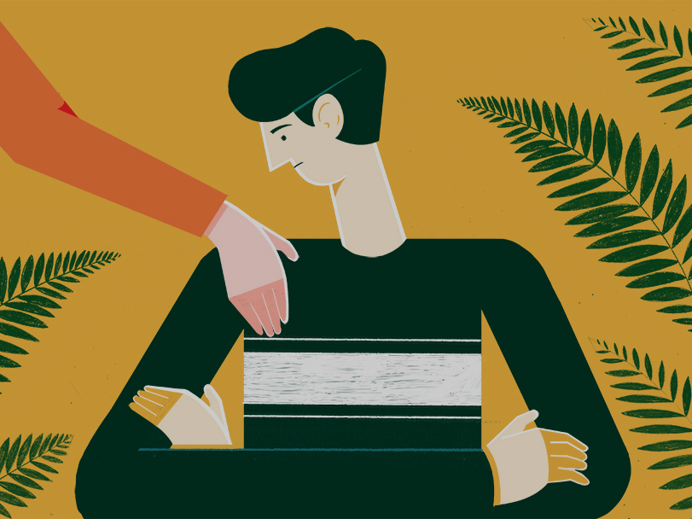
Where to ask for help?
https://www.ordemdospsicologos.pt/pt/apoio_utente 🡪 website with useful information about how psychological help works (in portuguese)
https://encontreumasaida.pt/ 🡪 find a psychologist in Portugal
A Linha Saúde 24 - 808 24 24 24 🡪 choose number 4 for psychological help
Linha SOS voz amiga. Linha de apoio emocional e prevenção ao suicídio - 800 209 899
https://eportugal.gov.pt/cidadaos/cuidador-informal/contactos-linhas-de-apoio 🡪 other useful Help Lines in Portugal

Slide 53
Websites to learn more:
https://dwdonline.ca/ → This website is meant for teens who have been coping with depressed mood. This resource gives accurate information and teaches a set of skills that teens can apply to their own life to help them through depression.
http://teenmentalhealth.org/ → This website offers information about mental health including specific information about disorders, but also about the teen brain, importance of sleep, and other issues impacting teens.
https://teenshealth.org/en/teens/your-mind/?WT.ac=t-nav-your-mind#catmental-health → Giving a safe place for teens who need honest and accurate information, this website provides resources on mental health issues.
http://escolasaudavelmente.pt/alunos/adolescentes/escola/testes-e-ansiedade → Portuguese website with information about different mental health topics

Slide 54
Resourceful videos:
https://www.youtube.com/watch?v=OsRF8xGgbPA → Breaking the Stigma and Shame of Mental Illness
https://www.youtube.com/watch?time_continue=102&v=zt4sOjWwV3M&feature=emb_title → Warning Signs of a Mental Health Condition
https://www.youtube.com/watch?v=z-IR48Mb3W0&list=PLJicmE8fK0EgFqcHoA4ufzsPD6VQThV5S → What is depression?
https://www.youtube.com/watch?v=vYR9JPztdn4 → Depression is an Illness, Not a Weakness
https://www.youtube.com/watch?v=K2sc_ck5BZU → What is schizophrenia?
https://www.youtube.com/watch?time_continue=2&v=xbagFzcyNiM&feature=emb_title → Living with schizophrenia
https://www.youtube.com/watch?v=iPGd6l76l9A&feature=emb_title → Living with schizophrenia

Slide 55
Created by Hana Radovanović

