Slide 1
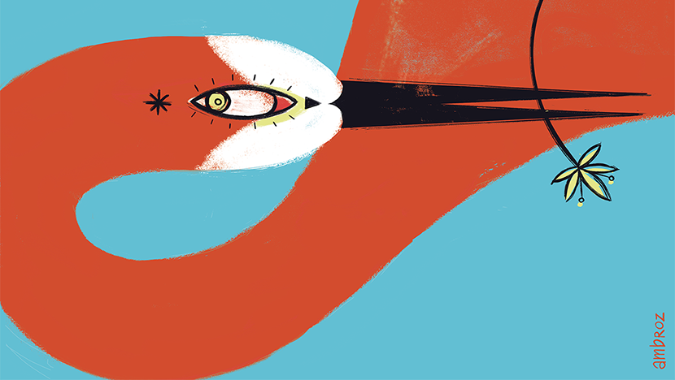
Normalizing sex

Slide 2
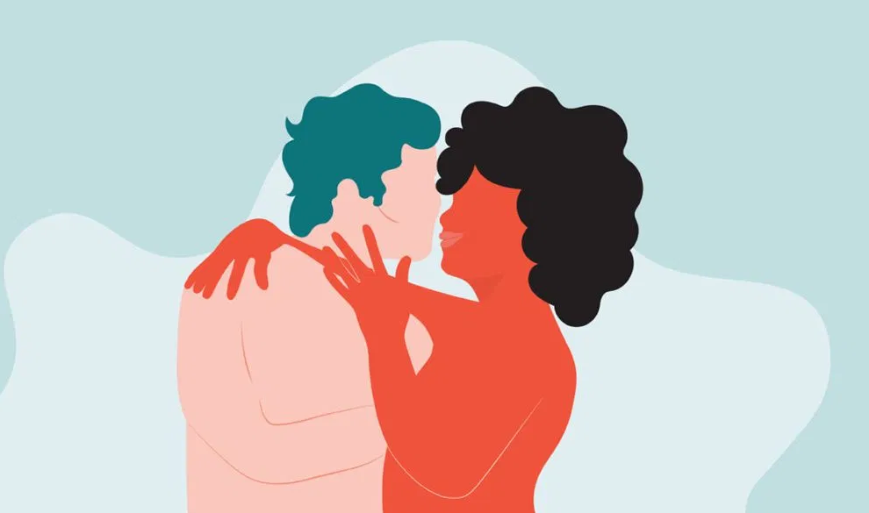
What is sex? : expanding the concept
Throughout our lives, we learn that “to have sex” or “to make love” means that a penis penetrates a vagina, but it is important to know that this is just one aspect of sex (vaginal sex), and that sex can include so much more.
Sex is basically anything that brings you sexual pleasure.
How you define sex, and what brings you most pleasure is totally up to you, and your definition can change through time, because sexuality is fluid.

Slide 3
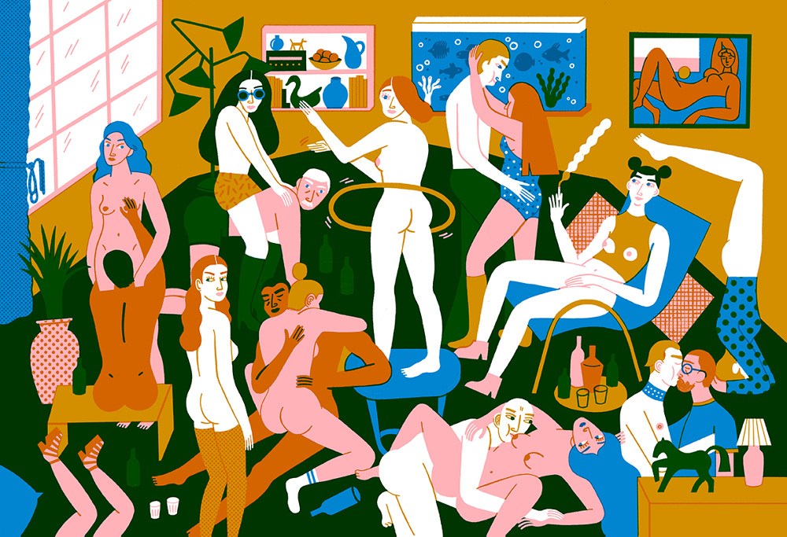
There are as many definitions of sex as there are people!

Slide 4
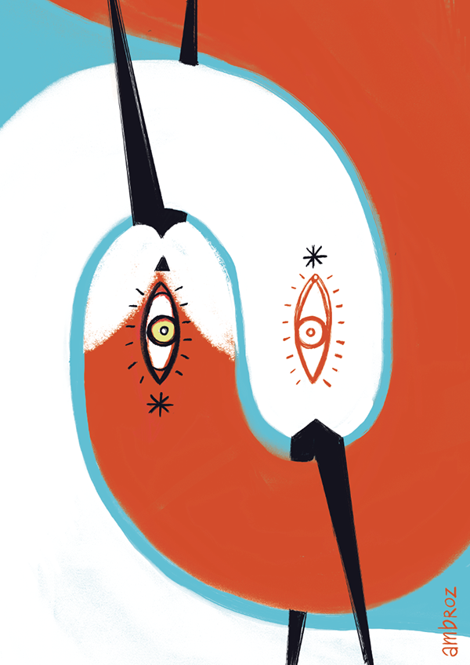
What are sexual activities?
Sexual activities can be directed to others, but also self-directed.
Sexual activities directed to others can include many different behaviours, such as:
Kissing
Hugging
Any sexual touching
Touching the other’s person genitalia
Oral sex
Anal sex
Vaginal sex
Sending sexual texts or pictures to someone
and much more!

Slide 5
Self-directed sexual activities include:
Sexual fantasies
Masturbation
The best way to discover and explore your sexuality is by starting from yourself.
Take some time to privately explore all parts of your own body. You can take a mirror to meet your genitalia in person and discover all parts of it. By touching, you can discover which movements and sensations bring you pleasure, and which maybe don’t. Knowing what you like or don’t like might help you achieve greater sexual pleasure with a partner in the future. While you are at it, think about what thoughts and fantasies feel good for you and how you might like to experience sexual pleasure with someone else.

Slide 6
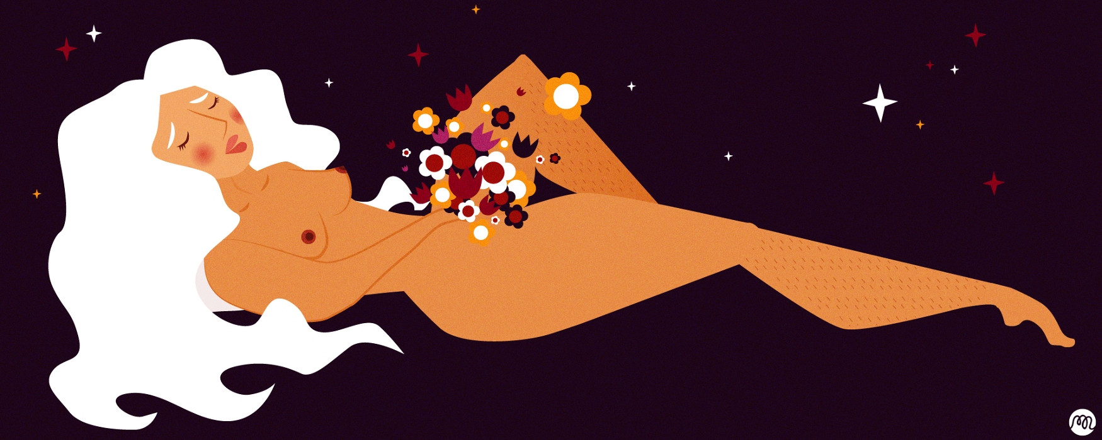
Masturbation

Slide 7
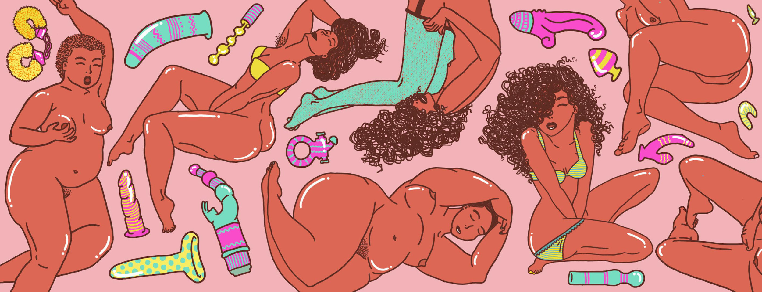
What is masturbation?
Self-stimulating your genitals in order to achieve sexual pleasure.
You can masturbate alone or with someone else, as long as it’s consensual and done in privacy.
Some people use their hand or other objects like pillows, vibrators, sex toys or streams of water to masturbate.
Some people use their imagination to fantasize or think sexy thoughts while they masturbate.
Who masturbates?
The majority of people masturbate, including people of all genders, abilities, sexualities, ethnicities, cultures, religions, and ages, and people who are single or in relationships.
Choosing not to masturbate is okay too.

Slide 8
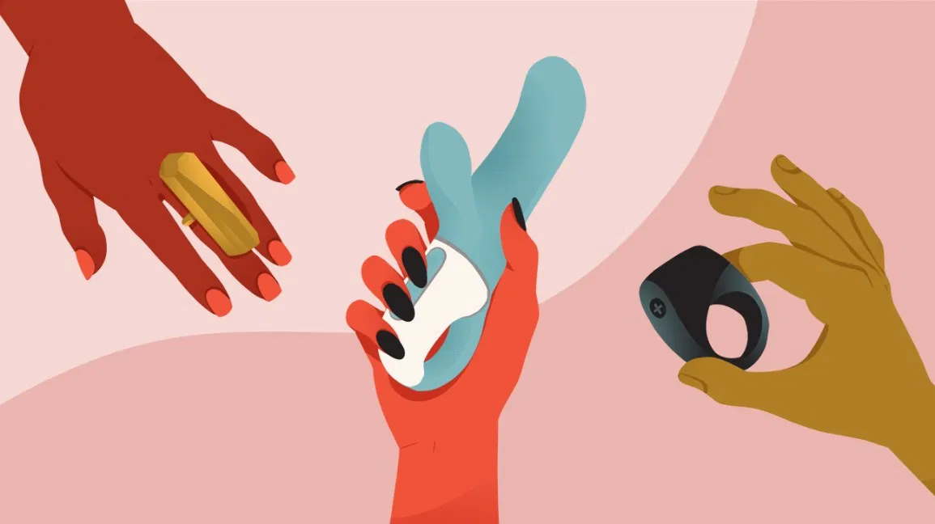
Why masturbate?
Because it feels good!
It is a way to explore your body and find out what feels good for you.
It can prepare you for sex with someone else.
It can relieve stress and help you relax.
With masturbation there is no risk of pregnancy or STIs.
Masturbation can relieve symptoms of PMS.
How often is it okay?
Some people masturbate several times a day, some a few times a week, others every once in a while, and some never. Everyone is different and it’s important to find out what feels right for you.
You can masturbate as much as you like as long as you are still enjoying other activities in your life too and it doesn’t interfere with your normal functioning.

Slide 9
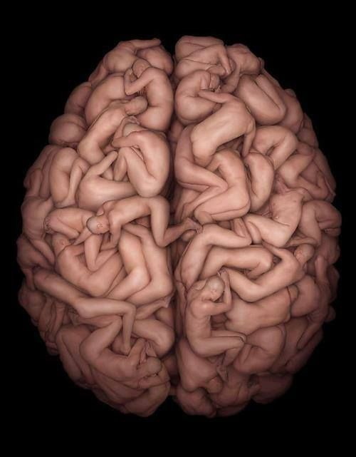
Sexual fantasies

Slide 10
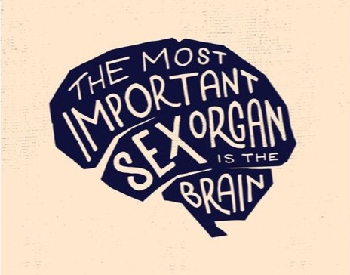
What is a sexual fantasy?
Any mental image that is sexually arousing or erotic for an individual who experiences it.
A normal and very common aspect of human sexuality.
It is also normal if you don’t have sexual fantasies.
They can occur spontaneously or can be induced by something.
They can occur during or outside of sexual activities.
They can be basic or very elaborate.

Slide 11
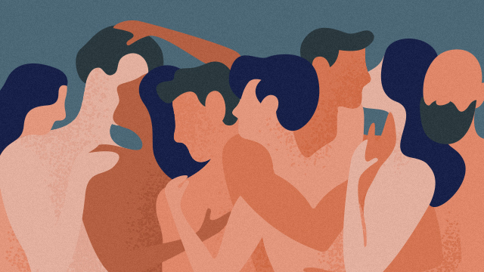
What are the most popular sexual fantasies?
Conventional representations of the past, present, or imaginary lovers.
Having sex with multiple people.
Sex in places or ways we have never done it before.
Fantasies about power and control that often include scenes of submission / domination with some sort of physical coercion.
It is not unusual that people have some fantasies for which they feel guilty or ashamed because those actions are not acceptable in the real world, but it is important to know that the fantasies are not connected to real behaviour, and being aroused by some fantasies doesn’t mean that we really want to try them. Also, the content of your fantasies does not tell anything about what kind of a person you are.

Slide 12
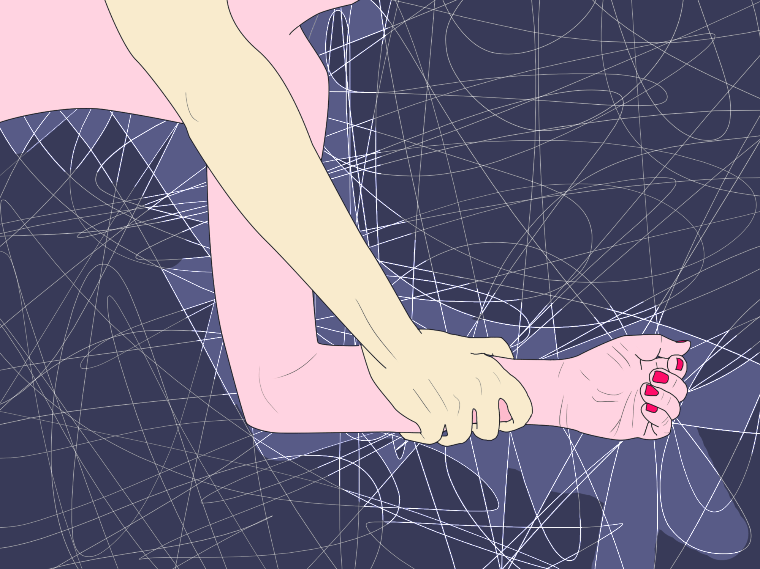
Why do people have fantasies?
They can induce or increase sexual arousal.
They provide a safe environment to have thoughts that bring excitement, but are not really appropriate to try out.
They can relieve internal tension or need in a relatively painless way.
They allow young or inexperienced people to fantasize about the upcoming sexual experience and to try what it will be like, to anticipate difficulties, to “practice in imagination”.
But when does fantasizing become a problem?
When it becomes obsessive and interferes with your thinking or behaviour.

Slide 13
If your fantasy is appropriate to try it out in real life (if it does not endanger anyone else or it is not illegal), and you want to try it, you can propose it to your partner if you feel comfortable - for some people it is very fulfilling, but some people get disappointed because it does not turn out the way they expected - in real life there are many things that can go wrong, especially if another person is involved.
It is common that people draw inspiration for their fantasies from pornografic movies - and that is completely fine!
But it is important to be aware that porn is not a true representation of what sex looks like in real life!

Slide 14
Porn

Slide 15
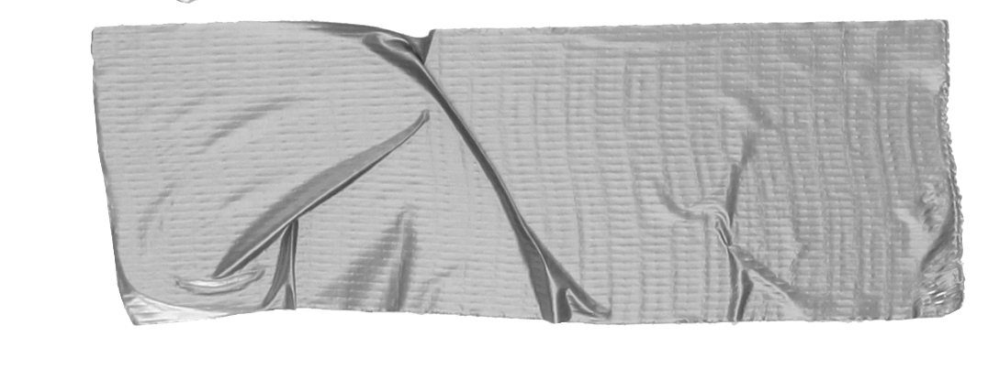
The Debate: Porn
There is no denying that Porn is a prevalent part of our culture nowadays. Many young people watch porn to stimulate sexual arousal or simply out of curiosity.
It is a $13billion-a-year industry in the US. Nine out of 10 boys in America are exposed to it before the age of 18, and men are 543% more likely to be users than women.
For some people it is a driver towards sexual liberation and empowerment and more open attitudes towards sex and sexuality.
For others, it is problematic. It encourages the objectification of women and normalises unsafe, painful and unrealistic forms of sex where real life human feelings aren’t accounted for.

Slide 16
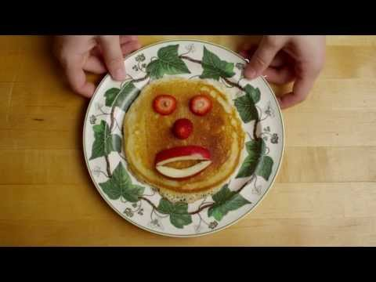
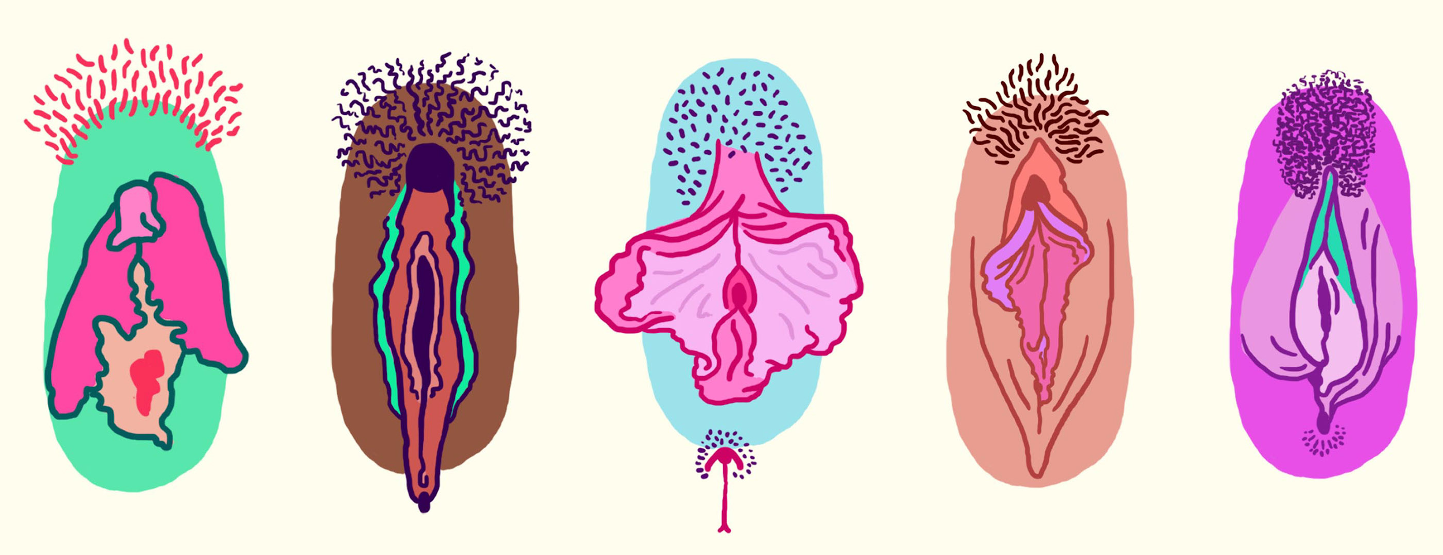
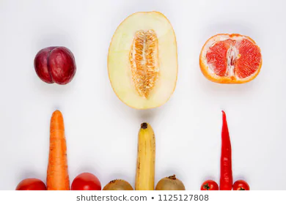
REALITY
FANTASY (PORN)
Penises and Vaginas come in all different shapes and sizes, there is no normal or standard. Some people have pubic hair and some people choose to shave or wax. As for breasts and general bodysizes, we are completely unique- there is no standard shape or size!
Pornos often project unrealistic ideals of genitalia and appearances. Penis size varies, as does a woman’s breast size and labia. Actors are usually what society deems as sexually attractive with model genitals that have no pubic hair.
Tip

Slide 17
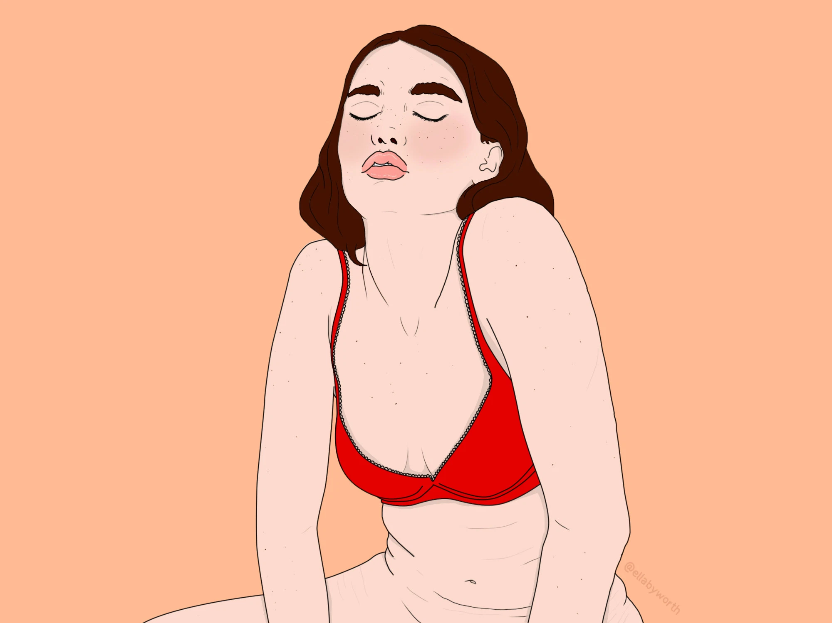
REALITY
FANTASY (PORN)
Sex should be centred around mutual consensual pleasure. Both parties should be able to have a say in how the experience goes. It is often more difficult for a woman to climax and orgasm as it often involves clitoral stimulation. The people involved can express pleasure in any way they wish and can carry out any sexual desires they want IF they are consented to without any pressure or coercion.
Porn often shows the woman in a subservient position to the man. The woman normally reaches climax, simply through penetration. She is shown to enjoy the sex by having theatrical moans and cries. Often men ejaculate on the woman as if she is an object. In reality, women often feel they should live up to this fake performance.
Tip

Slide 18
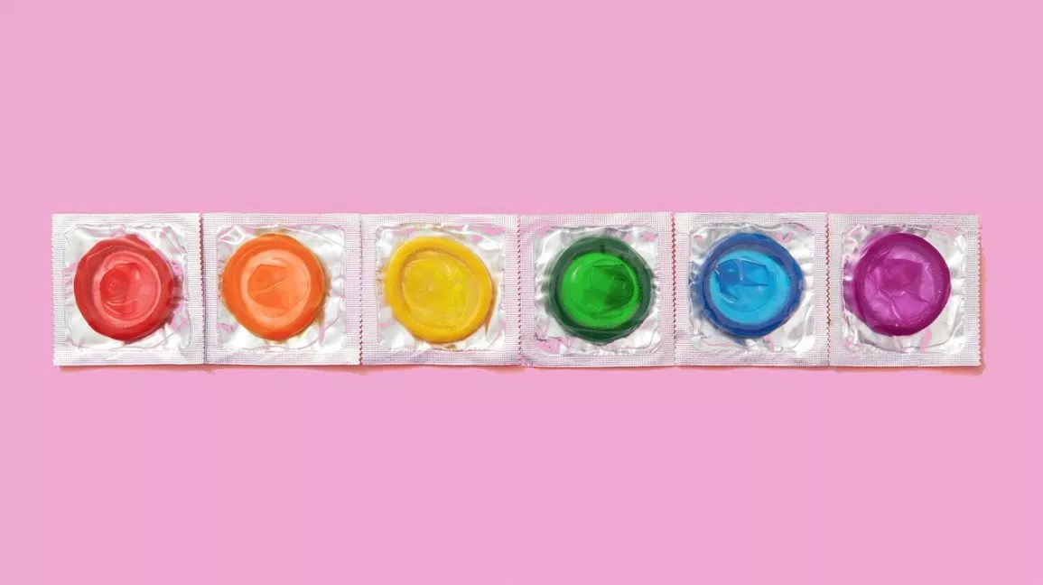
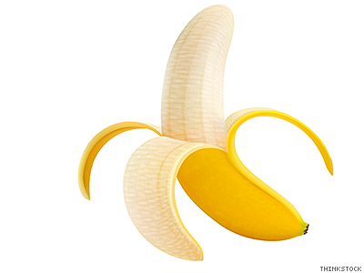
REALITY
FANTASY (PORN)
Condoms must be used to protect from STIs .
In porn, condoms are not used.
Tip

Slide 19
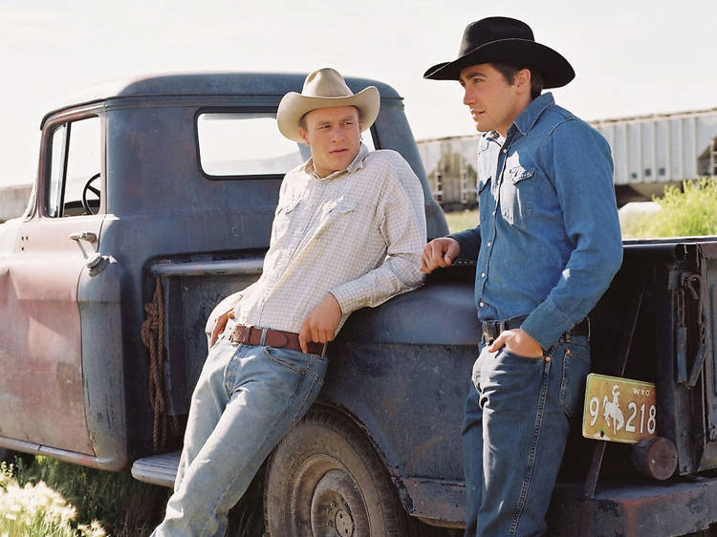
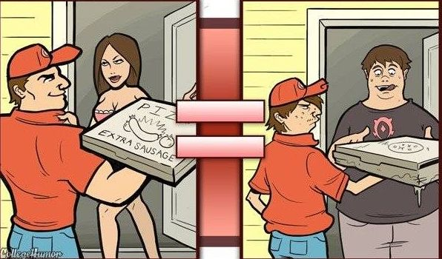
REALITY
FANTASY (PORN)
Sex isn’t always like in the movies. There can be pauses, it may not always be ‘smooth’, you might wish to stop, it might not look ‘pretty’.
The fantasy projected by porn is always ‘perfect’. Everything is planned and scripted for the viewer, it is not a true representation of sex.
Tip

Slide 20
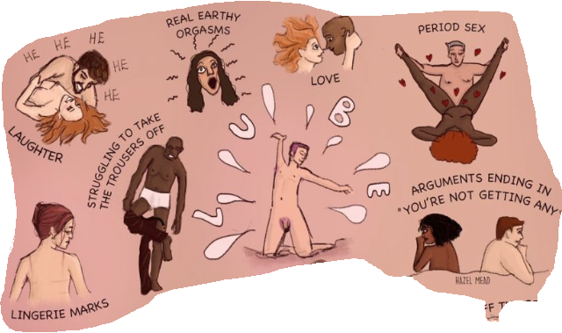
Things you don’t see in mainstream porn...
@hazel.mead

Slide 21
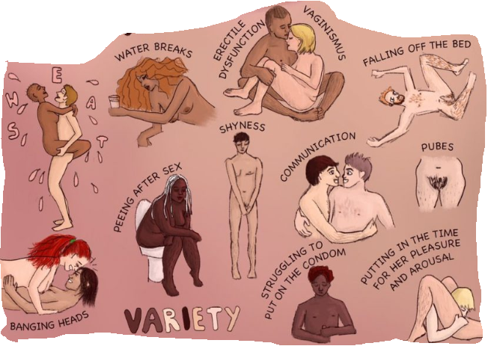
Things you don’t see in mainstream porn...

Slide 22
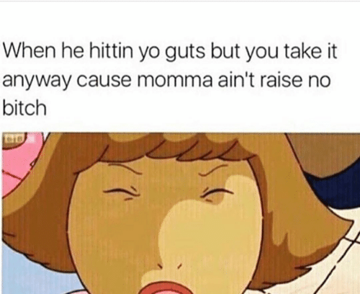
Why are these memes problematic?

Slide 23
Words adapted from @lalalaletmeexplain’s instagram
These memes show females enduring painful sex as if it is an obligation.
If you are a female and enjoy painful sex, that is fine.
However, many females actually tolerate this pain that they don’t enjoy because they believe saying no makes them look undesirable.
Many women are subjected to sex that men have seen in porn. Porn isn’t all bad, BUT, the majority of free porn is degrading towards women and even violent.
Notes:
If you love having your cervix bashed up, this post is not for you. This post is for people who have tolerated painful sex that they didn't enjoy because they believed that saying stop would make them look stupid, or undesirable. ⁣
⁣
It's sadly a pretty common problem among young women who are subjected to sex that men have seen in porn. Porn isn't all bad, but the vast majority of accessible free porn shows very little depiction of female pleasure or real orgasms, whilst showing a lot of violence towards, and degradation of women. Some men are emulating violent porn style sex with women because they believe that that's what we want, whereas some men engage in that because they enjoy hurting women and they couldn't give a shit about our pleasure.⁣
⁣
Consensual BDSM is one thing, again, that's not what this post is about. It's about sex where one party is suffering solely for the pleasure of the other and who feels unable to make it stop because they don't feel they have a choice.⁣
⁣
Sex isn't supposed to hurt and if it does then we must say stop. But there are barriers that can get in the way of easily being able to do that. We discuss this on my podcast with @wecantconsentto - women have to know that they have the right to say no and that if saying no puts a guy off then they have had a lucky escape. It can be hard to voice the fact that you aren't enjoying something, especially if you like the guy and you don't want him to think you're bad in bed - but if he's hurting you then he's the one whos bad in bed and he needs to know. If you're worried that he will turn nasty then you are with the wrong man and you need professional support to address this. If you're worried that you'll seem bad compared to all the other women that can take rough sex, or that you'll be called a prude then you need to learn to own that. Who cares what anyone else thinks of your sex style. The biggest motivation should always be pleasure and if you're with someone who doesn't give you that, who hurts you in bed, and who you are unable to communicate your feelings to then you need to look at why you are putting a not nice person above yourself. You deserve better

Slide 24
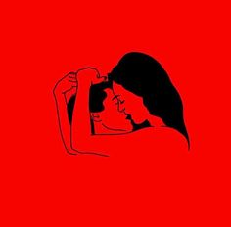
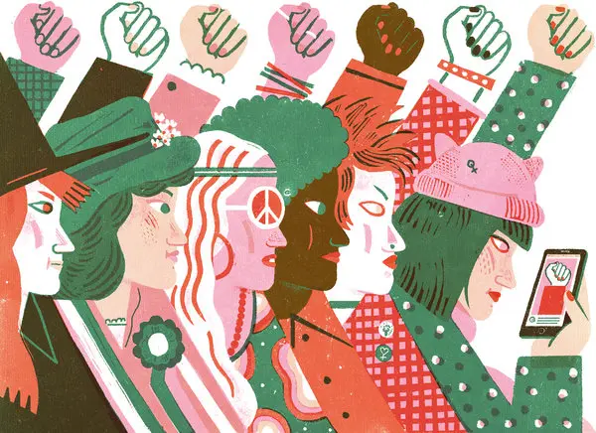
Men emulate what they see because they believe this ‘fantasy’ is what women want, and more worryingly, some men enjoy hurting women.
Women, and men, you have the right to SAY NO and to communicate what you like and don’t.
You are not a prude or worse than other women for not liking rough sex.
The biggest motivation should always be pleasure, if you are with someone who doesn’t give you that or hurts you in bed when you don’t want this, you deserve BETTER.
Notes:
If you love having your cervix bashed up, this post is not for you. This post is for people who have tolerated painful sex that they didn't enjoy because they believed that saying stop would make them look stupid, or undesirable. ⁣
⁣
It's sadly a pretty common problem among young women who are subjected to sex that men have seen in porn. Porn isn't all bad, but the vast majority of accessible free porn shows very little depiction of female pleasure or real orgasms, whilst showing a lot of violence towards, and degradation of women. Some men are emulating violent porn style sex with women because they believe that that's what we want, whereas some men engage in that because they enjoy hurting women and they couldn't give a shit about our pleasure.⁣
⁣
Consensual BDSM is one thing, again, that's not what this post is about. It's about sex where one party is suffering solely for the pleasure of the other and who feels unable to make it stop because they don't feel they have a choice.⁣
⁣
Sex isn't supposed to hurt and if it does then we must say stop. But there are barriers that can get in the way of easily being able to do that. We discuss this on my podcast with @wecantconsentto - women have to know that they have the right to say no and that if saying no puts a guy off then they have had a lucky escape. It can be hard to voice the fact that you aren't enjoying something, especially if you like the guy and you don't want him to think you're bad in bed - but if he's hurting you then he's the one whos bad in bed and he needs to know. If you're worried that he will turn nasty then you are with the wrong man and you need professional support to address this. If you're worried that you'll seem bad compared to all the other women that can take rough sex, or that you'll be called a prude then you need to learn to own that. Who cares what anyone else thinks of your sex style. The biggest motivation should always be pleasure and if you're with someone who doesn't give you that, who hurts you in bed, and who you are unable to communicate your feelings to then you need to look at why you are putting a not nice person above yourself. You deserve better

Slide 25
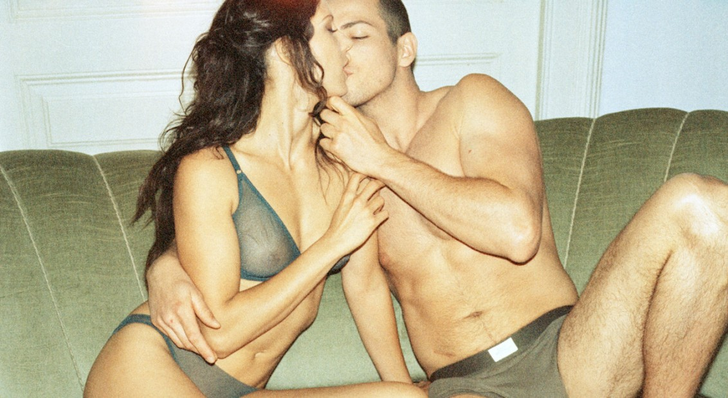
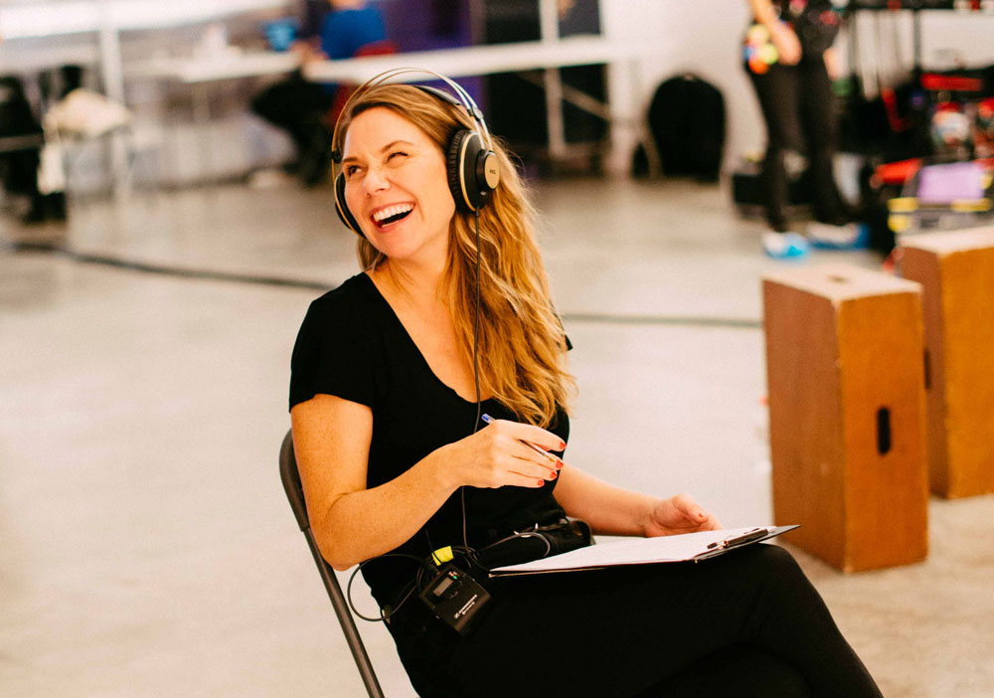
Erika Lust: feminist film maker changing the face of porn
Erika Lust creates adult, porn films from a female perspective that serve to empower women to embrace their sexual nature.
Her series XConfessions are inspired by her audience’s real life fantasies.
https://erikalust.com/about/.

Slide 26
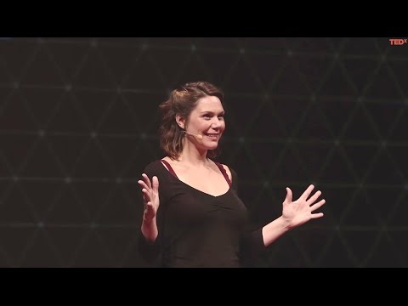

Slide 27
Common myths about sex

Slide 28
Myths about Sex
“Popping your cherry”
Aka breaking your hymen
Hymens tend to be a layer of thin tissue that surrounds the vaginal opening, with a hole in the centre.
Some people have thicker layers of tissue than others, and some have layers so small that it seems they have no hymen at all.
Having a broken hymen is not a sign that you are not a virgin. Many women’s have already broken due to physical activity, putting in a tampon or masturbation.
So, some women do bleed when losing their virginity, others do not.

Slide 29
Myths about Sex
“You can get an STI from a toilet seat”
You get STIs by having sex (vaginal, oral or anal) or by skin-to-skin touching--not from toilet seats.
“You can’t get an STI through oral sex”
During oral sex, you can give your partner your STI and you can get theirs. Not all STIs are transmitted through oral sex, but some are. For example, if your partner has a cold sore (oral herpes) and performs oral sex on you, you could become infected with herpes in your genital area.

Slide 30
Myths about Sex
“Blue balls is a medical condition”
FACT! But . . . not a serious one. The correct medical term for "blue balls" is vasocongestion. This happens when blood builds up in the testicles and/or prostate when a male gets aroused ("turned on") but doesn't ejaculate. It is often accompanied by a cramp-like ache and pain or tenderness in the groin area. While this can be uncomfortable, it is not a serious condition and is not an excuse to pressure a partner into sex. There are two ways to get rid of this problem--a guy can masturbate until he ejaculates, or just let the feelings of arousal go away on their own.It should be noted that girls can have the same pain and discomfort from getting aroused and not having an orgasm as well..

Slide 31
Safe Sex

Slide 32
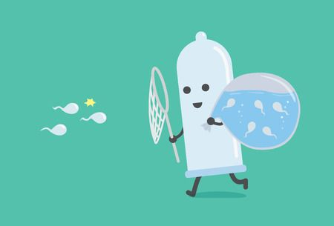
Safe sex
Can be related to
Contraception, sexually transmitted infections (STI)
Consent, how safe the situation is emotionally and physically
Safe sex makes sex more relaxed and fun when you don’t need to worry constantly
When you think of safe sex, you’ll most likely think of condoms - but it is good to remember, that being emotionally safe is just as important!

Slide 33
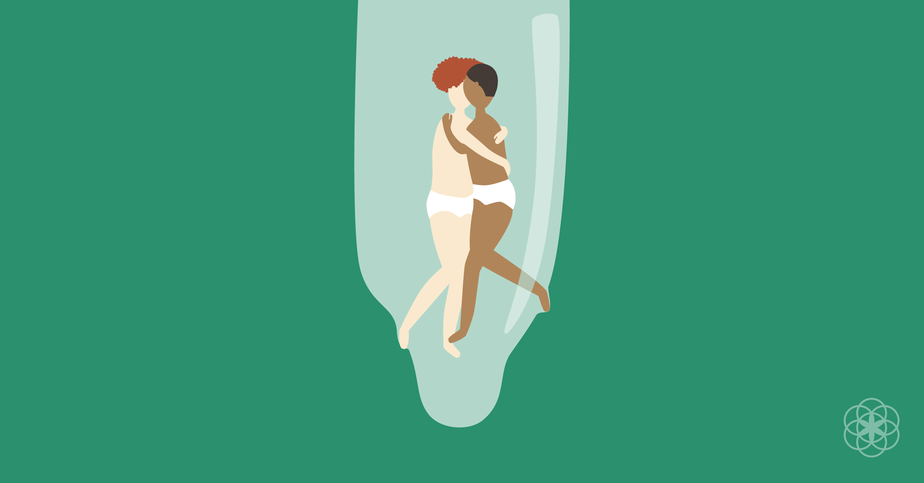
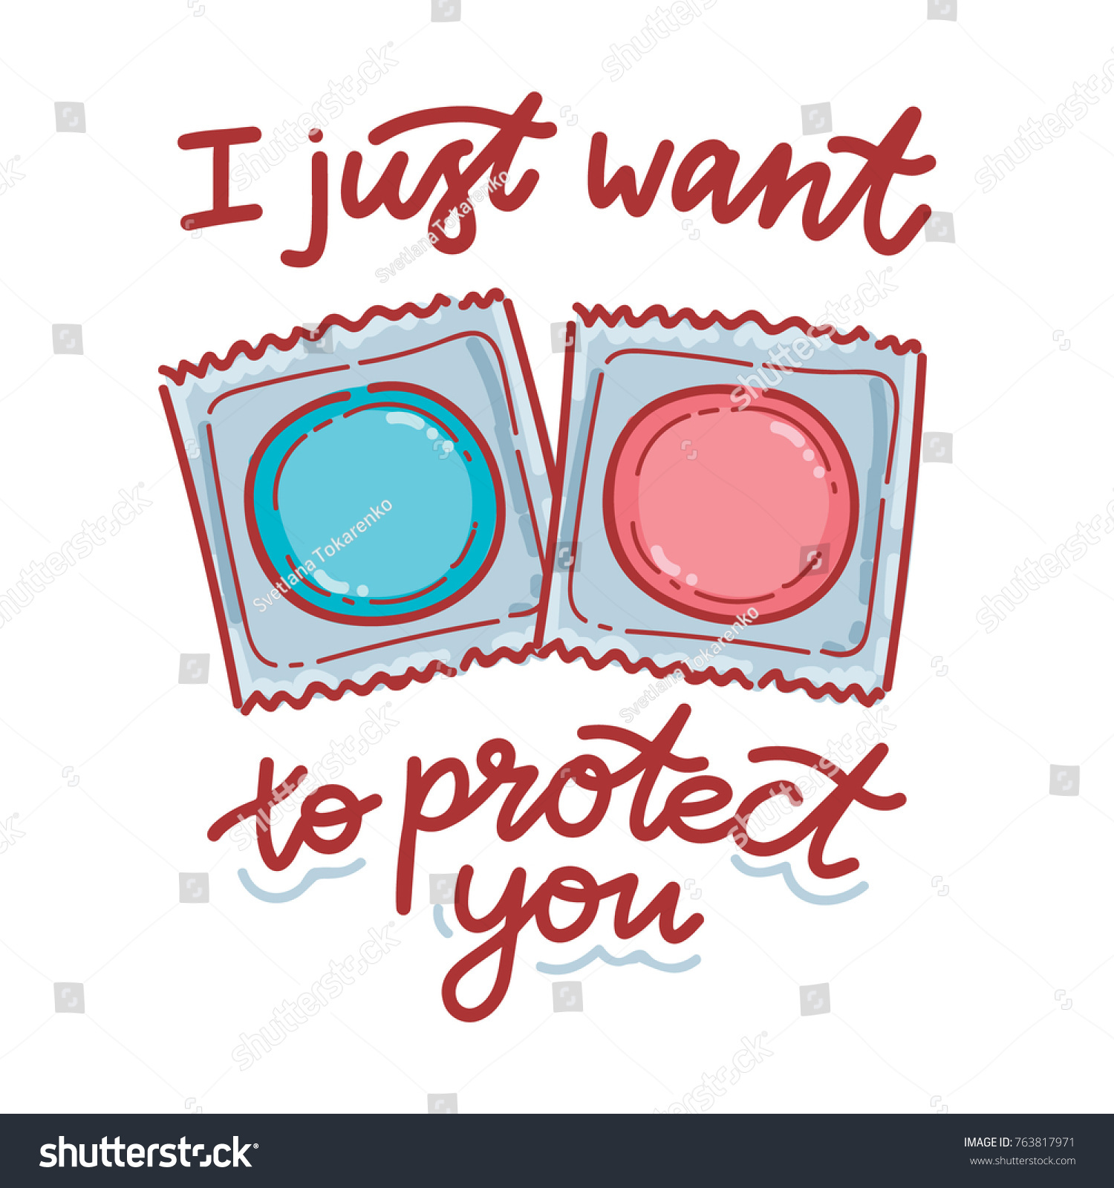
Contraception can be many things, such as condoms, vaginal rings, IUDs and pills. Talk to a medical professional before trying hormone altering options such as the contraceptive pill or vaginal ring.
In the next slides, the presentation will only focus on condoms, since they are easily available for everyone and are the only thing that will prevent unwanted pregnancy and sexually transmitted infections, when used correctly!
Remember, that everyone is responsible for their own sexual health, don’t count on your partner to use contraception!

Slide 34
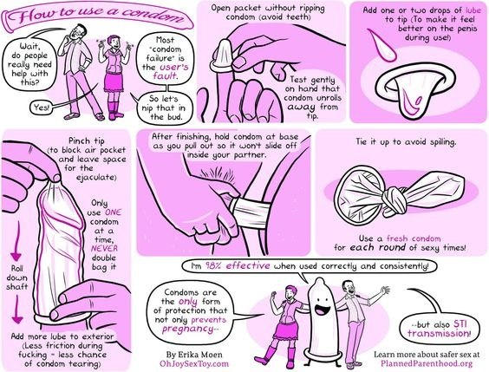
Using lubricant is optional, but if you use it, make sure that it is water or silicone based, not oil based (this may cause the condom to break more easily).
Check that the condom has not expired.
If you have a foreskin, pull it back before covering the head of the penis with the condom.
If you lose your erection the condom may slip. This is the biggest single cause of condom failure. Fingers held round the base of the condom will help it stay put.

Slide 36
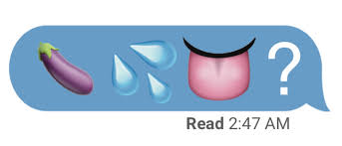
What is emotionally safe sex?
Sex should not leave you feeling bad, used, embarrassed or guilty
You should not feel like you’re afraid to say no or voice your desires in any way
Sex should not be motivated by feeling like you have to do it (through coercion or obligation)
Might sound boring, but it’s true: a key to a safe and enjoyable sex life is communication. Being able to tell your partner what you feel like, that you want use contraception or what you like and don’t like is really important.
Talking about sex may feel awkward at first, but the more you talk, the more natural it will start feeling.
Whether you are in a relationship or single, having sex should always come from a place where you feel safe.

Slide 37
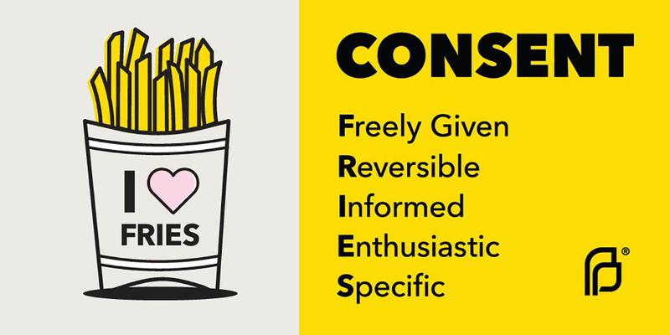
Sexual consent
→ Consent is part of emotionally safe sex. It is permission for something to happen.
→ Consent can be given verbally and nonverbally.
→ Saying yes to one thing doesn’t mean saying yes to everything.
Saying ‘maybe’ or ‘no’ is not yes - make sure that the answer is always yes, when proceeding with sexual activities.
Remember, you can change your mind at any time!

Slide 38
Consent can’t be given if...
Someone says ‘stop’ or ‘don’t’.
Someone is too drunk/high to give consent, if they seem too out of it.
Someone is tricked, for example taking the condom off without the other’s knowledge.
Someone is asleep or unconscious and unable to say yes.
Someone is being coerced - manipulated, threatened or pressured without force. (E.g. ‘If you really love me, you’d want to have sex with me’).

Slide 39
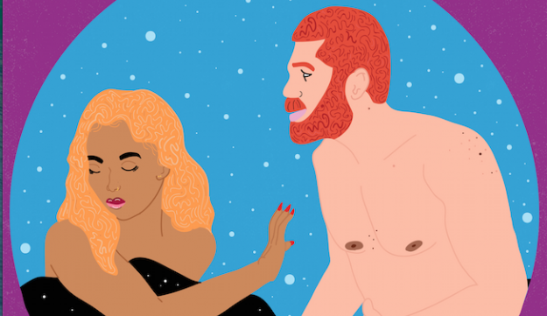
Saying ‘no’ and accepting ‘no’
There are a lot of reasons why someone might not feel ready or comfortable with sexual activities (for ex. spiritual reasons, upbringing, not feeling comfortable in your body, asexuality). All reasons are acceptable and normal - do what makes you feel comfortable and good, it is different for everyone!
Saying ‘no’ in sexual situations might make you feel guilty or feel bad, but in these situations, try to remember that it is completely ok and normal. Respect for your boundaries is what will make you feel safe and able to enjoy sex.
Accepting that someone is saying ‘no’ to you might cause feelings of anger, feeling hurt or rejected. This is normal and ok too, but it is never a justification to make your partner(s) feel guilty or pressure them to do something they don’t want to.

Slide 40
How to make safe sex fun?
Practice
If you have a penis, you can practice putting on a condom on our own and maybe masturbating with it - to make the connection of sexual arousal and pleasure to the condom.
Talk
Keep a sense of humour and have fun with sex! A little laughing might release the tension and make the whole sexual situation more comfortable - it doesn’t have to be serious.
Experiment
Exploring what your partner (or you on your own) really enjoy can be really exciting. Experiment with foreplay also! Figure out what really makes you get in the mood - candles, massaging, kissing - it can be anything!

Slide 41
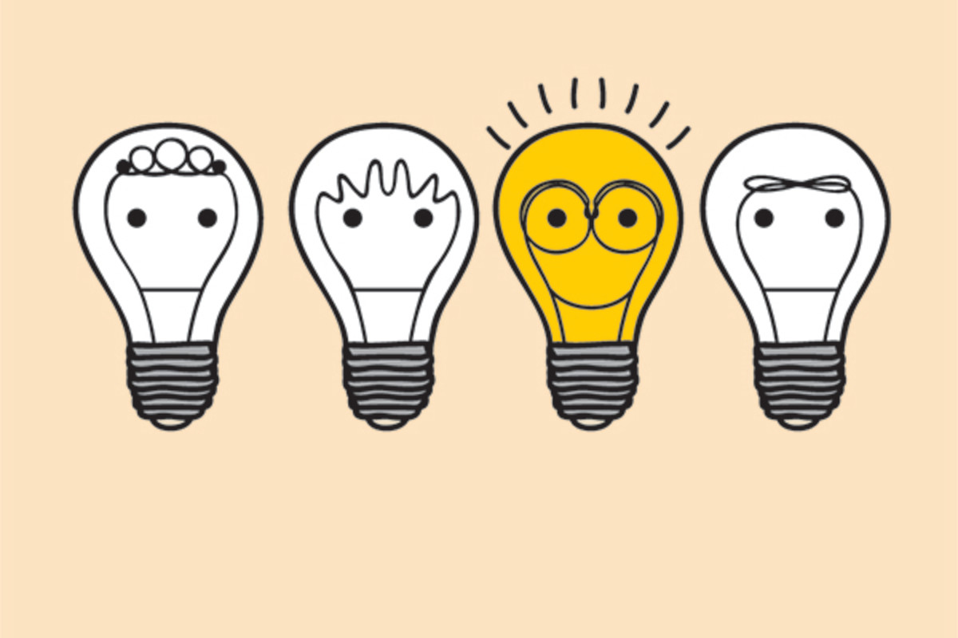
Websites to learn more:
http://teenhealthsource.com/topics/sex/ - Learn more about different sex-related topics!
https://playsafe.health.nsw.gov.au/ - Australian website with useful and educational content; contacts and services are not applicable for portuguese students
https://www.saudereprodutiva.dgs.pt/espaco-jovem.aspx?v=%3d%3dBQAAAB%2bLCAAAAAAABABLLiiwNQQAyHpIHAUAAAA%3d - Programa Nacional de Saúde Reprodutiva - Direção-Geral de Saúde
https://acesportoocidental.org/public/Text.php?section_id=74&text_id=73 - where to get tested for HIV in Porto http://abraco.pt/o-que-fazemos/teste-vih/# - where to get tested for HIV in Porto

Slide 42
Sources of the illustrations in this presentation:
https://misul-do.com/filter/sexuality/Illustration-about-Female-Sexuality-for-Kurnik-Magazine
https://www.cosmopolitan.co.za/politics/knowyourrights/withdraw-consent-during-sex/
https://www.behance.net/gallery/74259373/Sexuality-illustrations
https://noasnir.com/how-you-see-me
https://www.behance.net/agiuliannalira
https://www.taarikajohn.com/editorial.html
https://metro.co.uk/2017/11/29/why-do-half-of-women-have-fantasies-about-being-raped-7099630/
https://www.rappler.com/science-nature/ideas/science-solitaire/241204-science-sexuality-complicated
https://www.pinterest.es/pin/740912576183582719/
https://www.thevulvagallery.com/anatomy
https://www.everydayhealth.com/hs/hepatitis-c-understanding/safe-sex/
https://www.brittany-england.com/
https://www.abc.net.au/life/what-to-do-when-you-and-your-partner-like-different-kinds-of-sex/11390520

Slide 43
Presentation created by Utopia500 Team
Lydia Patrick, Anna Rikama & Hana Radovanović
UIDB/04097/2020

