Slide 1
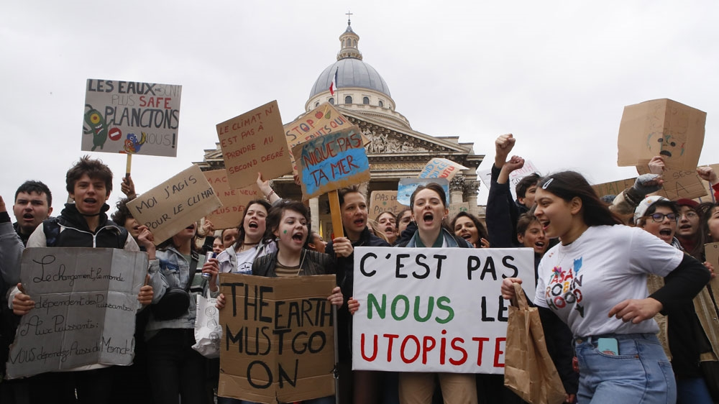
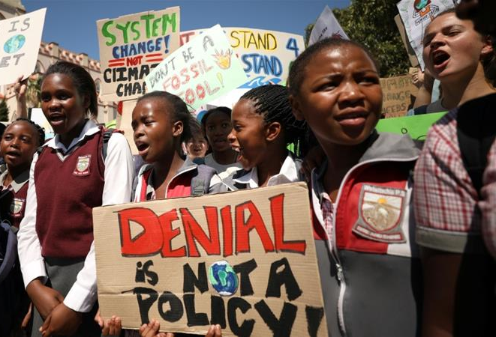
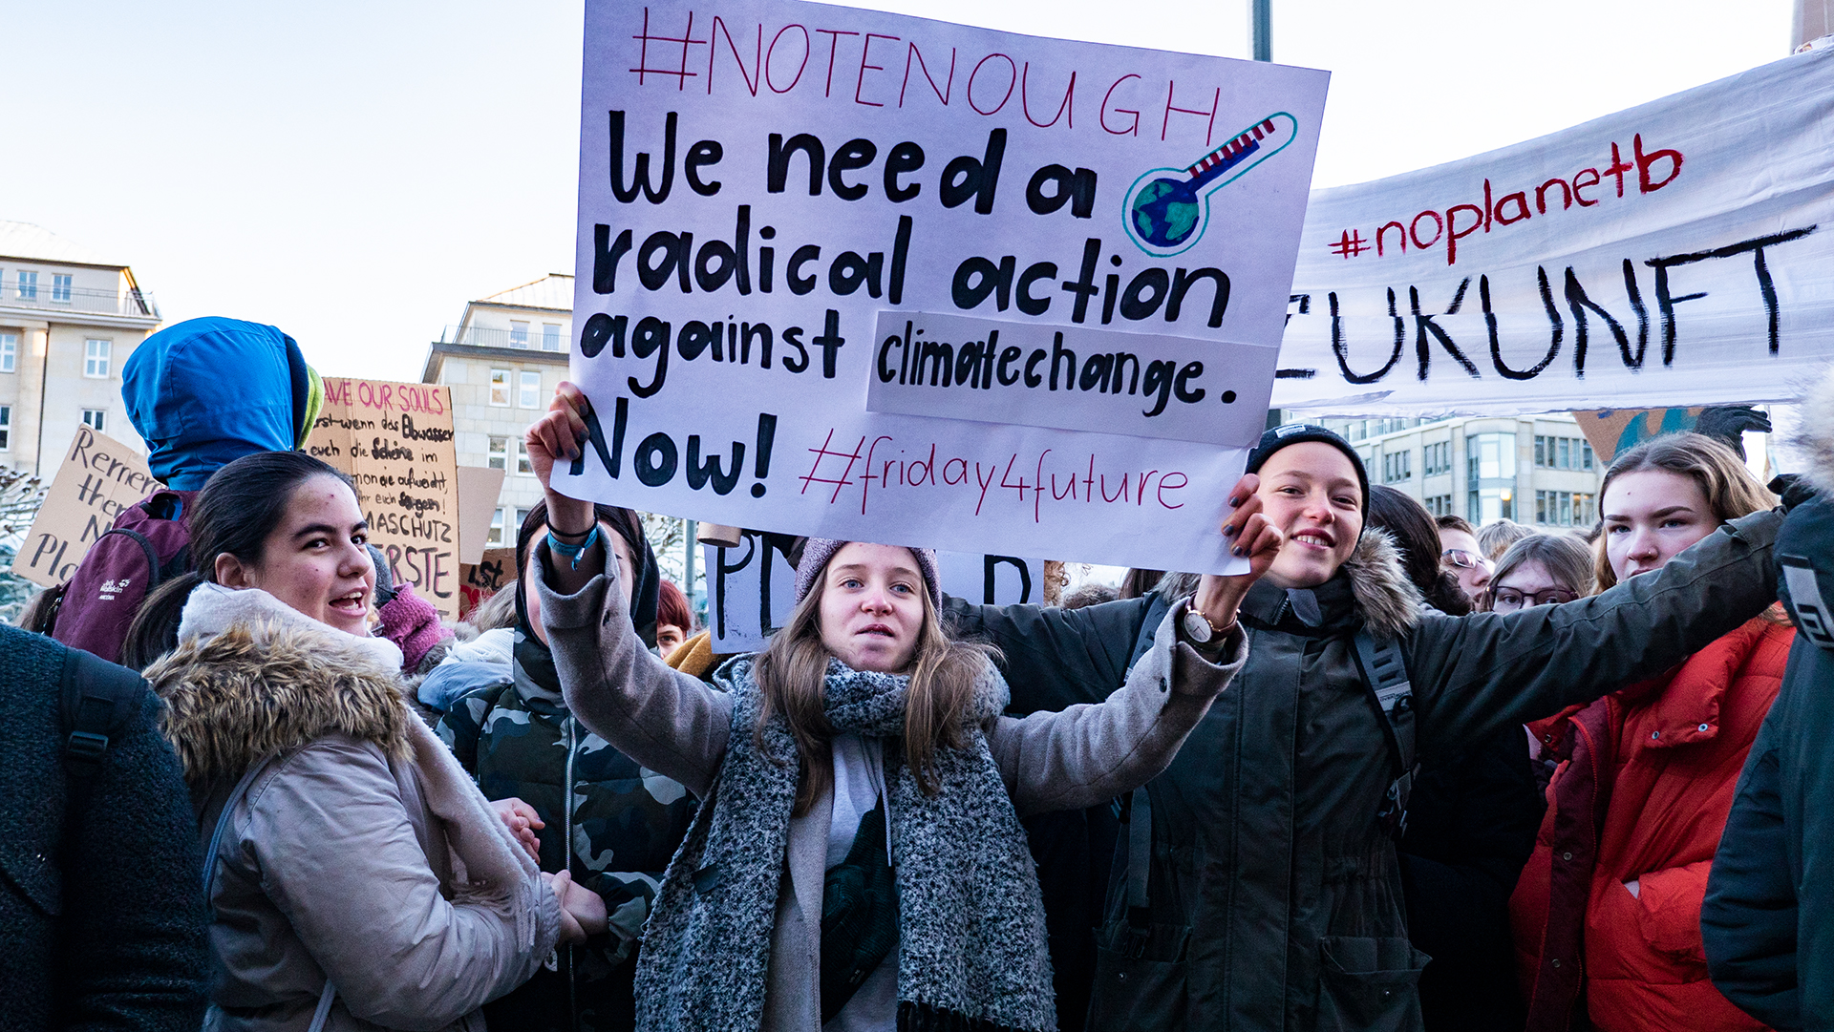
WHY AND HOW TO GET ACTIVE AGAINST CLIMATE CHANGE
Eco-Activism

Slide 2
WHAT IS CLIMATE CHANGE ?
WHO IS EFFECTED?
HOW TO GET ACTIVE?

Slide 3
WHAT IS CLIMATE CHANGE?
https://climate.nasa.gov/climate_resources/25/interactive-climate-time-machine/

Slide 4
C02 EMISSIONS

Slide 5
WHO IS EFFECTED?
BANGLADESH

Slide 6
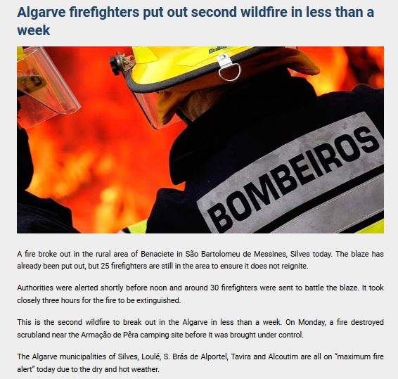
PORTUGAL
Coast line (tourism)
Sea level rising
Changed sea life
Forest fires
Violent storms
Extension of summer season

Slide 7
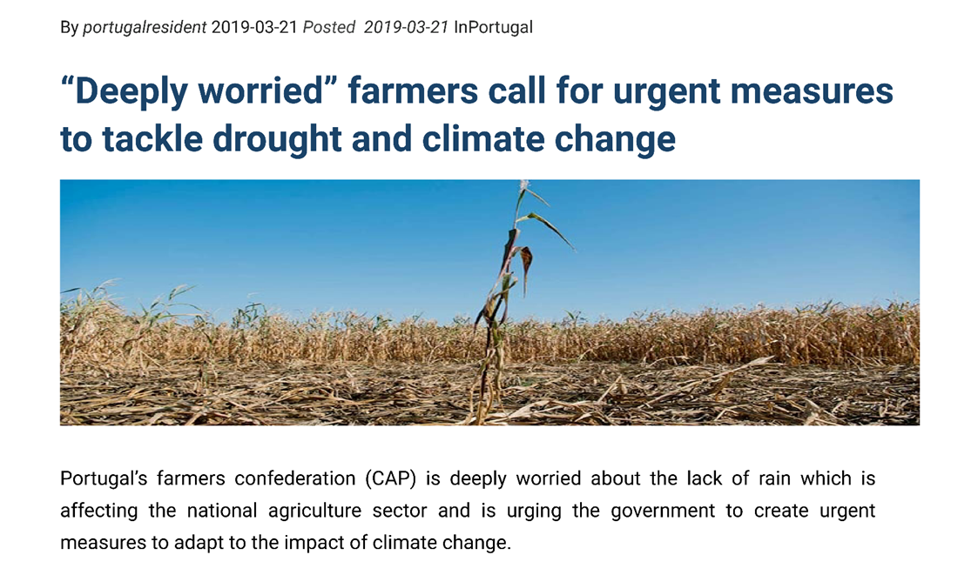
AGRICULTURE
Wine industry
Earlier harvest
Changed aroma and color
Decreased wine quality
Wine corks
https://www.youtube.com/watch?v=y70hmLsyvDE

Slide 8
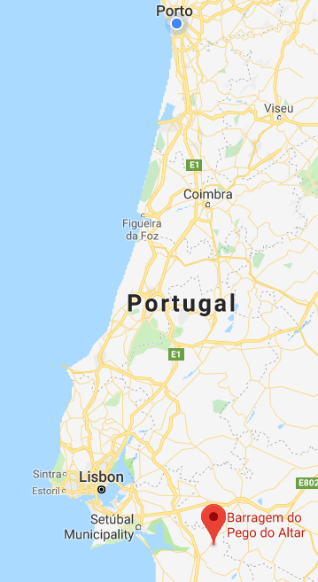
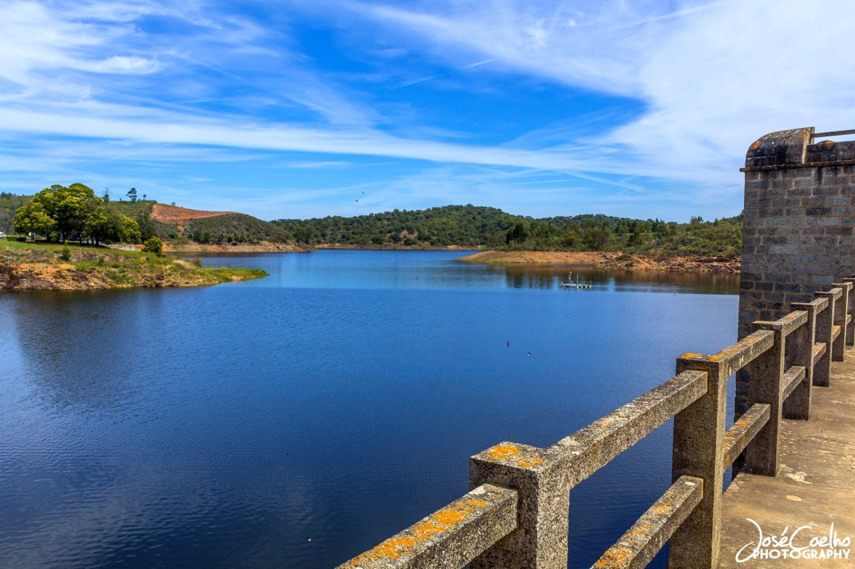
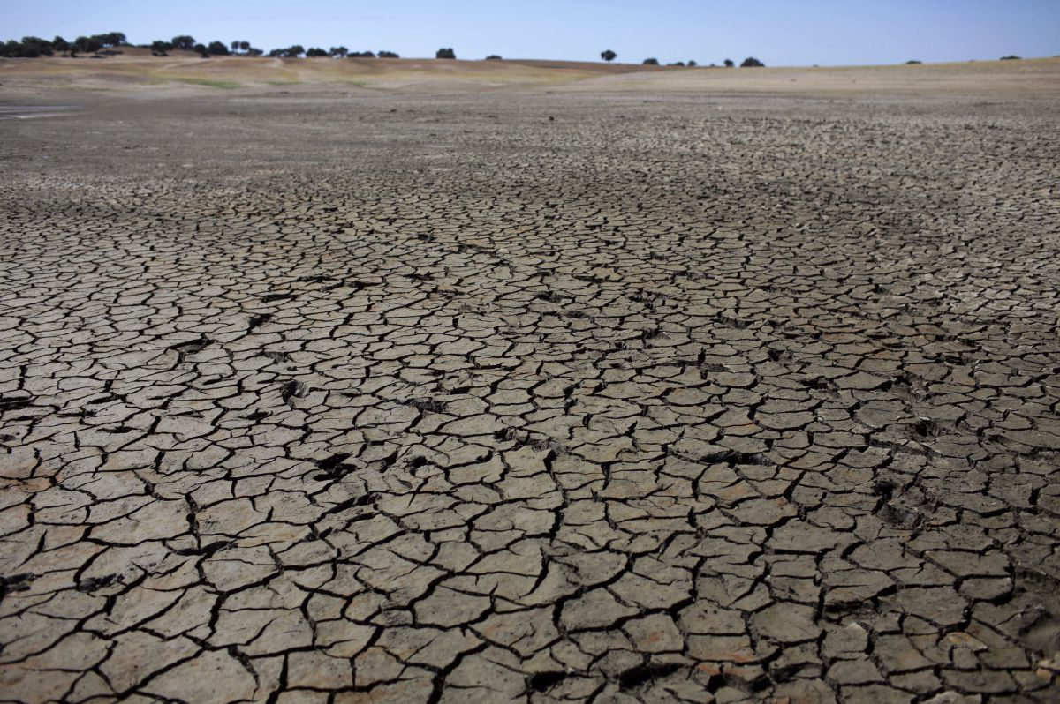
DROUGHT
Pego do Altar reservoir
(2017.-after the drought)

Slide 9
WHAT CAN BE DONE?

Slide 10
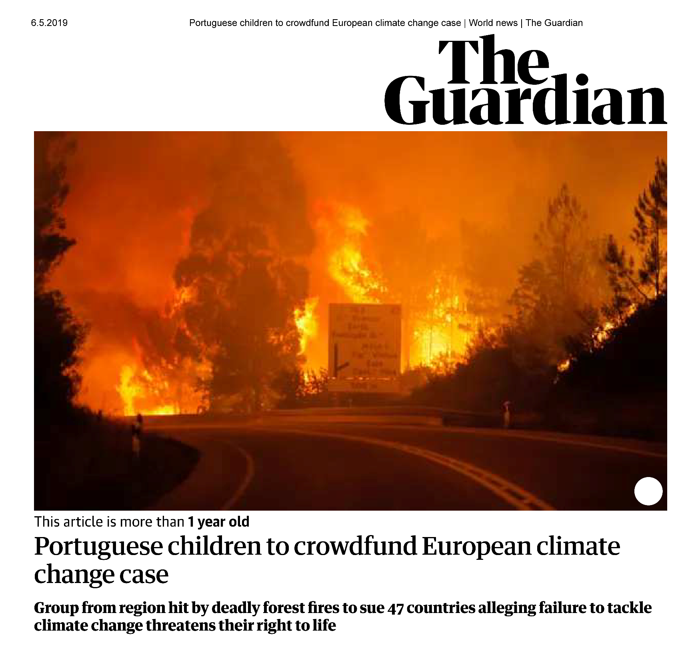
WHAT CAN BE DONE?

Slide 11
WHAT CAN BE DONE?

Slide 12
GROUPS

Slide 13
GROUPS

Slide 14
INDIVIDUALS THAT MADE A CHANGE
Jeanny Yao and Miranda Wang developed bacteria capable of transforming plastic into CO2 and water
The technology is used in two ways: To clean the beaches and also to produce raw materials for clothing
Javier Fernández-Han developed algae-powered energy system that combines a dozen new and existing technologies to treat waste, produce methane and bio-oil for fuel, produce food for humans and livestock, sequester greenhouse gases, and produce oxygen

Slide 15
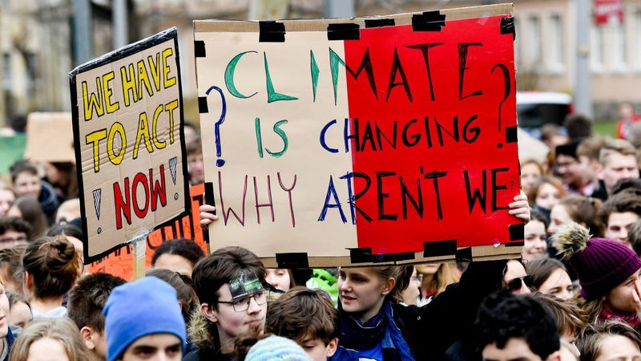
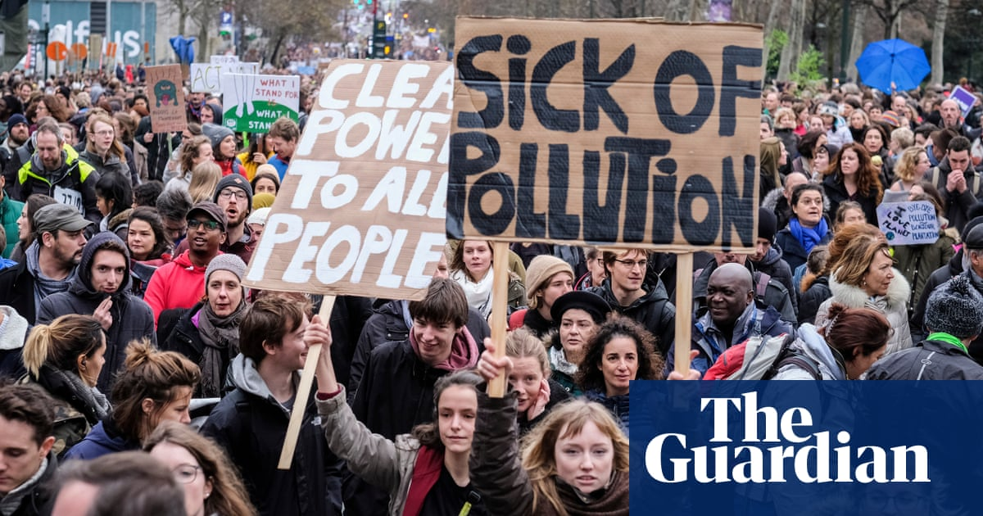
SOCIAL AND POLITICAL PRESSURE ON COMPANIES

Slide 16
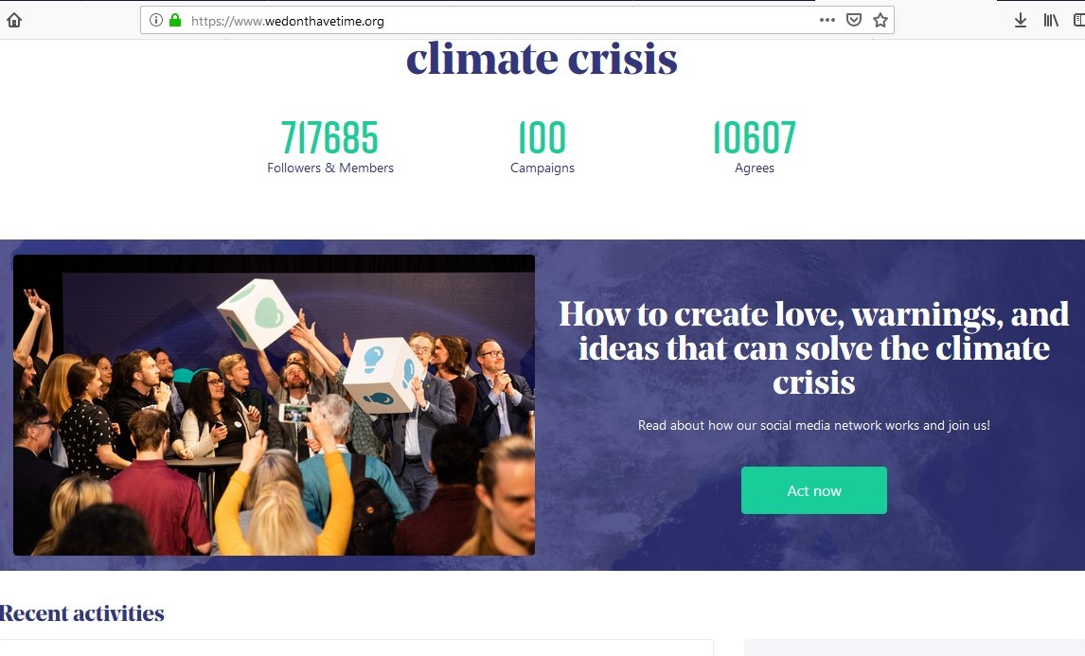
https://www.wedonthavetime.org/

Slide 17
THANK YOU!
UTOPIA 500 TEAM:
MIGUEL OHNESORGE
ISABEL RELVAS
EMILY STOTT
NINA LICUL
ANTONIJA SAMARŽIJA

