Slide 1
SUSTAINABILITY AND SUSTAINABLE TOURISM
Made by the Utopia 500 team:
Hermine Schwalbe
Polina Kireva
Timea Varga

Slide 2
SUSTAINABILITY
ENGLISH
Sustainability = to sustain (maintain, support, endure) + ability
LATIN
Sustinere = tenere (to hold)
sub (under)

Slide 3
DEFINITIONS
Sustainability is defined as a requirement of our generation to manage the resource base such that the average quality of life that we ensure ourselves can potentially be shared by all future generations. ... Development is sustainable if it involves a non-decreasing average quality of life.
[Geir B. Asheim, Sustainability, The World Bank, 1994]

Slide 4
DEFINITIONS
"Sustainability is something everyone can work towards... whether it is picking up garbage you see on the street or boycotting a company that practices environmentally harmful business methods, we all can make a difference. "
[UN Decade of Education for Sustainable Development 2005–2014]

Slide 5
DEFINITIONS
"A sustainable future is one in which a healthy environment, economic prosperity and social justice are pursued simultaneously to ensure the well-being and quality of life of present and future generations. Education is crucial to attaining that future."
[Learning for a Sustainable Future - Teacher Centre]

Slide 6
DEFINITIONS
"The first and perhaps most difficult problem, one that seldom gets addressed, is the time frame…Is a sustainable society one that endures for a decade, a human lifetime, or a thousand years?"
[Donald Worster: The Shaky Ground of Sustainable Development in Global Ecology, 1993]

Slide 7
3 PILLARS
The Future Generations

Slide 8
9 BOUNDARIES
climate change
biosphere integrity
stratospheric ozone depletion
freshwater use
ocean acidification
biogeochemical flows (of N, P)
landscape change
introduction of novel entities

Slide 9
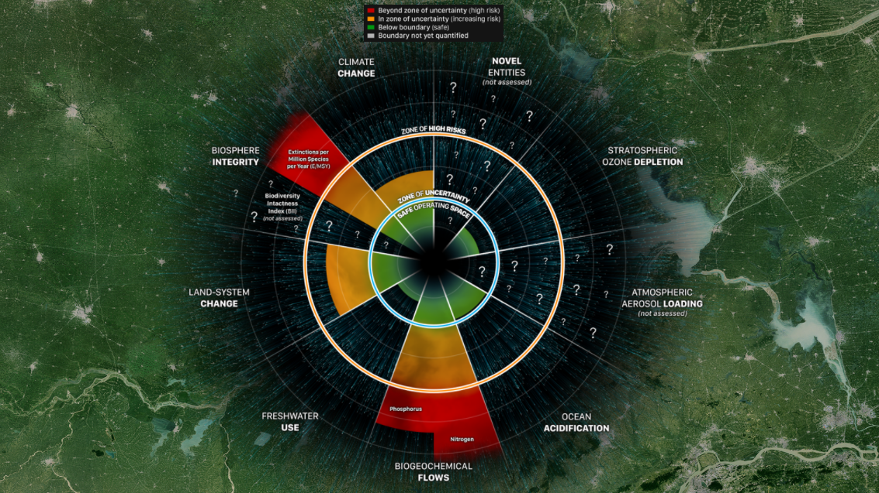
9 BOUNDARIES
climate change
biosphere integrity
stratospheric ozone depletion
freshwater use
ocean acidification
biogeochemical flows (of N, P)
land system change
introduction of novel entities

Slide 10
The BALANCE Game
Show us by using your body...
What is to be in BALANCE?

Slide 11
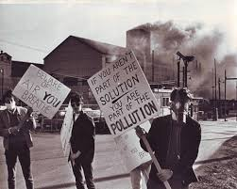
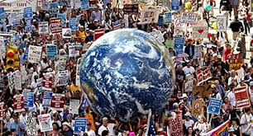
ENVIRONMENTALISM
... Is a social movement that seeks to influence the political process by lobbying, activism and education in order to protect natural resources and ecosystems;
Hand in hand with sustainability science!

Slide 12
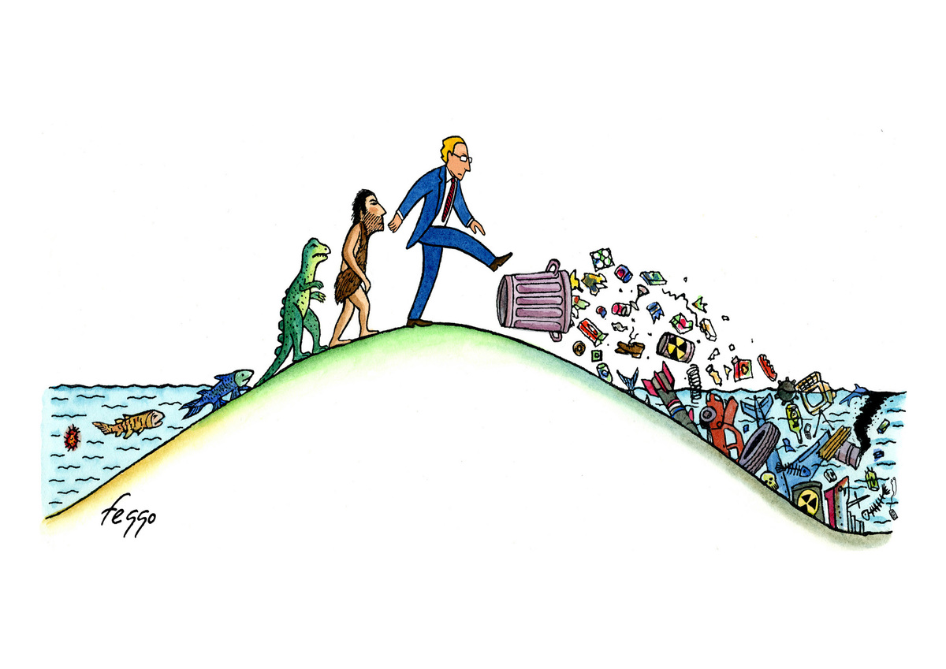
Evolution ?

Slide 14
EARTH DAY: 22 April
It all started on 22 April 1970 when about 20 million Americans took to the streets, parks, and auditoriums to demonstrate for a healthy and sustainable environment in massive demonstrations all over the country;
In 1990 Earth Day went global, mobilizing over 200 million people in 141 countries and lifting environmental issues onto the world stage.

Slide 15
New York City on the first Earth Day in 1970. © Corbis/Bettmann
Earth Day at the Capitol, Washington, D.C., April 22, 1990. © Todd Gipstein/Corbis

Slide 16
EARTH SUMMIT RIO 1992
In 1992 in Rio de Janeiro took place the United Nations Earth Summit;
It acknowledged for the first time the existence of human-induced climate change and gave industrialised countries the major part of responsibility for combating it.

Slide 17
More than 400,000 people turned out for the People’s Climate March in New York City on September 21, 2014 along with a series of companion actions worldwide, just days before many of the world’s leaders were expected to debate environmental action at the United Nations climate summit.

Slide 18
KYOTO PROTOCOL
The Kyoto protocol was the first agreement between nations to mandate country-by-country reductions in greenhouse gas emissions (like CO₂, CH₄, and N₂O).
The treaty was signed in 1997, in Kyoto, Japan, after and it went into force in 2005.
Under Kyoto, industrialised nations have to cut their yearly emissions of carbon (reduce the carbon footprint).

Slide 19
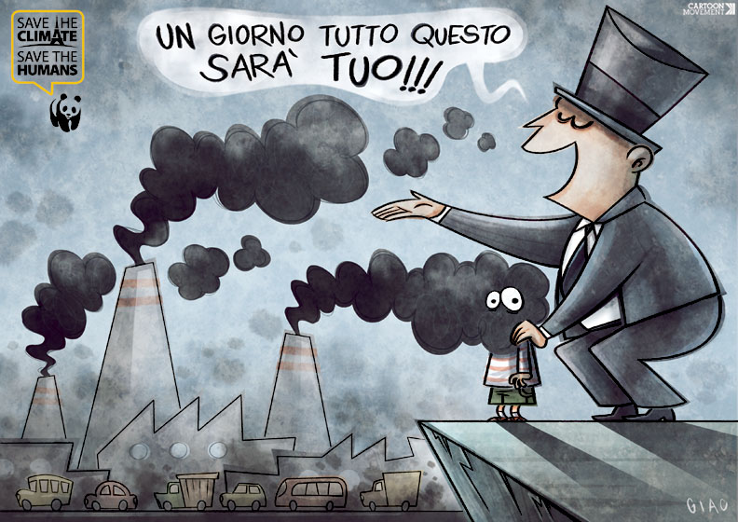
( ONE DAY ALL THIS WILL BE YOURS… )

Slide 20
PARIS 2015
In December 2015 for the first time after 23 years of international negotiations such an agreement is reached.
Paris climate agreement is signed and adopted by 195 countries (are all of the UN member states).
For the first time USA and China officially oblige themselves to cut their emissions.

Slide 23
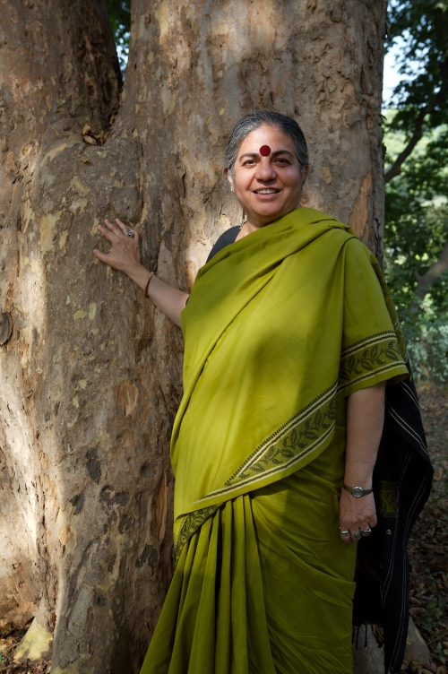
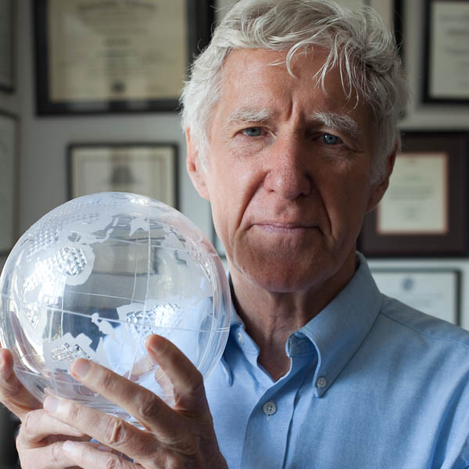
Environmentalists 20th c.

Slide 24
Rachel Carson
"There is no drop of water in the ocean, not even in the deepest part of the abyss, that does not know and respond to the mysterious forces that create the tide." /The Sea Around Us, 1951/
Books:
Under the Sea Wind, 1941;
The Sea Around Us (O Mar Que Nos Cerca), 1951;
Silent Spring, 1962.

Slide 25
Lester Russel Brown
«In Mexico City, Tehran, Kolkata, Bangkok, Shanghai, and hundreds of other cities, the air is no longer safe to breathe. In some cities, the air is so polluted that breathing is equivalent to smoking two packs of cigarettes per day.» /Plan B 3.0/

Slide 26
Vandana Shiva
Biospiracy (Biopirataria): The Plunder of Nature and Knowledge (1997),
Stolen Harvest: The Hijacking of the Global Food Supply (1999),
Earth Democracy: Justice, Sustainability and Peace (2007).

Slide 27
Dr. Andrew Manning
Born and raised in New Zealand;
2001 PhD in Oceanography (USA);
Invented the world’s first continous, high precision atmospheric O₂ analyzer;
2006 moved to England;
Established the ‘Carbon Related Atmospheric Measurement’ Laboratory at University of East Anglia;
Leader of the International atmospheric O_{2 intercomparison programme.}

Slide 28
S U S T A I N A B I L I T Y
…the Ability to Sustain Life on Earth…
for the benefit of both:
present + future generations

Slide 29
SUSTAINABLE TOURISM

Slide 30
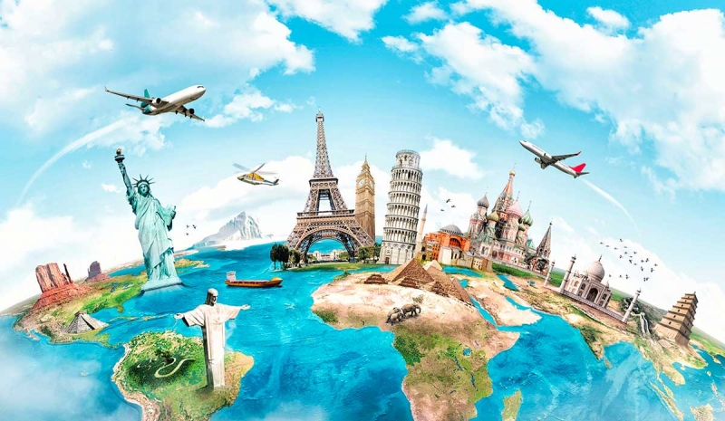
"Tourism will never be completely sustainable as every industry has impacts, but it can work towards becoming more sustainable.”

Slide 31
DID YOU KNOW...?
By 2030 there will be 1.8 billion tourists/year
Since 1970 1/3 of the natural world has been destroyed by human activity
Luxury hotel room: 1800 l person/night
Average Portuguese household: 500 l per day

Slide 32
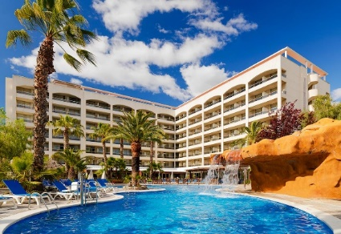
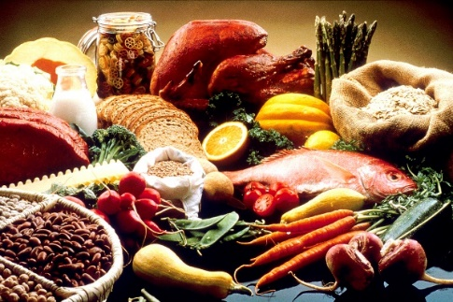
PROBLEMS
Impact of tourism:
on natural resources
on social systems
It involves: transportation, accommodation, entertainment, recreation, shopping, food.

Slide 33
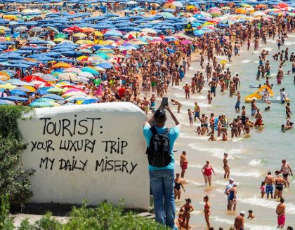
PROBLEMS
Damaging the environment – especially coastal areas.
Flying alone accounts for 75% of tourism’s climate impact.
Loss of cultural heritage.
Economic dependence.
Growing demand: over 1 billion international tourists.

Slide 34
OVERTOURISM

Slide 35
OVERTOURISM
It occurs when there are too many visitors to a particular destination;
Rent prices push out local tenants;
Roads become jammed with tourist vehicles;
Wildlife is scared away;
Tourists cannot view landmarks because of crowds;
Fragile environments become degraded.

Slide 36
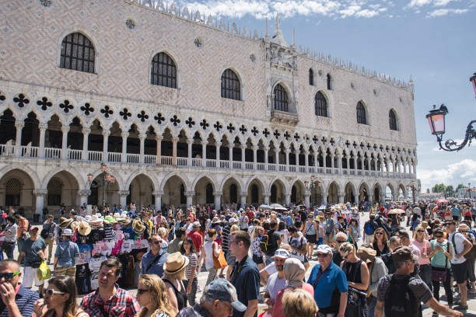
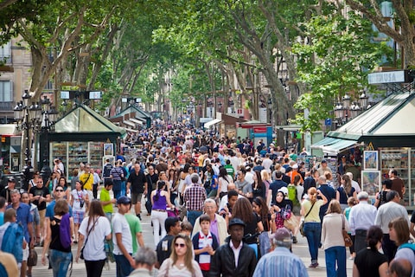
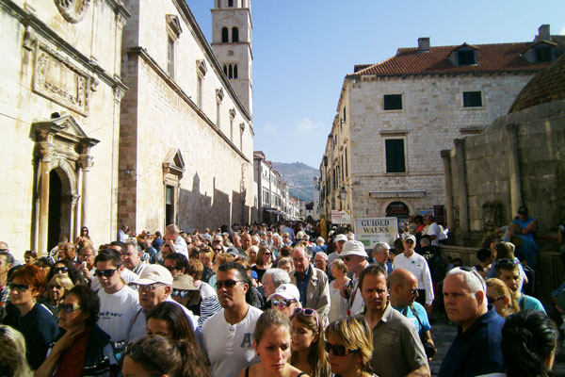
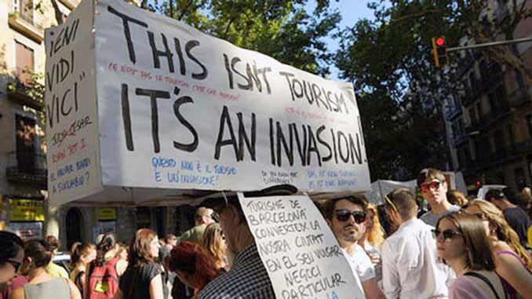
Venice
Dubrovnik
Barcelona

Slide 37
Tourists per resident:
Porto: 8
London: 4
Barcelona: 5
Lisbon: 9
228 tourist per square kilometer
1,6 million tourist per year
PORTO

Slide 38
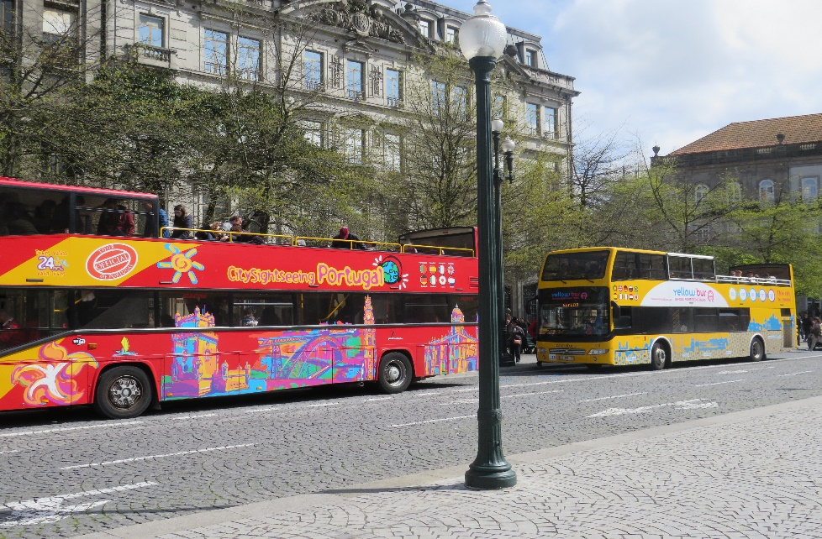
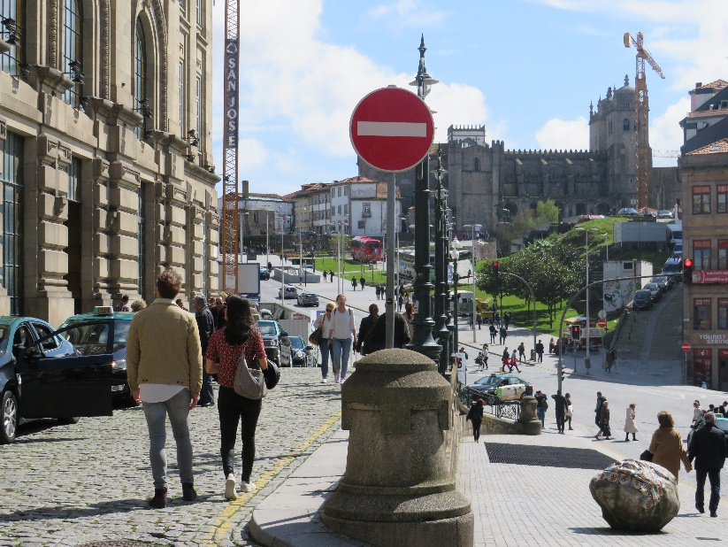
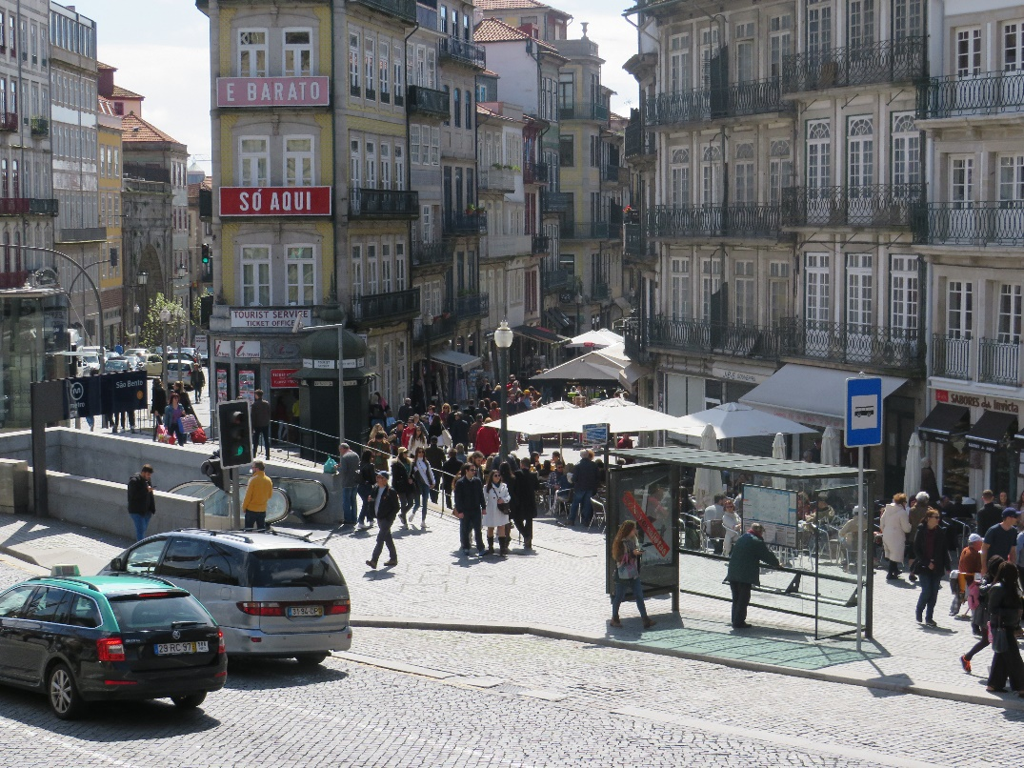
Porto, 14 April, Saturday afternoon

Slide 39
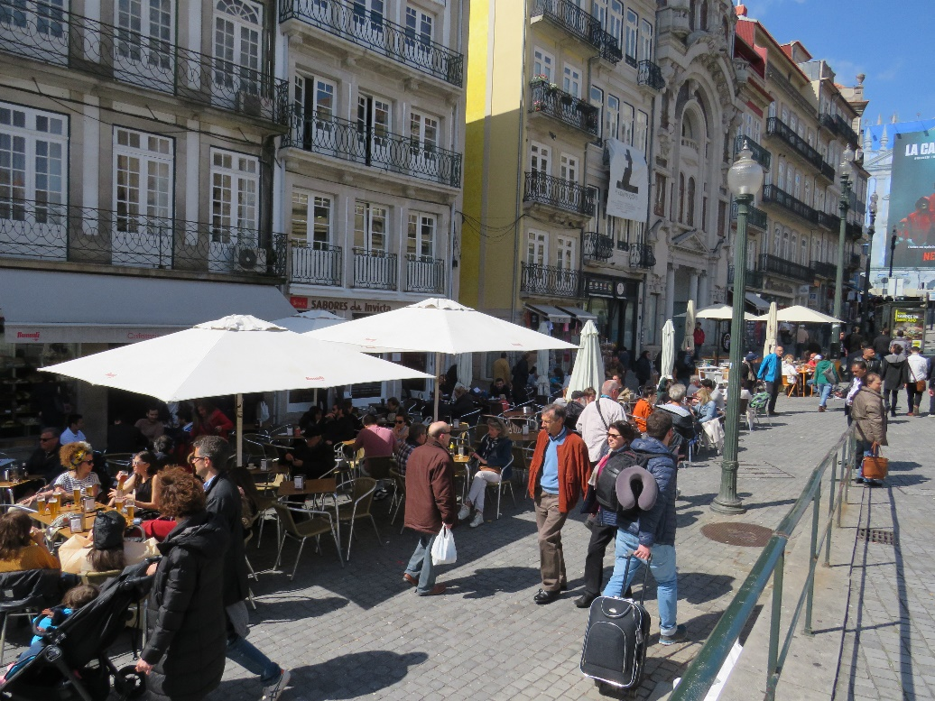
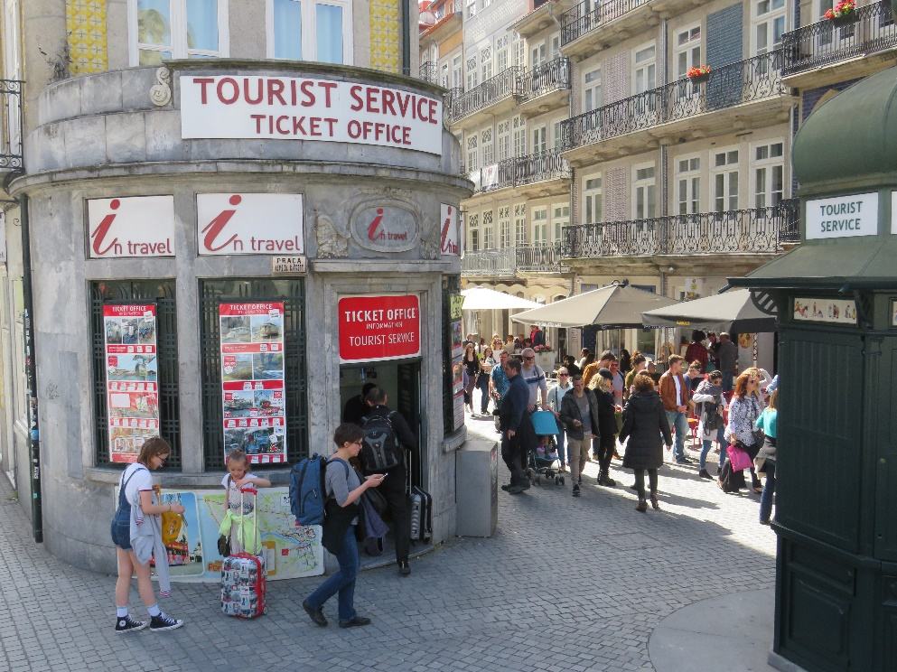
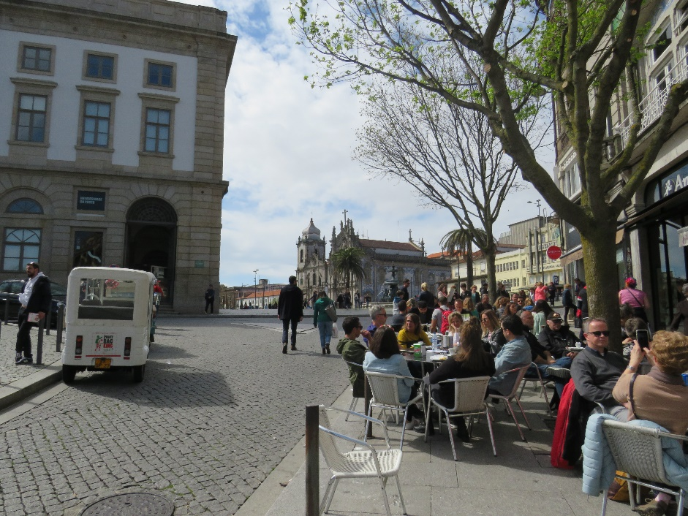

Slide 40
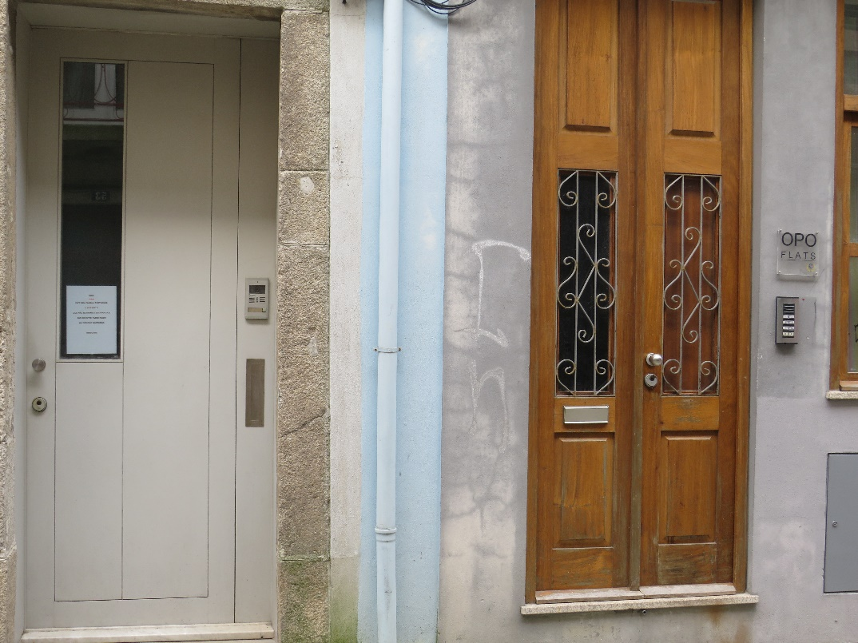
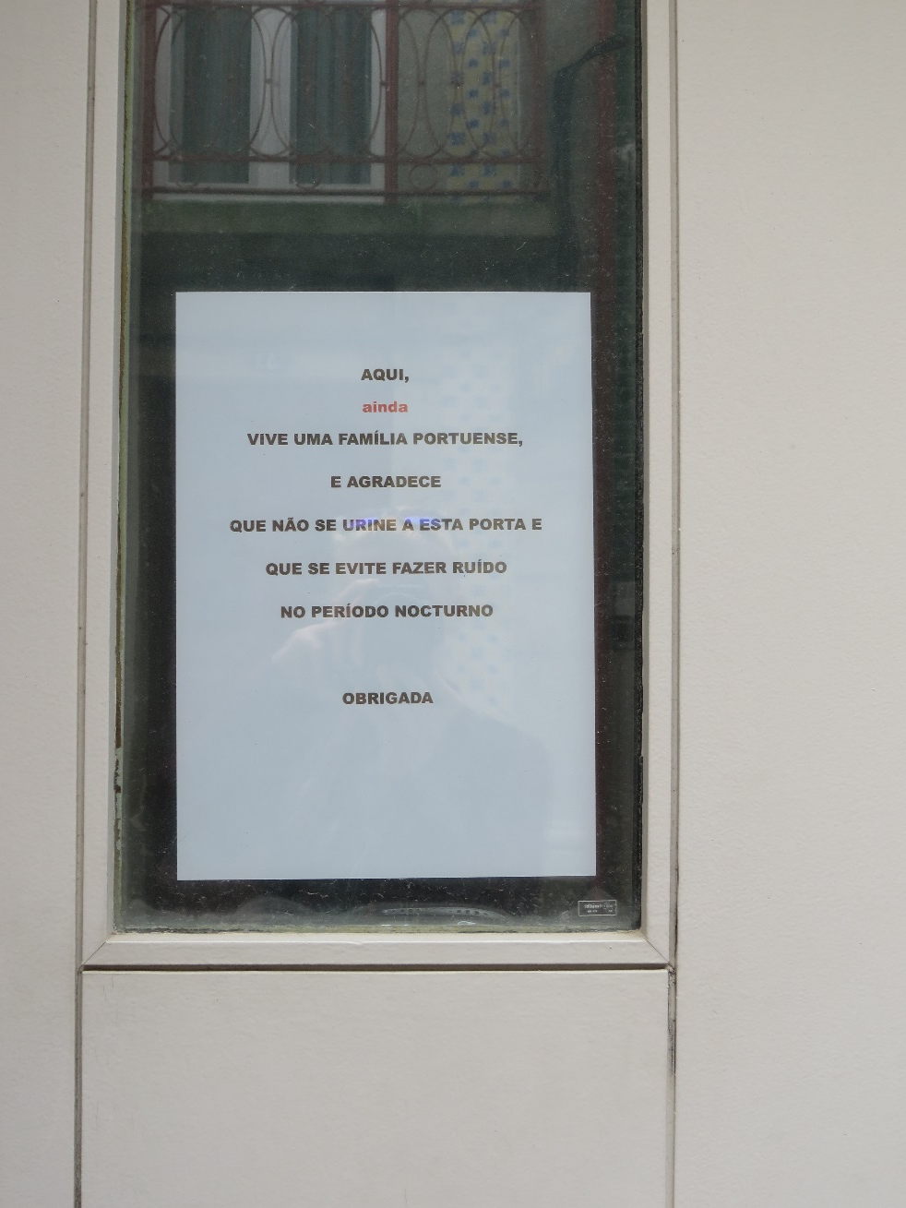
And how the locals feel...

Slide 41
SUSTAINABLE TOURISM
Re-focusing and adapting;
Make a positive effect on the environment, society, economy;
Sustainable mobility;
Maximize the benefits, while safeguarding cultural heritage;
Environmentally and culturally sensitive.

Slide 42
5 CHARACTERISTICS
Benefits local economic development.
Ensures the benefits of the local community and environment.
Is profitable and applicable.
Becomes part of the local culture.
Reinvests in the local region.

Slide 43
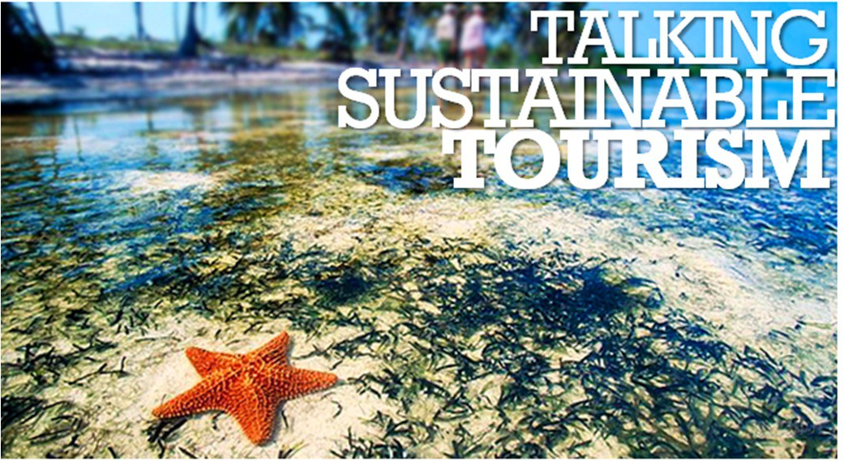
SUSTAINABLE TOURISM
Related terms:
ecotourism
carrying capacity

Slide 44
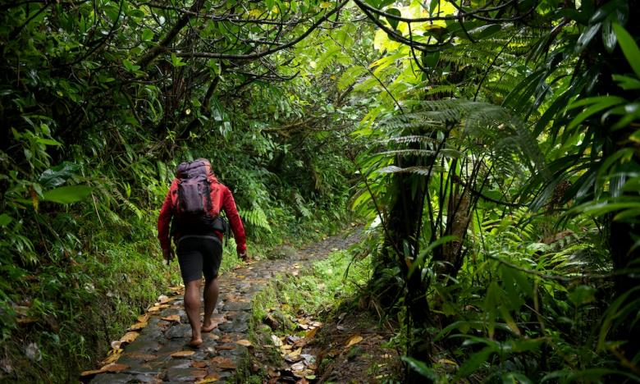
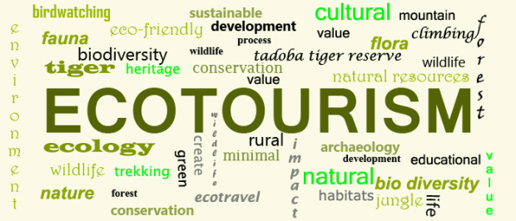
ECOTOURISM
Visiting natural areas with as low impact as possible;
Responsible travel;
Conserve the environment.

Slide 45
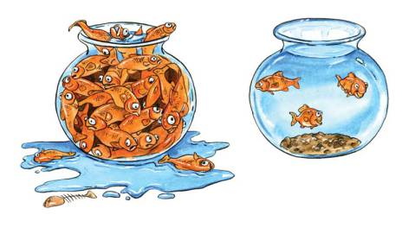
CARRYING CAPACITY
The amount of tourists an area can sustainably tolerate without major damage;
Set up in order to manage visitors in a protected area;
Different forms: physical, economic, social, biophysical;
Difficult to calculate the numbers.

Slide 46
FORMS
Physical: the max. number of people an area is able to support – 1 meter/person;
Economic: a destination is able to accommodate tourist functions;
Social: reduced local tolerance;
Biophysical: the extent to which the natural environment is able to tolerate it.

Slide 47
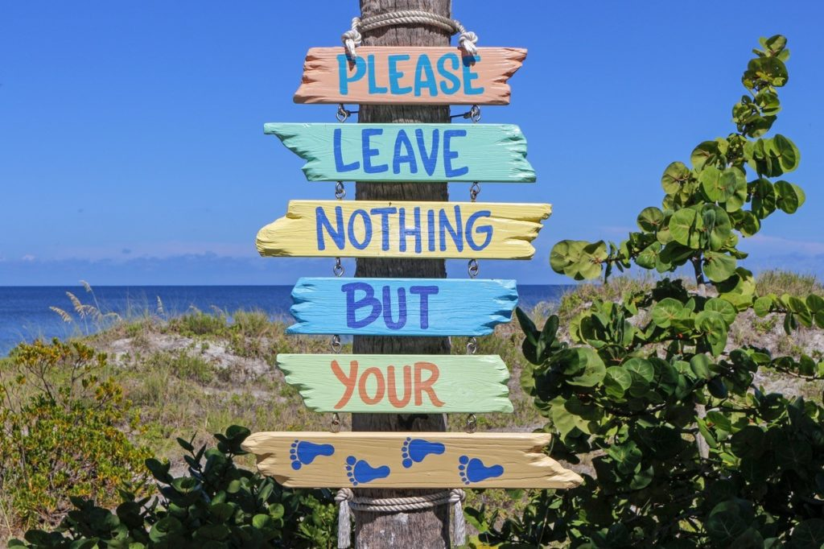

Slide 48
...BUT HOW

Slide 49
As a tourist how can you make sure:
you have a positive impact
on the local environment AND community you visit?
3 mins

Slide 50
POSSIBLE SOLUTIONS
Gather information about the place before leaving;
Respect locals and their culture;
Support local businesses, order local food;
Conserve resources;
Think about transportation possibilities.

Slide 51
POSSIBLE SOLUTIONS
Be considerate of the communities you visit;
Always ask before taking photographs;
Dress in a respectful manner;
Support responsible tourism organizations.

Slide 52
As a local citizen, who hosts and promotes tourism, how can you make sure that you practice sustainable tourism?
3 mins

Slide 54
Good examples:

Slide 56
Thank you!

