Slide 1
Dating violence
Notes:
https://www.breakthecycle.org/sites/default/files/Break%20the%20Cycle%20Activity%20Guides.pdf
http://www.poehealth.org/wp-content/uploads/2014/07/Healthy-Relationships-Session-Outline.pdf

Slide 2
Structure
Warm-up activity
Dating violence
Victims
Group Dynamic

Slide 3
“Atrás de um grande homem, está sempre uma grande mulher”
Notes:
Group dynamic
Have you heard this saying before?
Do you agree with this saying?

Slide 4
“Até que a morte os separe”
Notes:
Group dynamic
Have you heard this saying before?
Do you agree with this saying?

Slide 5
“Quanto mais me bates mais gosto de ti”
Notes:
Group dynamic
Have you heard this saying before?
Do you agree with this saying?

Slide 6
“Não se mete o nariz onde não se é chamado”
Notes:
Group dynamic
Have you heard this saying before?
Do you agree with this saying?

Slide 7
“Entre marido e mulher não se mete a colher”
Notes:
Group dynamic
Have you heard this saying before?
Do you agree with this saying?

Slide 8
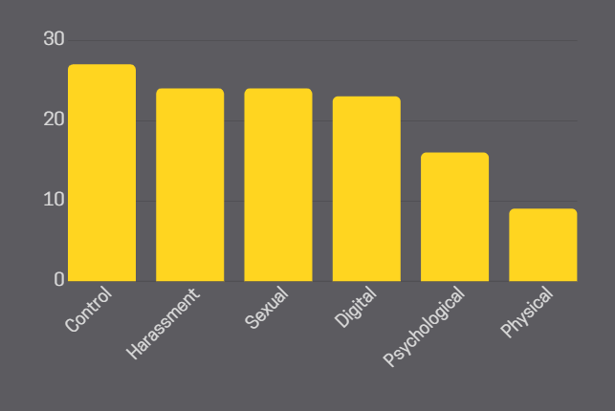
Legitimization
67% of all young people think at least one of these violent behaviors is normal
*Statistics taken from “Estudo Nacional sobre a Violência no Namoro 2019”
Notes:
Statistics taken from “Estudo Nacional sobre a Violência no Namoro 2019” done by UMAR - União de Mulheres Alternativa e Resposta, feminist organization that, since 1976, fights for the rights of women. As a non-profit non-governmental organization that has the defense and promotion of Women's Rights and Gender Equality as a beacon, and it is a member of the Consultative Council of CIG - Comissão para a Cidadania e Igualdade de Género.

Slide 9
Control
Prohibition to go out without a partner
Prohibit wearing a particular piece of clothing
To hang out or talk to a friend
Force your partner to do something they don’t want
Notes:
What would you do if, for example, your partner tells you not to wear that sweater you like so much?
How would you react if your partner tells you to send them a picture of your whole body before going out with some friends?
You were talking to a friend on Whatsapp and your partner saw you online. After a while he texts saying you were online and didn’t text them.

Slide 10
Psychological Abuse
“Insulting your partner is a sign of emotional abuse”
E.g. “What are you wearing?! You look RIDICULOUS.”
Notes:
Of all young people….
Discuss 2 or 3 cards

Slide 11
Psychological Abuse
“Making threats to your partner is acceptable”
E.g. “If you go out tonight I’m breaking up with you”
Notes:
Of all young people….
Discuss 2 or 3 cards

Slide 12
Psychological Abuse
“Emotional abuse is a form of violence”
Notes:
Of all young people….
Discuss 2 or 3 cards

Slide 13
Psychological Abuse
27% do not think that insulting a partner during an argument is a form of psychological abuse
9% of young people think that making threats is acceptable (14% of boys, 5% of girls)
16% don’t recognise psychological abuse as a form of dating violence
*Statistics taken from “Estudo Nacional sobre a Violência no Namoro 2019”
Notes:
Of all young people….
Discuss 2 or 3 cards

Slide 14
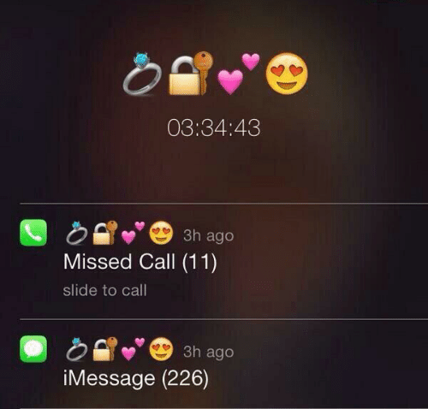
Harassment
What is harassment?
Harassment can take many different shapes and forms. For example…
The need for constant communication, non-stop calling and texting throughout the day.
Following and stalking
Constant verbal abuse
Threats
Notes:
•Lydia
What does this image show?
Is this a sign of a normal and healthy relationship? Do you think social media and smartphones have had a positive effect on relationships?
Do you think that jealousy is a sign of love in a relationship?
Harassment covers a broad range of categories that fall under Dating Violence

Slide 15
Sexual abuse
In form of coercion, abuse or rape.
CONSENT
You can say yes to one thing and no to another!
You can stop what you are doing at any time.
Make sure you have consent.
24% legitimizes sexual violence in dating relationships (girls 15% and 34% boys)
Notes:
Rape, sexual assault, and sexual abuse can have different legal definitions. In general, rape, sexual assault, and sexual abuse are forms of violence in which there is sexual contact without consent.
Sexual violence doesn’t happen in one single way. There doesn’t need to be a weapon involved and the victim doesn’t need to have fought back, screamed, or said “no” repeatedly in order for it to count as rape or sexual assault. Most sexual assaults don’t happen by strangers in dark alleyways. Often, it’s someone the victim knows or even a romantic partner.
Does anyone know what consent means?
Consent occurs when one person voluntarily agrees to the proposal or desires of another. Consent means actively agreeing to be sexual/physical with someone. Consent lets someone know that kissing/touching/sex is wanted. Sexual activity without consent is rape or sexual assault.
Consent can be taken back at any time. Even if you’re in the middle of something, if you start feeling uncomfortable, you always have the right to stop.
Consent is not a free pass. Saying yes to one act doesn’t mean you have to consent to other acts. Each requires its own consent. You may say yes to kissing but no to touching for example.
It’s not consent if you’re afraid to say no. It’s not consent if you’re being manipulated, pressured, or threatened to say yes. It’s also not consent if you or a partner is unable to legitimately give consent, which includes being asleep, unconscious, under the influence of conscious-altering substances or not able to understand what you’re saying yes to.
Be clear and direct with your partner if you don’t want to do something. Don’t be embarrassed to say that you don’t want to get physical. Be honest and make sure that you are heard. If the other person is not listening to you, then you can for example leave the situation.
CONSENT (cards) Sexual coercion is unwanted sexual activity that happens when you are pressured, tricked, threatened, or forced in a nonphysical way. Coercion can make you think you owe sex to someone. Persuading someone to have sex/do physical things when they don’t really want to.
If your partner says “yes” or makes it clear that they’re into it, then you have consent.
If your partner says “no,” doesn’t say anything, or says yes but seems unsure or uncomfortable, then you DON’T have consent. In all the situations the best thing you can do is Ask!

Slide 16
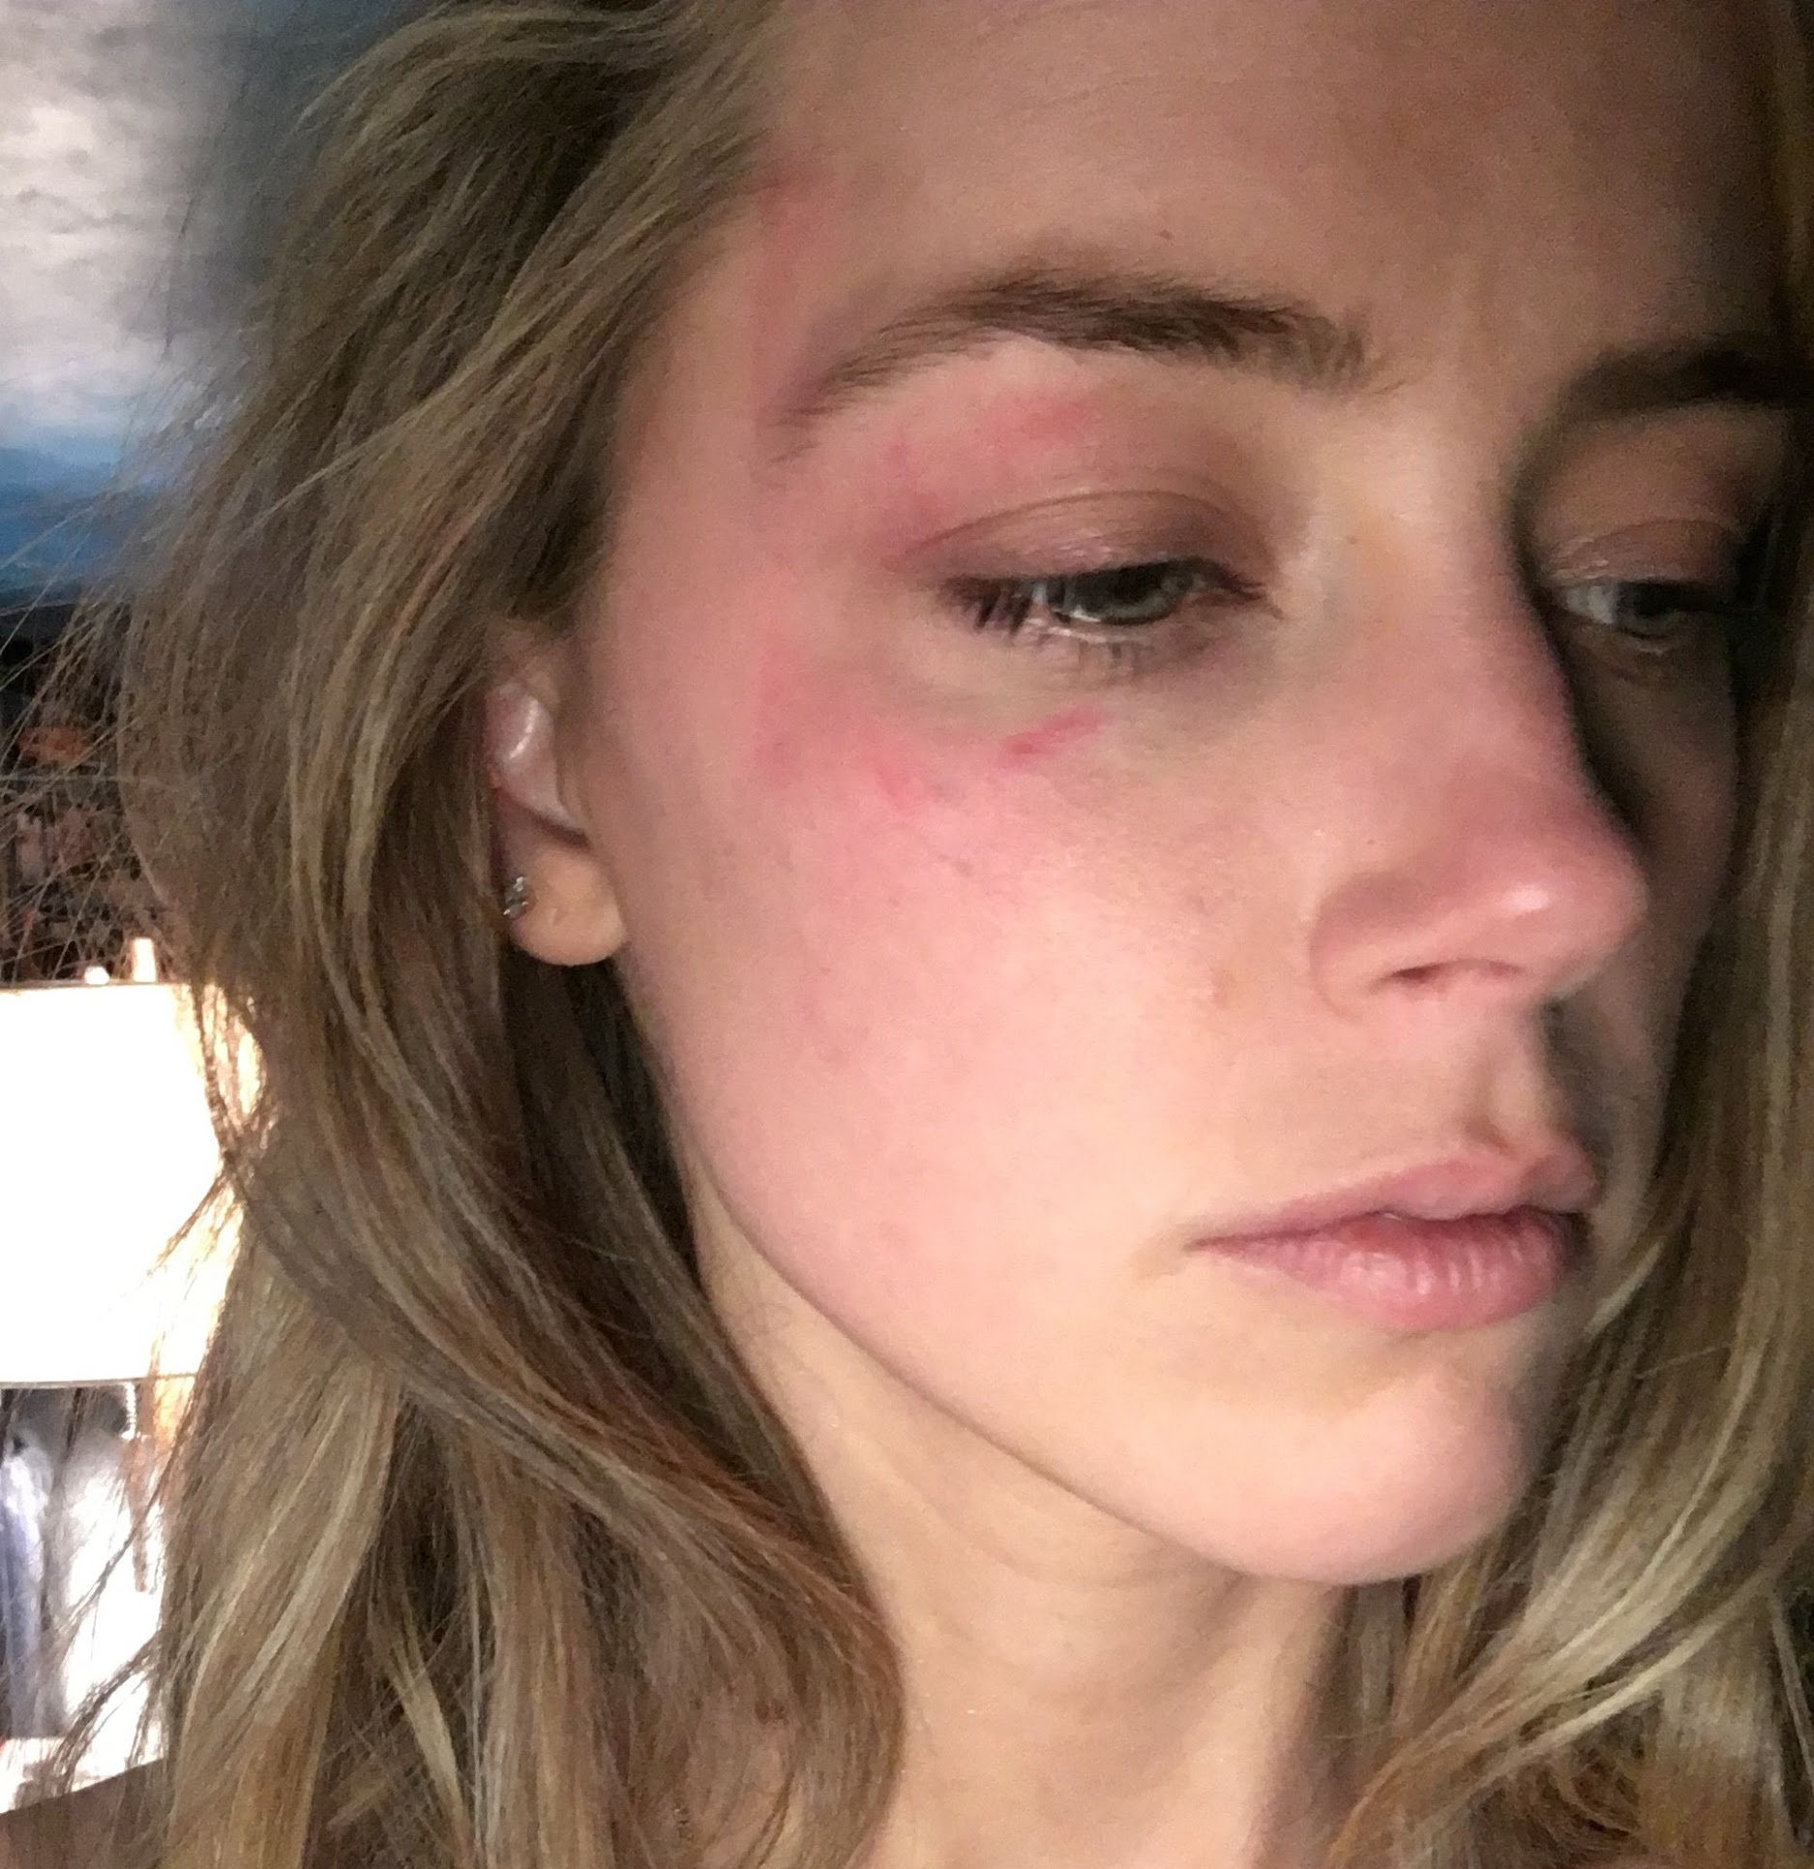
Physical Violence
Intentional bodily aggression that may leave marks or wounds
9% of the young participants naturalized behaviors of this form of violence, especially if the violence did not lead to visible injuries or marks
more legitimized by boys (10%) than girls (4%)
Notes:
GIULIA
Physical abuse/violence/assault = any intentional act or behavior causing injury or trauma by way of bodily contact. It basically involves one or more persons using a physical force against others causing harm.
Victims = in most cases children (abusive acts toward children can often result from parents’ attempts at child discipline through excessive corporal punishment). But adults can be victims too (domestic violence and workplace aggression).
Types = Physical abuse can involve any of the following violent acts:
1) Scratching or biting
2) Pushing or shoving
3) Slapping
4) Kicking
5) Choking or strangling
6) Throwing things
7) Physically restraining you (i. e. = pinning you against a wall, floor, bed, etc)
8) Torturing
It can start with a slap or a push, but then become more intense over time.
Blaming the victim (the abuser usually blames someone else, such as the victim, for saying or doing something that caused his/her violent behaviour. But also cause = alcohol or drugs, or stressed/frustrated mood)
Telling you they’re sorry begging for forgiveness and promising they’ll never do it again
Physical violence is always illegal. Remember that is not your responsibility and that abuse is never justifiable. It is never acceptable

Slide 17
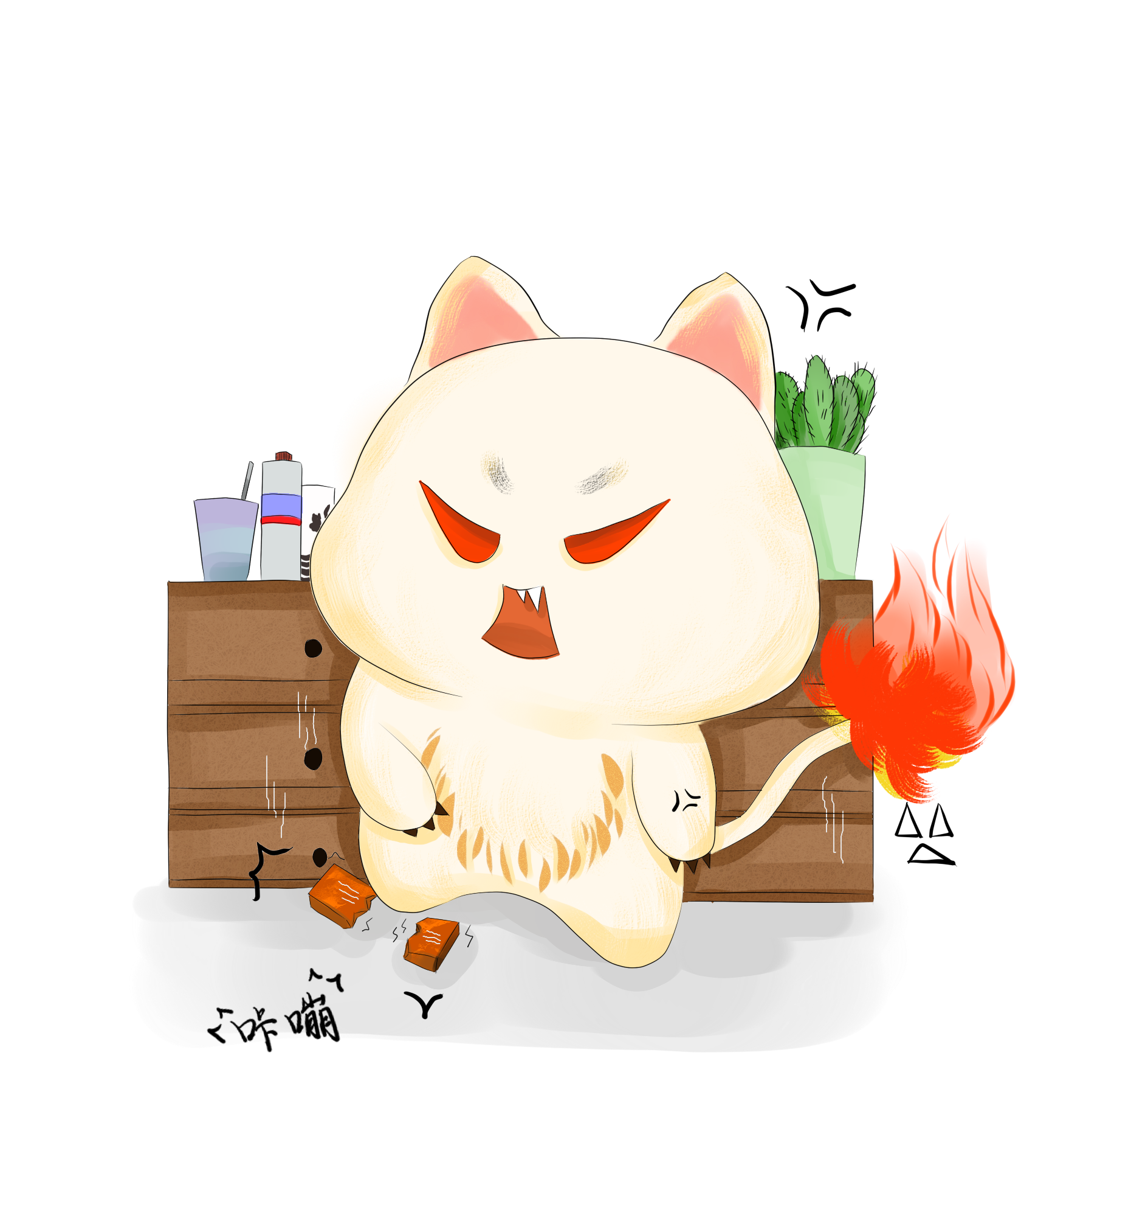
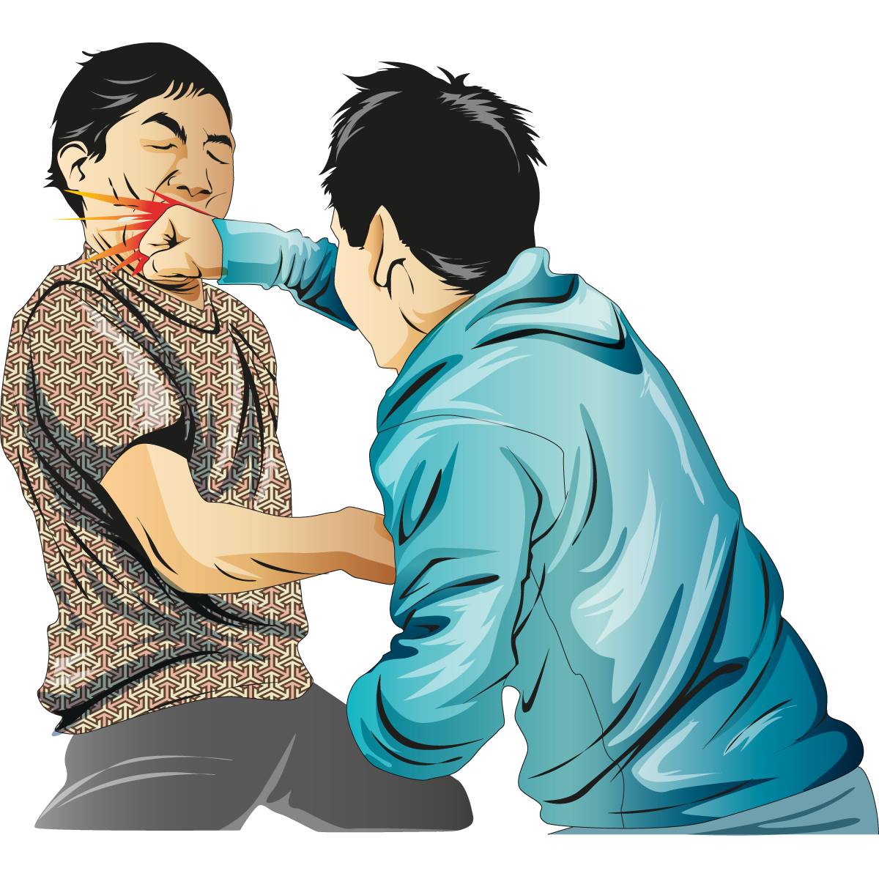
How does it occur?
Scratching
Biting
Pushing
Shoving
Slapping
Kicking
Choking
Throwing things
Ruining or breaking one’s belongings
Throwing against the wall

Slide 18
Blaming the victim (or anything else) is a common practice
Asking for forgiveness is common as well
Don’t beat yourself up!
Notes:
GIULIA
Physical abuse/violence/assault = any intentional act or behavior causing injury or trauma by way of bodily contact. It basically involves one or more persons using a physical force against others causing harm.
Victims = in most cases children (abusive acts toward children can often result from parents’ attempts at child discipline through excessive corporal punishment). But adults can be victims too (domestic violence and workplace aggression).
Types = Physical abuse can involve any of the following violent acts:
1) Scratching or biting
2) Pushing or shoving
3) Slapping
4) Kicking
5) Choking or strangling
6) Throwing things
7) Physically restraining you (i. e. = pinning you against a wall, floor, bed, etc)
8) Torturing
It can start with a slap or a push, but then become more intense over time.
Blaming the victim (the abuser usually blames someone else, such as the victim, for saying or doing something that caused his/her violent behaviour. But also cause = alcohol or drugs, or stressed/frustrated mood)
Telling you they’re sorry begging for forgiveness and promising they’ll never do it again
Physical violence is always illegal. Remember that is not your responsibility and that abuse is never justifiable. It is never acceptable

Slide 19
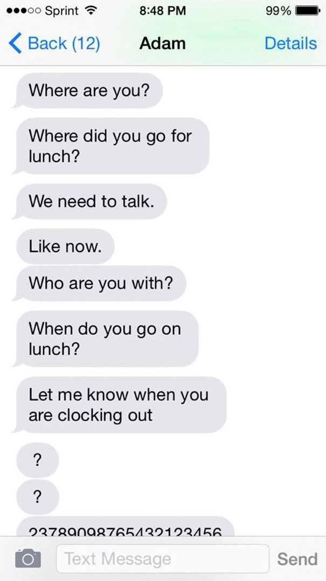
Digital Abuse
Notes:
Just like ‘real-life’ stalking and harassment, all this abusive behavior can also take place in the digital world. New technologies–social networking sites, texts, cell phones, and emails – have given abusers another way to control, degrade, and frighten their partners. Can you think of any ways people can use new technology to control their partner or their ex?
IS IT ABUSE, IF SOMEBODY (yes for all) ...
Sends you negative, insulting or even threatening emails, Facebook messages, tweets, DMs or other messages online.
Tells you who you can or can’t be friends with on Facebook and other sites.
Uses sites like Facebook, Twitter, foursquare and others to keep constant tabs on you
Puts you down in their status updates
Sends you unwanted, explicit pictures and/or demands you send some in return
Pressures you to send explicit video or sexts
Steals or insists on being given your passwords.
In a healthy relationship, all communication is respectful whether in person, online or by phone.

Slide 20
Unauthorised sharing
Unauthorised sharing of messages
Revenge Pornography
Collect evidence take screenshots, save the webpage as a PDF, download videos…
Report the photos or videos to the website to get it removed most have strict policies and will remove content in the matter of minutes
Contact Authorities to make an official report
Notes:
When we are in a relationship, we tend to share personal things, even secrets with our partner, because we trust them. Unfortunately, because of how modern technology works, you lose control of any electronic message once your partner receives it. They may forward it or use it to control you even after the relationship ends. That’s why it's important to know exactly what to do in case your partner or your ex decides to share something without your permission.
Evidence is extremely important from the legal aspect
Especially if you are still a minor, social media platforms and even porn sites will take your photos off in a manner of minutes to avoid potential lawsuits.
After taking these two steps to minimize damage, report the incident to the authorities. Give them all the evidence you collected.

Slide 21
Cyberstalking
Unwanted messages
Threats
Identity Theft
Spreading rumours and false statements
Do not engage
Inform your support team (family or friends)
Fortify your social media change passwords, set additional protection
Report to the authorities
Notes:
We all have an idea of what stalking looks like in the real, physical world, but how can we recognize stalking online? First, it’s important to know what the main goal of any stalker is: to try to make the person they’re stalking feel intimidated and scared
Spreading false rumours about you, or
Constantly messaging or emailing you, sending you sexual comments or even threats
Impersonating you or hacking into your online accounts, pretending to be you on social media...
If any of this things only happen once, you should still tell your parents or friends and make sure your social accounts are safe. However, if it happens multiple times, it becomes stalking, which is an illegal act, so you should contact the police and get their advice. Don’t forget to save any messages or emails to show the police if necessary.

Slide 22
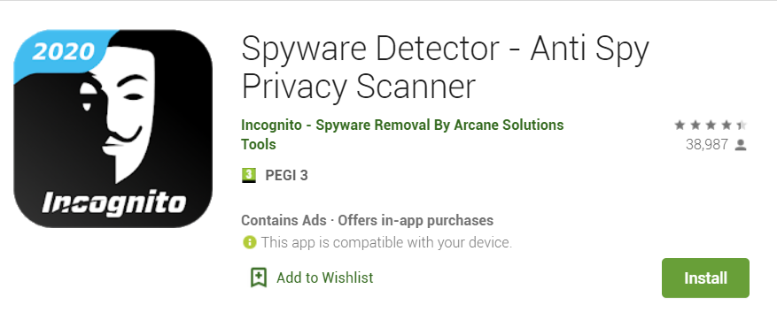
Unauthorised access
Use an Anti-Spyware program
Check if your device is being monitored View active connections
Factory reset your device. Back up your files first!
Notes:
Some abusive partners might ask you to share your passwords with them. Some might ask you to download a GPS tracking app so that they know where they are at all times. Some might physically demand you hand them your device. It’s important to remember you are never obliged to do any of that.
Do not share your passwords with anyone. Do not hand your phone over to anyone including your dating partner, this is private property and you do not have to share it. Know your privacy settings and keep your electronic devices, online accounts and social media accounts as secure as possible.
How to know if somebody is accessing your phone without you knowing?
On social media sites, such as Whatsapp, Facebook, Instagram you can check active connections and the list of all past logins.
SIGNS: overheating, battery drains, random shutting down, unusual texts (random letters)...
Use anti spyware program or a phone app to check if your phone is safe

Slide 23
Let’s talk
Notes:
https://www.loveisrespect.org/wp-content/uploads/2016/08/middle-school-educators-toolkit.pdf
Would you change the category where you put your card(s)?

Slide 24
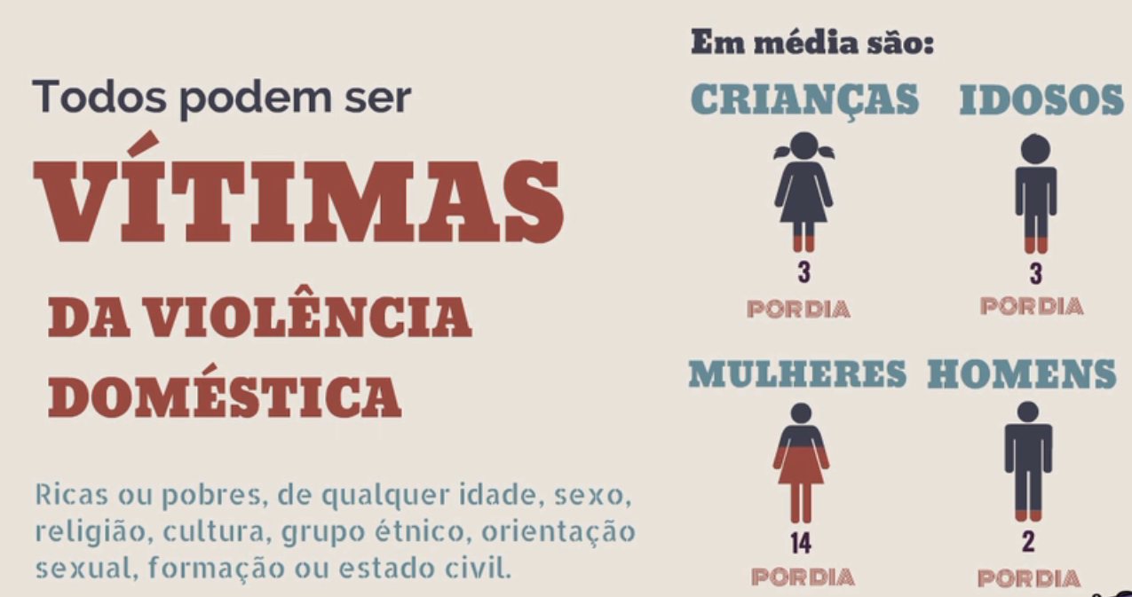
Group Dynamic
Notes:
Group dynamic. What a healthy relationship would be like?

Slide 25
How can we help?
58% of young people
in Portugal have already suffered at least one act of dating violence.
Talk to a friend/family member/ teacher/ responsible adult/someone you trust
28 deaths in 2018, 11 in 2019.
Lei 112/2009: prevenção da violência doméstica e à protecção e assistência das suas vítimas
Notes:
In 2018, 26.483 cases of domestic violence were reported in Portugal, both from men and women, according to the Annual Domestic Violence Monitoring Report. There were 28 deaths in 2018, 11 in 2019.
Lei 112/2009: prevenção da violência doméstica e à protecção e assistência das suas vítimas

Slide 26
How can we help?
Campanha #DitadosImpopulares
“Violence is not a private matter”
Domestic violence is considered a public crime in Portugal (if you witness it, you can report it)
Notes:
App VD - APPoio Against Domestic Violence, developed by CIG - Commission for Citizenship and Gender Equality. Victims can check how they can make a complaint or request information and which entities can give legal or psychological advice in this area. This is an application for mobile phones that is available on the App Store and Google Play.

Slide 27
How can we help?
Application for mobile phones: App VD - AAPPoio Contra a Violência Doméstica, developed by CIG - Comissão para a Cidadania e Igualdade de Género.
National helpline (800 202 148 and 144): Serviço de Informação a Vítimas de Violência Doméstica.
Free of charge, anonymous, confidential and available 24/7, or through email apav.sede@apav.pt

Slide 28
Thank you very much!

