Slide 1
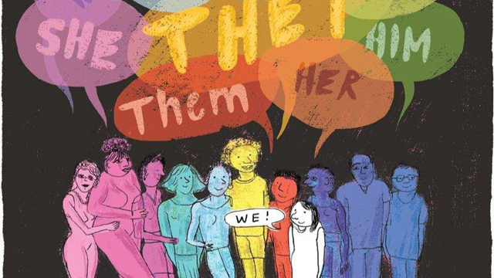
They, She, He, We – Representing Gender

Slide 2
Concepts
Gender system
Heteronormativity
Sexual orientation
Intersexuality
Gender identity
Reality of transs people
Non-binary cultural references
Queer model
LGBTI-phobia
How can we help?
What if I need help?

Slide 3
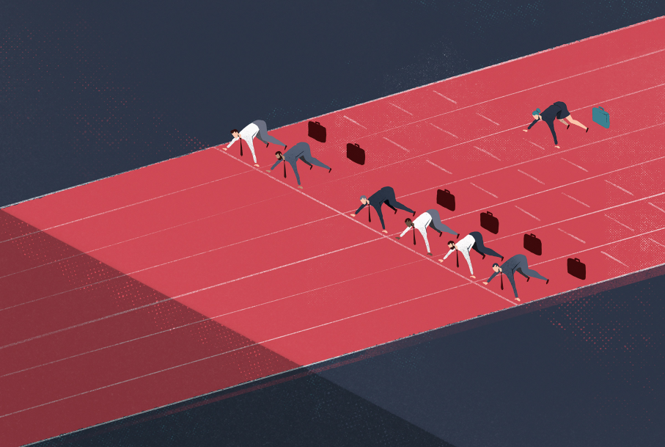
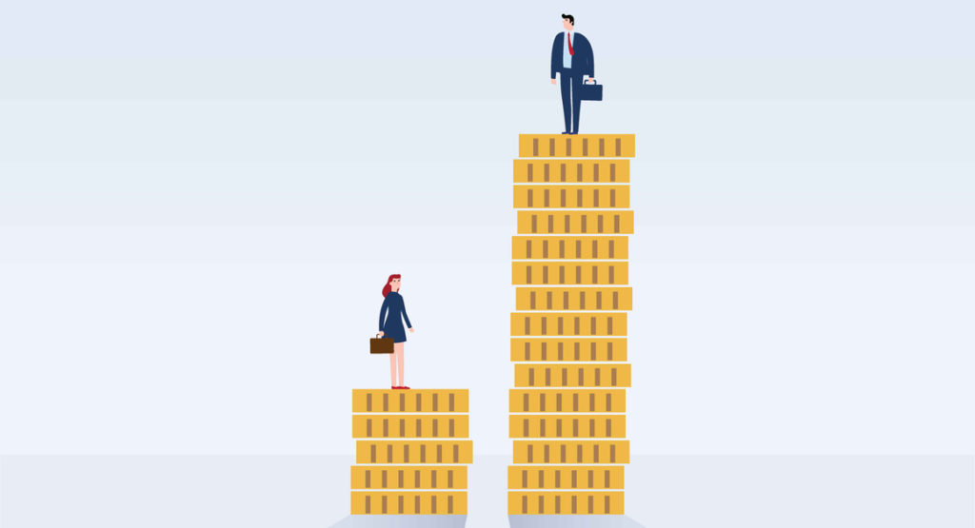
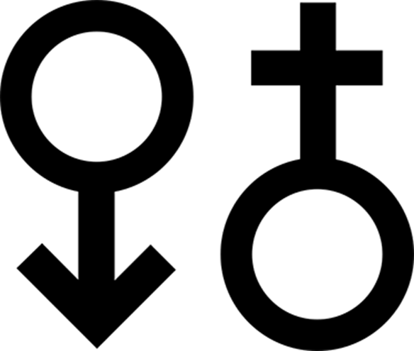
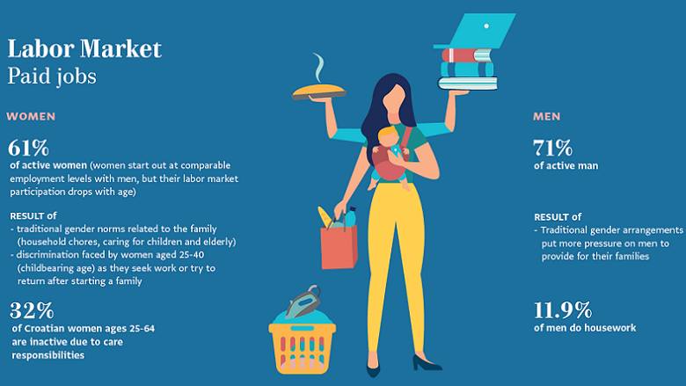
The current gender system is characterized by an inequality that is expressed in phenomena such as wage gap, sexual violence, workload at home ...

Slide 4
Gender system
Also, what has prevailed in the gender system has been the following:
SEX | XY | XX
GENDER | Male | Female
SEXUAL ORIENTATION | Attracted to women | Attracted to men

Slide 5
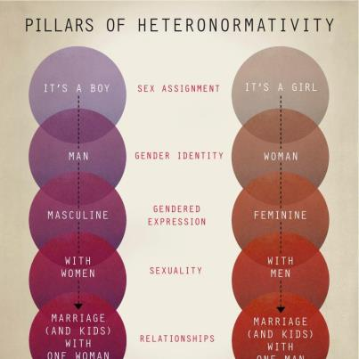
And this has effects in our day-to-day life:
(CIS) HETERONORMATIVITY: Michael Warner refers to "the set of power relationships, through which sexuality is normalized and regulated in our culture, and idealized heterosexual relationships are institutionalized and equated with what it means to be human"
All men must play with cars and wear blue clothing
They must like soccer
Crying is a sign of weakness
(…)
All women must play with dolls and wear pink clothes
They might practice ballet
Waxing their legs
(…)
Also check this out: https://www.youtube.com/watch?v=tp7v3JQna6U

Slide 6
CURRENT GENDER SYSTEM
Inequality in all its dimensions:
SEX / BODY: two only valid options in genitality
GENDER IDENTITY: two unique gender categories opposed to each other (Gender Binarism)
GENDER EXPRESSION: two unique expression options
Sexual orientation: monogamous heterosexuality
GENDER

Slide 8
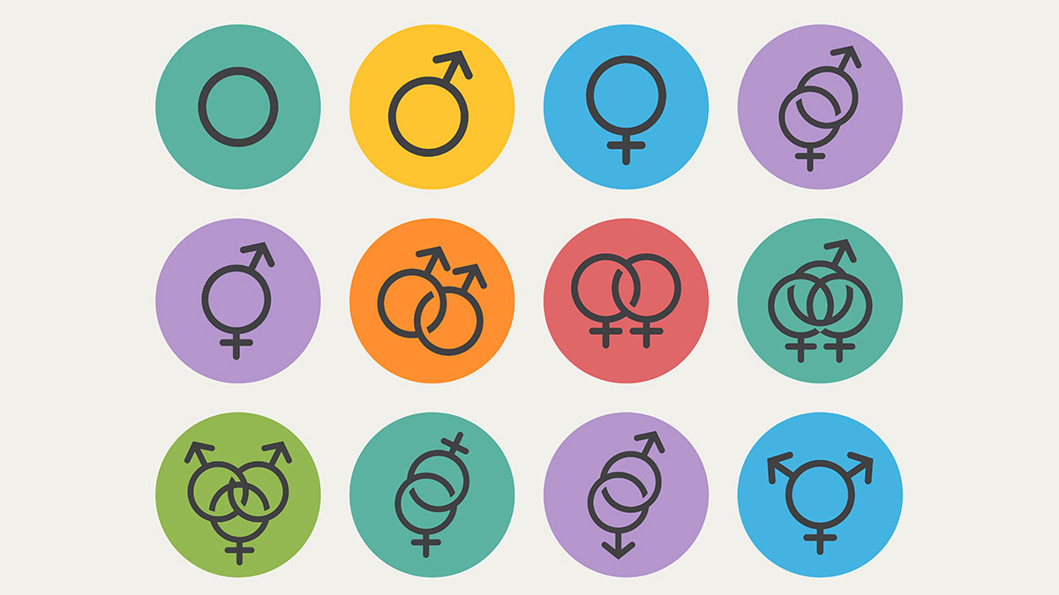
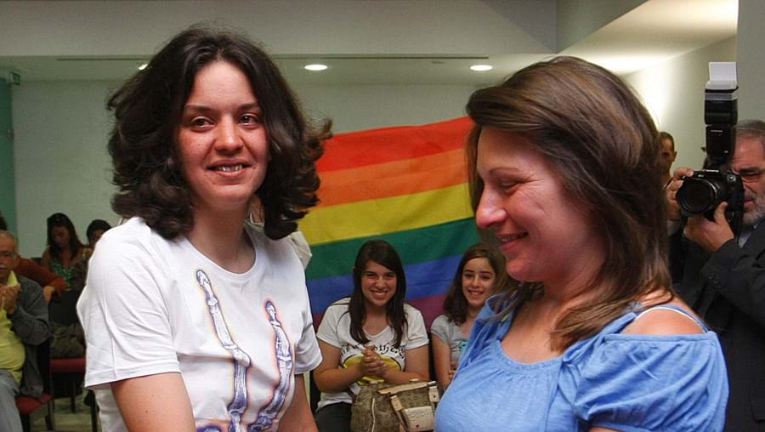
Homosexuality was considered a mental illness by the World Health Organization (WHO) until 1990.
Relevant data about Portugal:
- Homosexual activity legal since 1982
- Same-sex marriage since 2010
- Right to change legal gender accepted
- Same-sex adoption accepted
- LGBT discrimination illegal since 2004
- Conversion therapy not banned
In 2019, ILGA-Europe ranked Portugal 7th out of 49 European countries in relation to LGBT rights legislation.
"New" sexual orientations:
Pansexuality
Asexuality
Demisexuality ...
Helena and Teresa, the first homosexual couple to marry in Portugal after its legalization.

Slide 9
Dimension: SEX/BODY

Slide 10
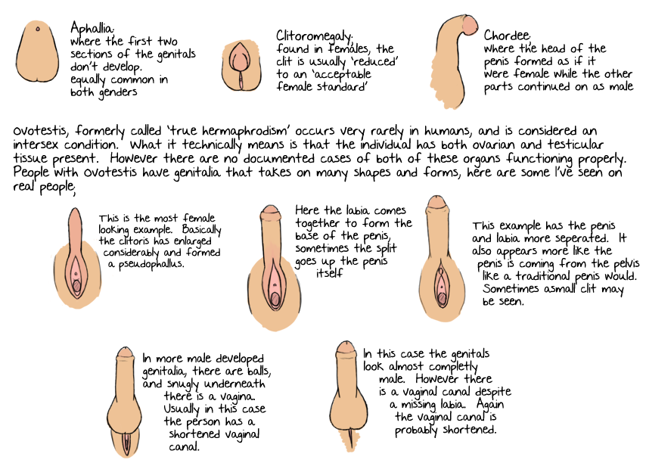
Curious fact:
What is it?
Individuals born with any of several variations in sex characteristics including chromosomes, gonads, sex hormones or genitals that, according to the UN Office of the High Commissioner for Human Rights, "do not fit the typical definitions for male or female bodies".

Slide 11
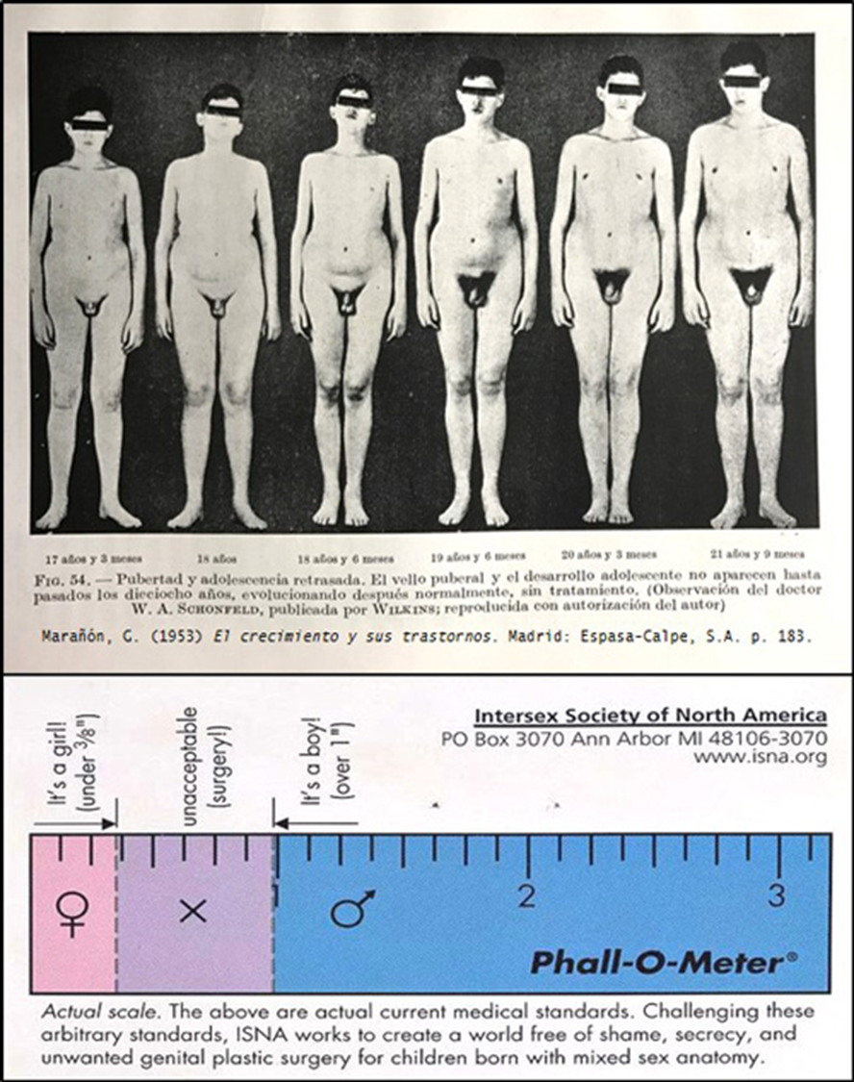
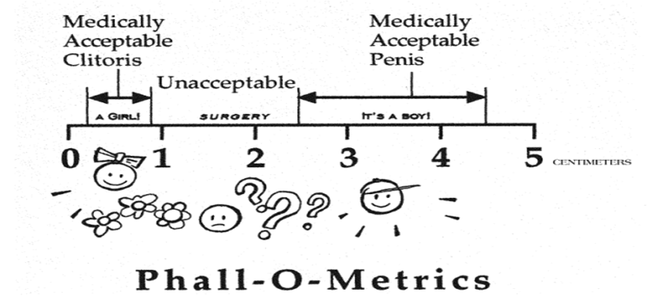
Intersex people face stigmatization and discrimination from birth, or from discovery of an intersex trait, such as from puberty. This may include infanticide, abandonment and the stigmatization of families. Globally, some intersex infants and children, such as those with ambiguous outer genitalia, are surgically or hormonally altered to create more socially acceptable sex characteristics:
This is considered controversial, with no firm evidence of favorable outcomes. In April 2015, Malta became the first country to outlaw non-consensual medical interventions to modify sex anatomy, including that of intersex people.
Check this out

Slide 13
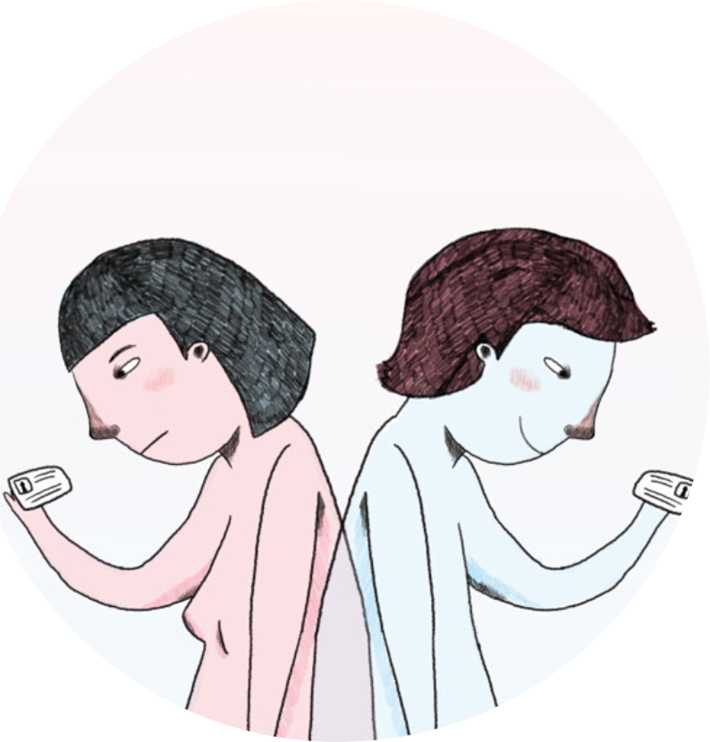
The identity of a person is more a process, than an isolated fact that appears at a certain age (Ghosh, 2009)
Gender identity: effect of sociocultural construction, which on a PERSONAL level translates into the intimate feeling of BEING women, men, or ...
Gender categories allow us to be socially recognized and to build our identity.
Consistency-Inconsistency. (J.Butler)

Slide 14
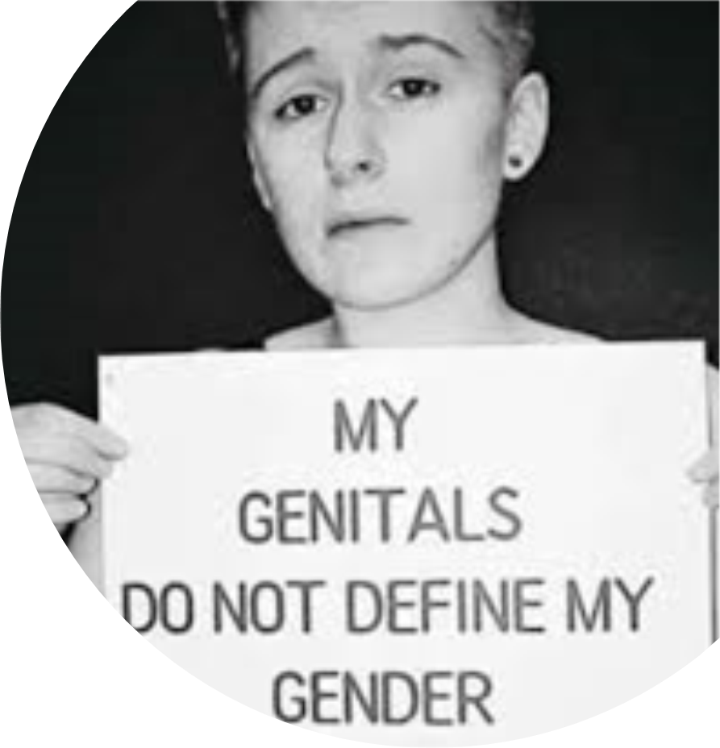
Reality of transsexual people
Trans: people who do not recognize themselves with the gender assigned at birth, assigned in turn based on genitality, that is, the biological sex of each individual.
Transsexuality was considered a mental illness by the World Health Organization (WHO) until 2018.
Historical invisibility
Overdiagnosed and Underserved (TGEU, 2017)
High suicide levels in trans population
Quality of health resources (General)
(Very) bad: 40%
Fair: 60%
HETEROGENEITY in the experience of similar processes
NECESSARY trend towards DEPATHOLOGIZATION
CORPORAL CHANGES = ADAPTATION TO SOCIAL EXPECTATIONS = other problems
"Do you know what happens? It is that society pressures so much, that it makes me hate my body but before I didn't hate it. I was not born in the wrong body (...) My body has always been mine, I like it as it is and I don't want to change it. Not for that reason I am less trans than another person who wants to undergo surgery, or less woman than a cis (…) ”
Trans Teenager' Story

Slide 15
Non-binary cultural references
Non-binary gender is an umbrella term that encompasses all those whose gender identity does not fit at either end of the male / female spectrum.
It may seem something new, but it is not at all. Throughout history and in different times and parts of the world we can see how it has been common:
Muxes in Mexico
Hijras in India
Fa’afafine in Samoa
Two-Spirit in Canada
(…)

Slide 16
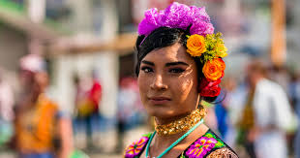
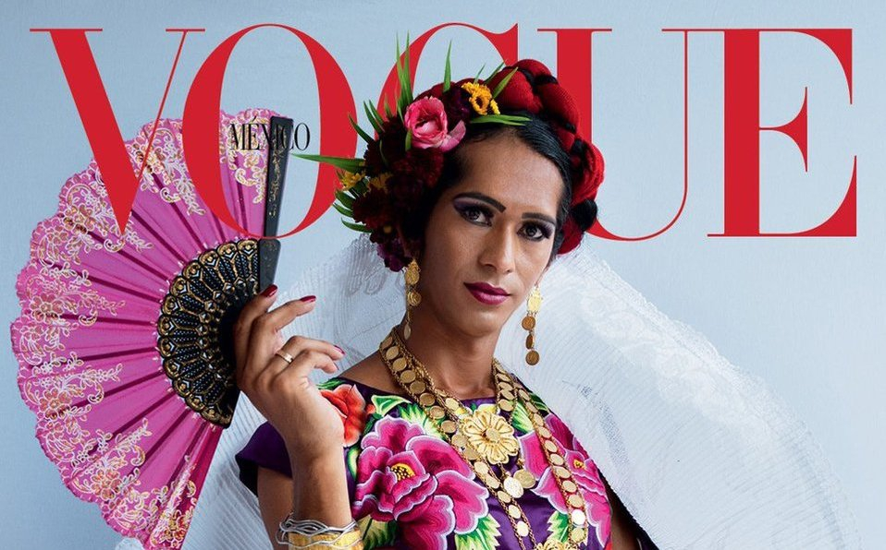
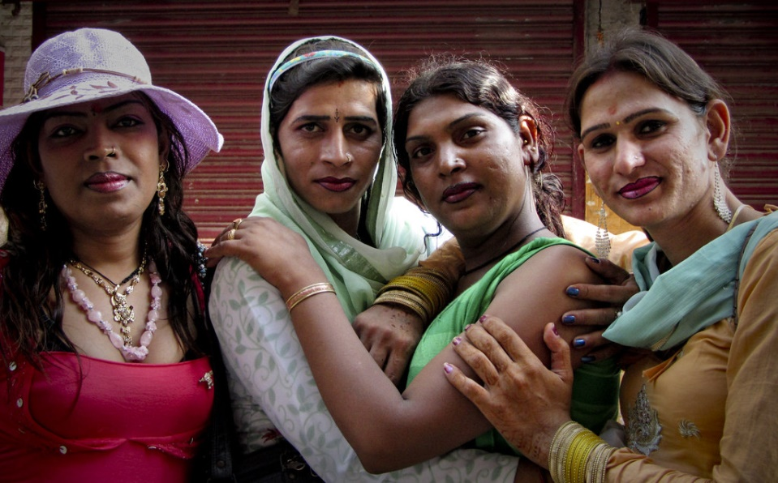
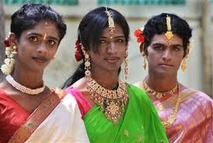
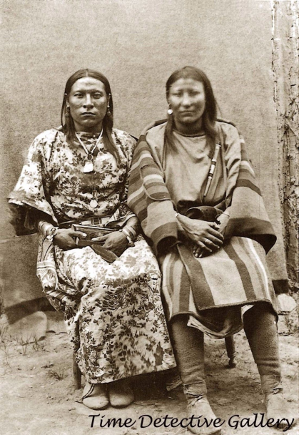
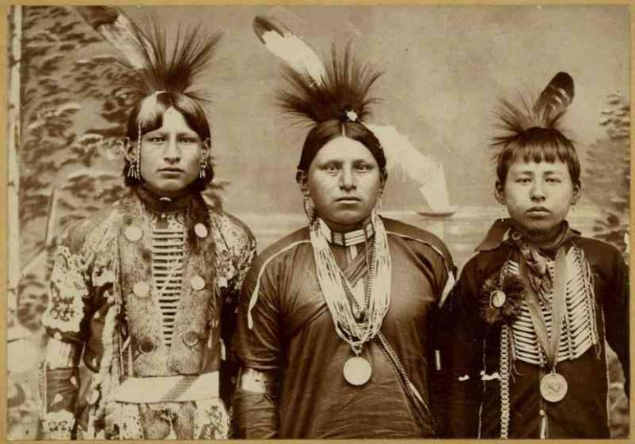
Muxes
Hijras
Two-spirit
Emphasize that these gender categories are a gender in itself in their respective places / times, outside the binarism typical of Western society, what may be difficult for us to comprehend.

Slide 18
Queer model
Challenge the base, the term of normality or naturalness
Includes intersectionalities:
Gender, ethnicity, class or sexual orientation, like other social categories, are far from being “natural” or “biological” but are constructed and interrelated, also in their respective systems of oppression, domination or discrimination.
Proposes a critique of heterosexuality / cisgender through the use of privileges
It advocates dignifying ambiguity and a theory of gender that combines sex, gender, sexuality, orientation, gender role, gender identity and genital identity.

Slide 19
All this could be somehow well summarized in the following cartoon:

Slide 21
Despite the advances in the legal framework achieved in this period of time, and the commitments made by public bodies and other social agents, the reality of LGBTI people still lacks systematic and in-depth knowledge, something that data shows:
186 complaints collected by ILGA Portugal in 2018 considered as discriminatory or violent against the LGTBI collective in Portugal.
Organization for Refugee, Asylum & Migration (ORAM) states that more than 175 million LGBTQ + people live in conditions of danger or violence worldwide, but it is estimated that less than 3,000 receive international protection each year.
In the world, 72 countries continue to criminalize the LGTBI + collective
In Saudi Arabia, Iraq, Iran, Nigeria, Syria, Somalia, Sudan and Yemen homosexuality is punishable by death.

Slide 22
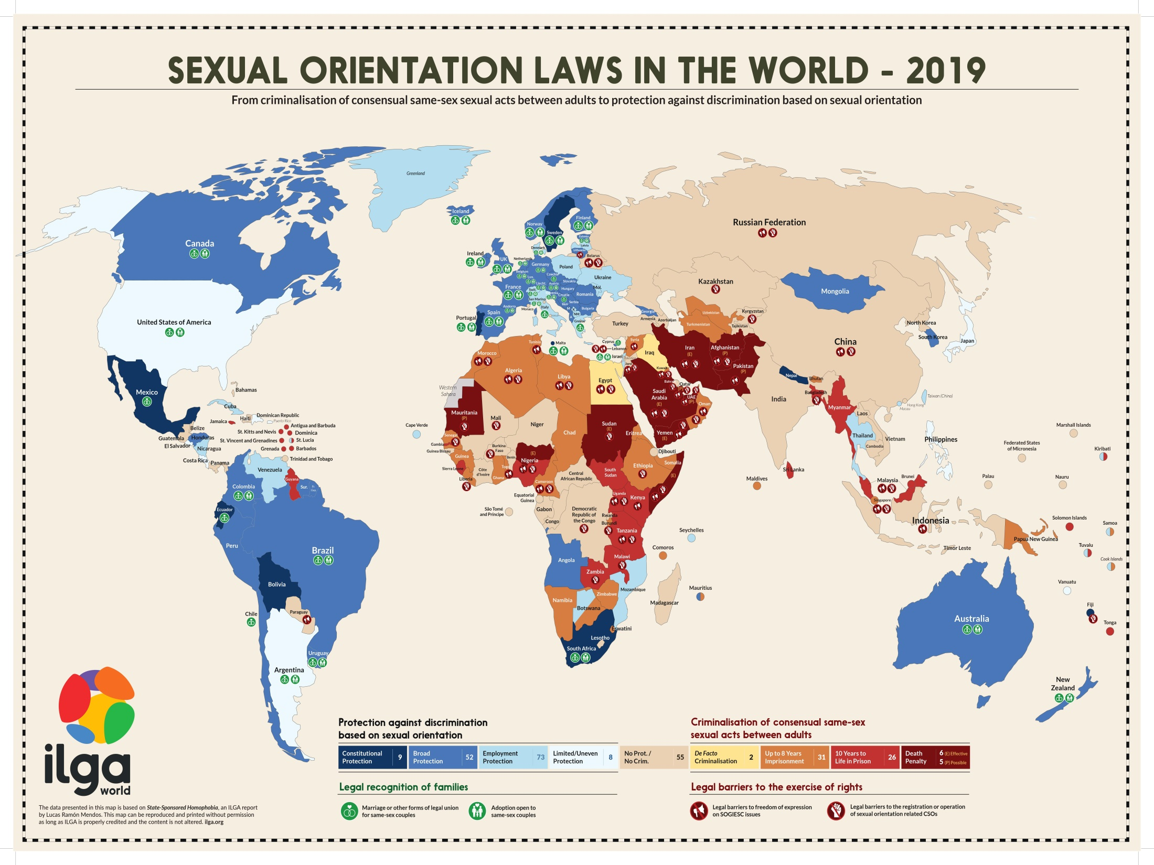

Slide 24
How can we help?
When in doubt about how to treat someone or what gender to use, it is ALWAYS best to ASK
Avoid / stop the use of jokes / LGBTphobic comments
Avoid the presumption of normative orientations / identities
Do not reveal anyone’s sexual orientation / gender identity without proper consent
Inclusive language
Check this out

Slide 25
What if I need help?
In Europe:
ILGA (The International Lesbian, Gay, Bisexual, Trans and Intersex Association)
TGEU (Transgender Europe)
In Portugal:
ILGA Portugal has a counseling service, composed by mental health practitioners to whom they provide mandatory training and supervision.
Centro GIS is a new project in the north, based in Porto, providing support to LGBTI people, including mental health counseling.
Casa Qui is a organisation aimed to provide psychological and social support for LGBTI youth, based in Lisbon.

Slide 26
Prepared by
Farileandro Londoño, Utopia 500
UIDB/04097/2020

