Slide 1
Dating violence
Notes:
https://www.breakthecycle.org/sites/default/files/Break%20the%20Cycle%20Activity%20Guides.pdf
http://www.poehealth.org/wp-content/uploads/2014/07/Healthy-Relationships-Session-Outline.pdf

Slide 2
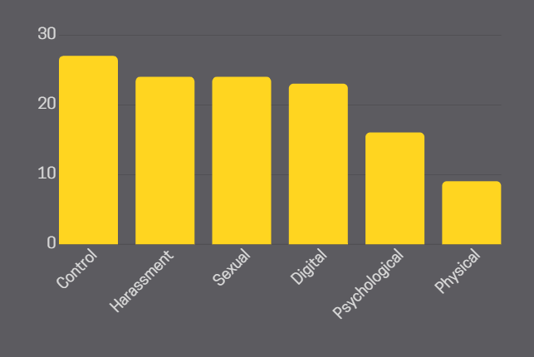
Legitimization
67% of all young people think at least one of these violent behaviors is normal
*Statistics taken from “Estudo Nacional sobre a Violência no Namoro 2019”
Notes:
Statistics taken from “Estudo Nacional sobre a Violência no Namoro 2019” done by UMAR - União de Mulheres Alternativa e Resposta, feminist organization that, since 1976, fights for the rights of women. As a non-profit non-governmental organization that has the defense and promotion of Women's Rights and Gender Equality as a beacon, and it is a member of the Consultative Council of CIG - Comissão para a Cidadania e Igualdade de Género.

Slide 3
Dating violence can occur as…
Controlling behaviour
Psychologial abuse
Sexual violence
Digital abuse
Physical violence

Slide 4
Control What controlling behaviour might look like:
Prohibition to go out without a partner
Prohibit wearing a particular piece of clothing
To hang out or talk to a friend
Force your partner to do something they don’t want

Slide 5
Psychological Abuse
Insulting your partner is a sign of emotional abuse.
E.g. “What are you wearing?! You look RIDICULOUS.”

Slide 6
Psychological Abuse
Making threats to your partner is not acceptable.
E.g. “If you go out tonight I’m breaking up with you”

Slide 7
Psychological Abuse
27% do not think that insulting a partner during an argument is a form of psychological abuse
9% of young people think that making threats is acceptable (14% of boys, 5% of girls)
16% don’t recognise psychological abuse as a form of dating violence
*Statistics taken from “Estudo Nacional sobre a Violência no Namoro 2019”

Slide 8
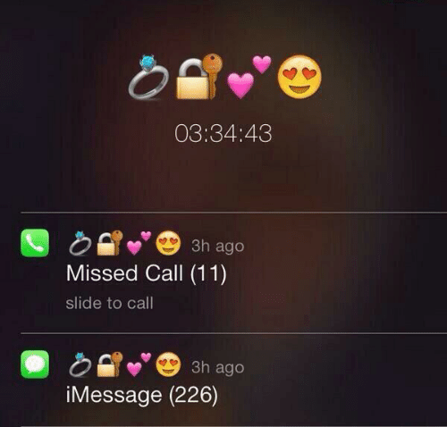
Harassment
What is harassment?
Harassment can take many different shapes and forms. For example…
The need for constant communication, non-stop calling and texting throughout the day.
Following and stalking
Constant verbal abuse
Threats

Slide 9
Sexual abuse In form of coercion, abuse or rape.
CONSENT
Consent means actively agreeing to being sexual/physical with someone, it can be verbal or nonverbal.
You can say yes to one thing and no to another!
You can stop what you are doing at any time.
It’s not consent if you feel manipulated, pressured or persuaded (when you don’t really want to do something), or you are unable to give consent (for ex. being asleep or too drunk).
If your partner says ’no’ or doesn’t say anything and seems unsure or uncomfortable – you don’t have consent. If they say ’yes’ or make it clear that they are into it – you have consent.
Always make sure you have consent!
The best thing to do is to communicate with your partner.
24% legitimizes sexual violence in dating relationships (girls 15% and 34% boys)
Notes:
In general, rape, sexual assault, and sexual abuse are forms of violence in which there is sexual contact without consent.
Most sexual assaults don’t happen by strangers. Often, it’s someone the victim knows or happens in a relationship.
Consent means agreeing to being sexual/physical with someone. Consent lets someone know in verbal or nonverbal ways that kissing/touching/sex is wanted.
Consent can be taken back at any time. Even if you’re in the middle of something, if you start feeling uncomfortable, you always have the right to stop.
You may say yes to kissing but no to touching for example, consent is not a freepass!
Be sincere with your partner if you don’t want to do something. Don’t be embarrassed to say that you don’t want to get physical. Be honest and make sure that you are heard. If the other person is not listening to you or still acts in a way you are not comfortable with, then you can for example leave the situation. Talking about consent and sex can be awkward at first, but it will get better the more you talk!
Sexual coercion is persuading someone to have sex/do physical things when they don’t really want to. This can happen through pressuring, threatening or forcing in a nonphysical way. Coercion can make you think you owe sex to someone. Only agree to sex and physical things when you want to!

Slide 10
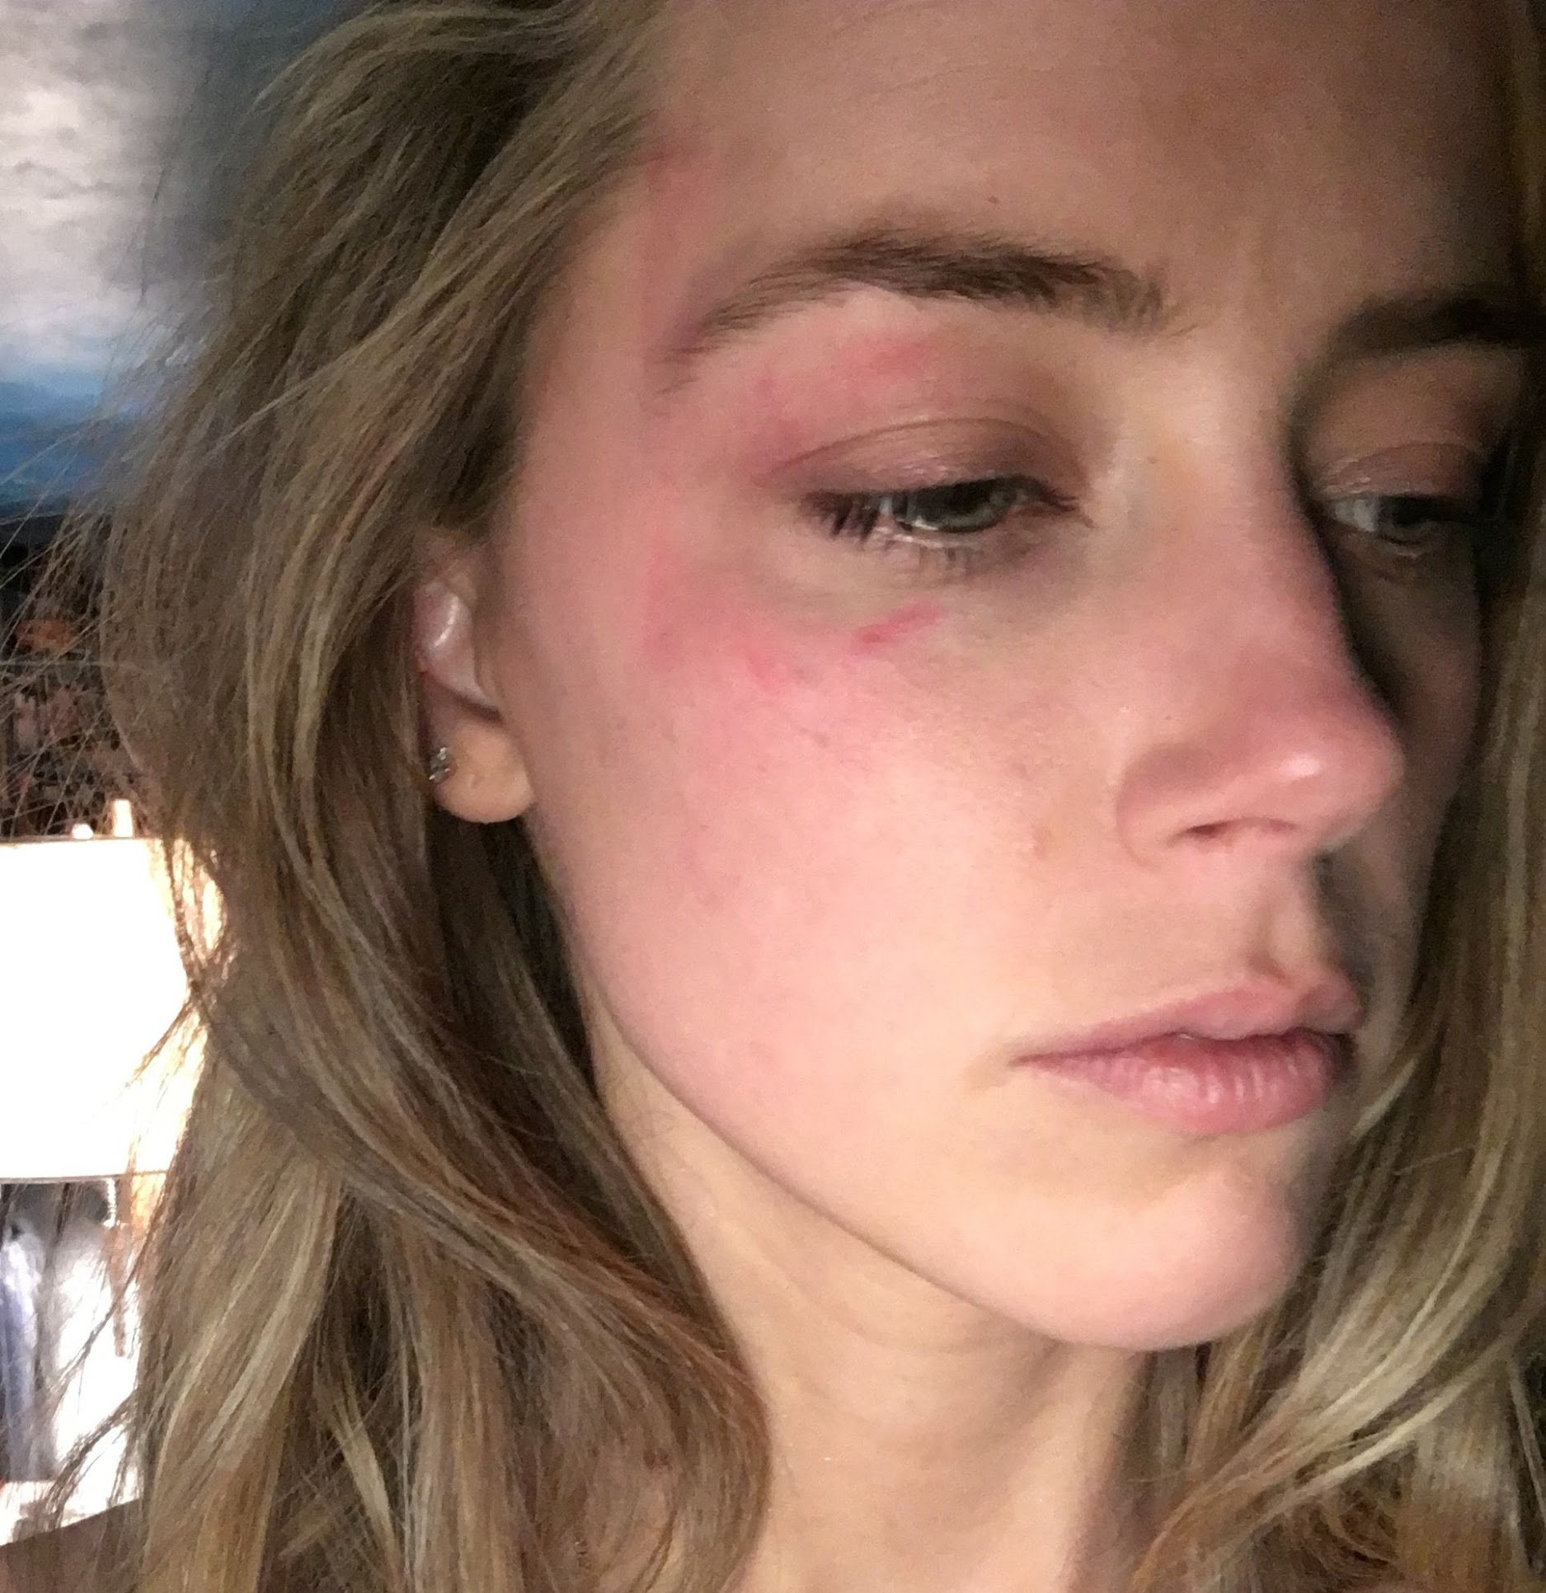
Physical Violence
Intentional bodily aggression that may leave marks or wounds
9% of the young participants naturalized behaviors of this form of violence, especially if the violence did not lead to visible injuries or marks
more legitimized by boys (10%) than girls (4%)
Notes:
Physical violence can start with a slap or a push, but then become more intense over time.

Slide 11
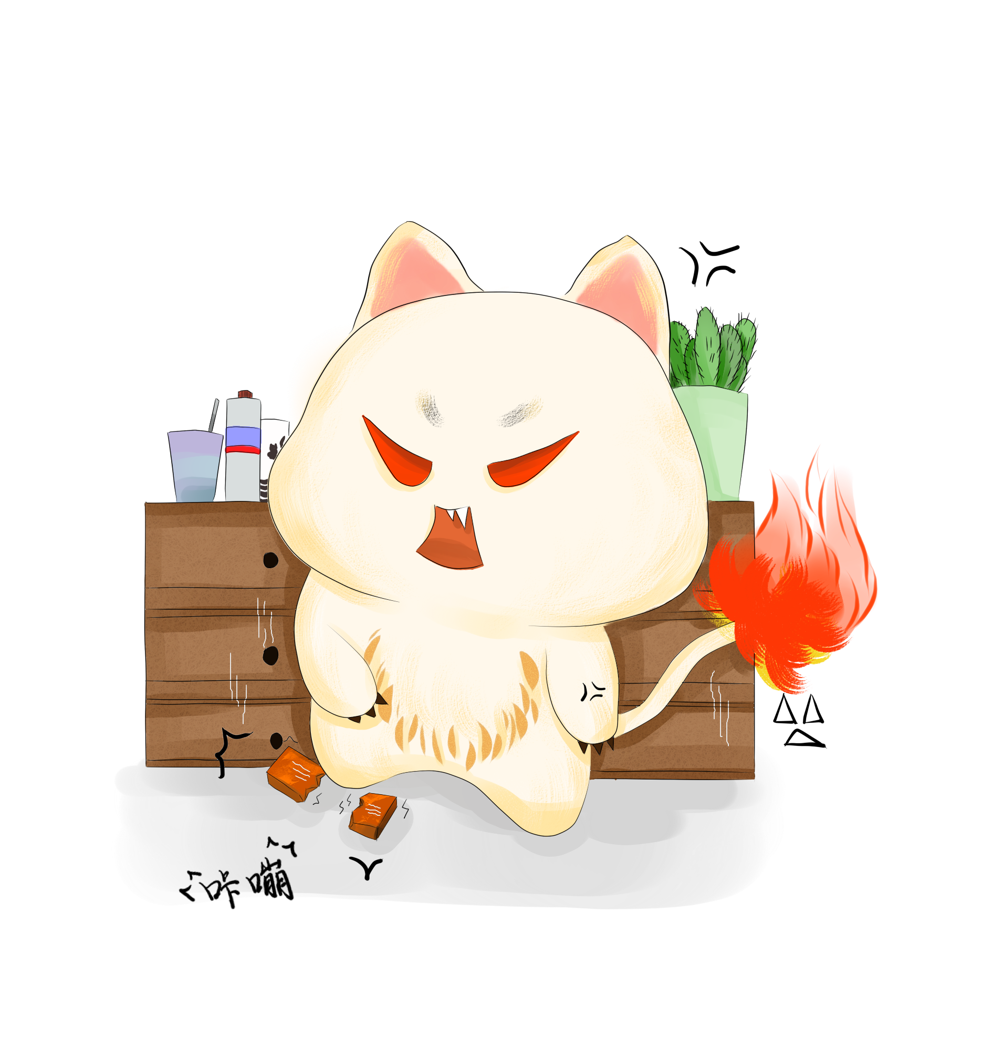
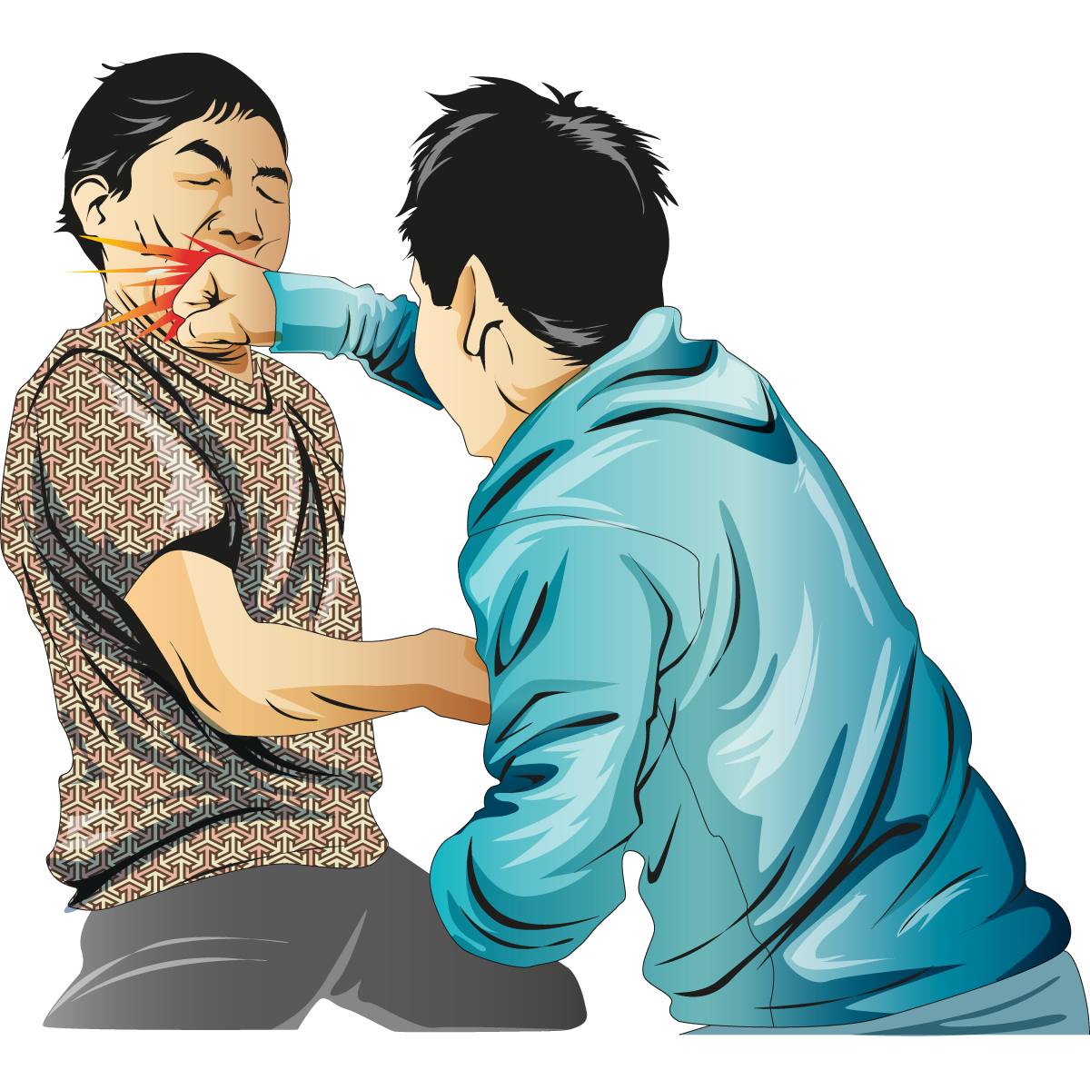
How does it occur?
Scratching
Biting
Pushing
Shoving
Slapping
Kicking
Choking
Throwing things
Ruining or breaking one’s belongings
Throwing against the wall

Slide 12
Blaming the victim (or anything else, alcohol for example) is a common practice.
Asking for forgiveness is common as well.
Just remember: physical violence is always illegal – it is never the victim’s fault or responsibility. Abuse is never justifiable or acceptable!

Slide 13
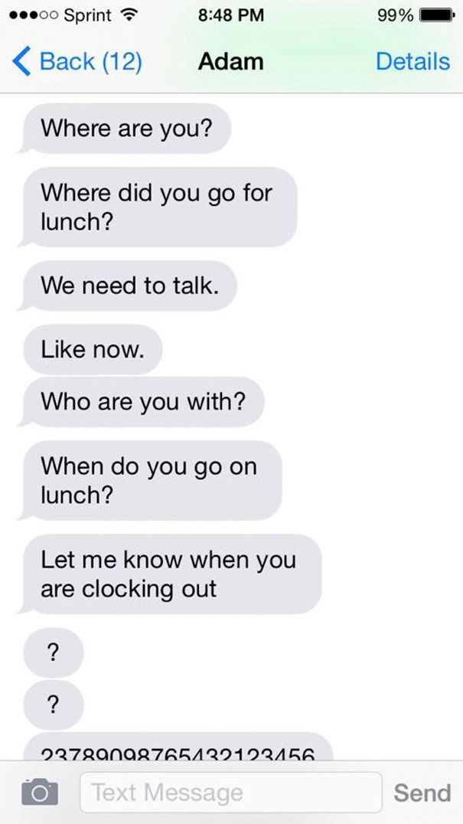
Digital Abuse
Notes:
Just like ‘real-life’ stalking and harassment, all this abusive behavior can also take place in the digital world. New technologies–social networking sites, texts, cell phones, and emails – have given abusers another way to control, degrade, and frighten their partners.

Slide 14
Digital abuse happens when someone…
…sends you negative, insulting or even threatening emails, Facebook messages, tweets, DMs or other messages online.
…tells you who you can or can’t be friends with on Facebook or other sites.
…uses sites like Facebook, Twitter, foursquare and others to keep constant tabs on you.
…puts you down in their status updates.
…sends you unwanted, explicit pictures and/or demands you send some in return.
…steals or insists on being given your passwords.

Slide 15
Unauthorised sharing
Unauthorised sharing of messages
Revenge Pornography
Collect evidence take screenshots, save the webpage as a PDF, download videos…
Report the photos or videos to the website to get it removed most have strict policies and will remove content in the matter of minutes
Contact Authorities to make an official report
Notes:
While in a relationship, we tend to share personal things with our partner. Unfortunately, because of how modern technology works, you lose control of any electronic message once your partner receives it. They may forward it or use it to control you even after the relationship ends. That’s why it's important to know exactly what to do in case someone shares something without your permission.
Evidence is really important from the legal aspect.
Especially if you are still a minor (under 18 years old), social media platforms and even porn sites will take your photos off in a manner of minutes to avoid potential lawsuits.
After taking these two steps to minimize damage, report the incident to the authorities. Give them all the evidence you collected.

Slide 16
Cyberstalking
Unwanted messages
Threats
Identity Theft
Spreading rumours and false statements
Do not engage
Inform your support team (family or friends)
Fortify your social media change passwords, set additional protection
Report to the authorities
Notes:
It’s important to know that the main goal of any stalker is to try to make the person they’re stalking feel intimidated and scared by for example:
False rumours
Continually messaging or emailing, sending sexual comments or even threats
Pretending to be you on social media or hacking into your online accounts.
If any of these things only happen once, you should make sure your social accounts are safe and tell your parents or friends. However, if it happens many times, it becomes stalking, which is an illegal act, so you should contact the police and get their advice. Save any messages or emails, collect evidence to show the police if necessary.

Slide 17
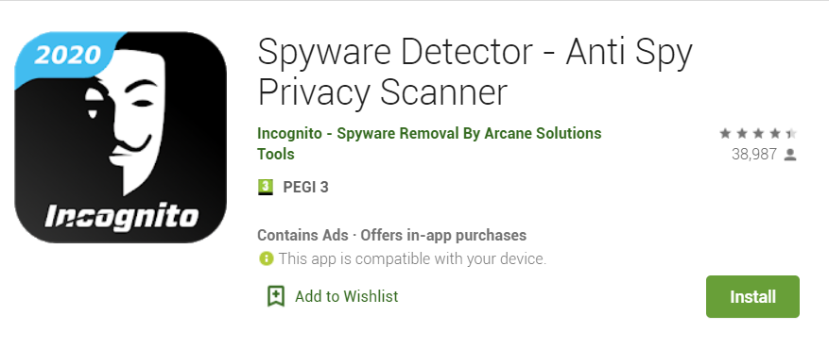
Unauthorised access
Some abusive partners might ask or demand you to share your passwords with them, it is important to remember that you are never obliged to do that! Your phone is your private property and you do not have to share it.
Possible signs that someone might be accessing your phone without you knowing:
Overheating, battery drains, phone randomly shutting down, unusual texts.
How to be safe:
Use an Anti-Spyware program
Check if your device is being monitored View active connections
Factory reset your device. Back up your files first!
Notes:
Some abusive partners might ask you to download a GPS tracking app (as well as your password) so that they know where you are at all times. Some might physically demand you give them your phone. It’s important to remember you are never obliged to give your passwords or your phone to anyone.
Do not share your passwords with anyone. Do not hand your phone over to anyone including your dating partner, this is private property and you do not have to share it. Know your privacy settings, such as passwords, and keep your phone, online accounts and social media accounts as secure as possible. On social media sites, such as Whatsapp, Facebook, Instagram you can check the list of all past logins. Use anti spyware program or a phone app to check if your phone is safe.

Slide 18
Group Dynamic

Slide 19
How can we help?
58% of young people
in Portugal have already suffered at least one act of dating violence.
Talk to a friend/family member/ teacher/ responsible adult/someone you trust
28 deaths in 2018, 11 in 2019.
Lei 112/2009: prevenção da violência doméstica e à protecção e assistência das suas vítimas
Notes:
In 2018, 26.483 cases of domestic violence were reported in Portugal, both from men and women, according to the Annual Domestic Violence Monitoring Report. There were 28 deaths in 2018, 11 in 2019.

Slide 20
How can we help?
Campanha #DitadosImpopulares
“Violence is not a private matter”
Domestic violence is considered a public crime in Portugal (if you witness it, you can report it)
Notes:
App VD - APPoio Against Domestic Violence, developed by CIG - Commission for Citizenship and Gender Equality. Victims can check how they can make a complaint or request information and which entities can give legal or psychological advice in this area. This is an application for mobile phones that is available on the App Store and Google Play.

Slide 21
How can we help?
Application for mobile phones: App VD - AAPPoio Contra a Violência Doméstica, developed by CIG - Comissão para a Cidadania e Igualdade de Género.
National helpline (800 202 148 and 144): Serviço de Informação a Vítimas de Violência Doméstica.
Free of charge, anonymous, confidential and available 24/7, or through email apav.sede@apav.pt

